Slide 1
Session 1

Slide 2

God

Slide 3
God
There is one being of God who exists in three distinct persons: Father, Son, and Holy Spirit.
Christians believe there are no partners with God because we believe there is only one God in all existence.
There are examples in our world of things that are 3 in 1
Time - The past is distinct from the present, which is distinct from the future. Each is simultaneous. They all share
the same nature of the category of time.
Space - Height is distinct from the width, which is distinct from depth, which is distinct from height. They all share
the same nature of space.
Matter/Material -Solid is not the same as a liquid, which is not the same as gas, which is not the same as solid. They
all share the same nature of matter.

Slide 4
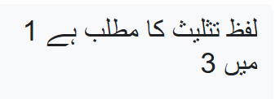

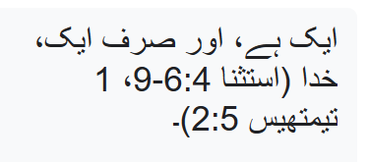
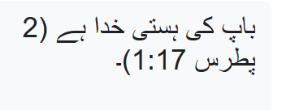
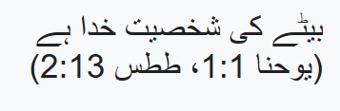
The Word Trinity means 3 in 1
The Teaching of the Trinity is in the Bible
1)There is one, and only one, God (Deuteronomy 6:4-9, 1 Timothy 2:5).
2) The person of the Father is God (2 Peter 1:17).
3) The person of the Son is God (John 1:1, Titus 2:13)

Slide 5
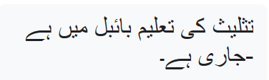
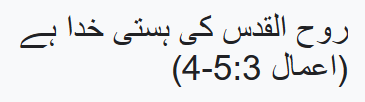
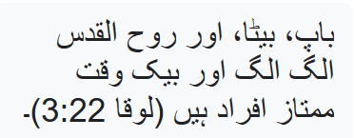
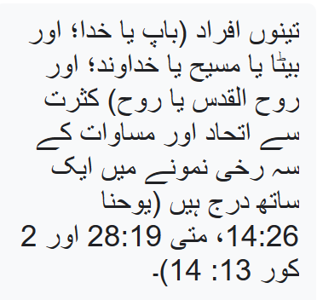
The Teaching of the Trinity is in the Bible -continued
4) The person of the Holy Spirit is God (Acts 5:3-4)
5) The Father, Son, and Holy Spirit are distinct and simultaneously
distinguishable persons (Luke 3:22).
6)The three persons (Father or God; and Son or Christ or Lord; and
Holy Spirit or Spirit) are frequently listed together in a triadic pattern of
unity and equality
(John 14:26, Matt. 28:19 & 2 Cor. 13:14).

Slide 6

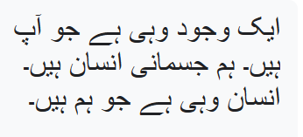
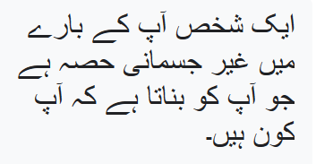
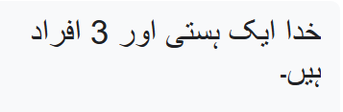
Vocabulary
A being is what you are. We are physical human beings.
Human beings is what we are.
A person is the non-physical part about you that makes you who you are.
God is one being and 3 persons

Slide 7
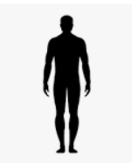



Vocabulary
Three people would be three human beings
Three separate god beings is polytheism
One God being is monotheism

Slide 8
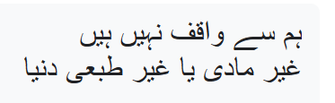




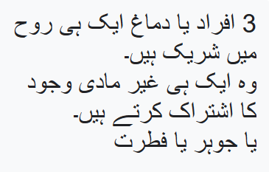
We are not familiar with the
immaterial or non physical world
Vocabulary
One soul/spirit/essence
3 Persons or minds share same soul
They share the same immaterial being
or essence or nature

Slide 9

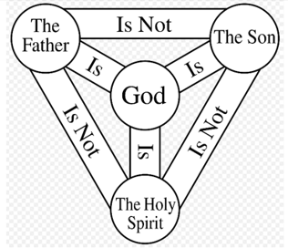

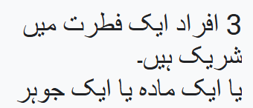
The 3 persons share one nature
or one substance or one essence

Slide 10


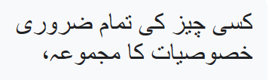
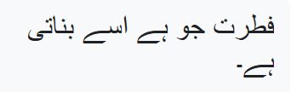
Nature
Nature refers to
  the total of all the essential qualities of a thing,
  The nature makes it what it is.

Slide 11
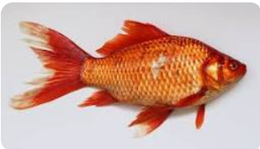

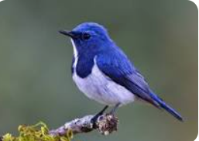
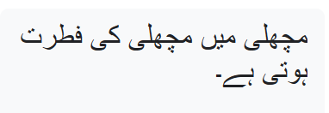
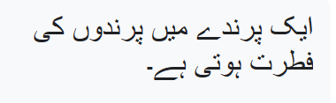
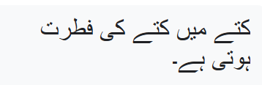
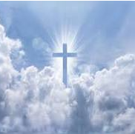
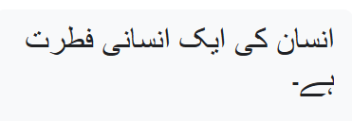

A fish has a fish nature
A bird has a bird nature
A dog has a dog nature
A human being has a human nature
God has a Divine nature

Slide 12
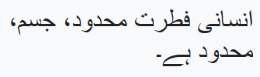
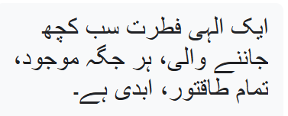
  A Human nature is finite, flesh, limited
  A Divine Nature is all knowing, everywhere present, all powerful, eternal

Slide 13

Jesus

Slide 14
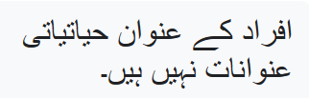

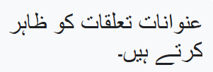


The titles of the persons are not biological titles
The Father does not have a wife who had a son
The titles show the relationship
The Father was always a Father.
The Son was always a Son

Slide 15
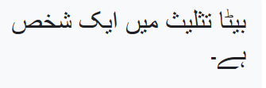
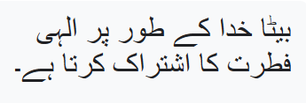
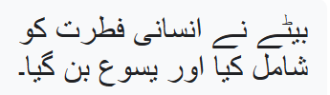
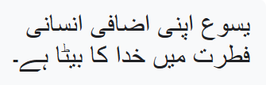
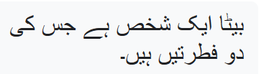
The Son is one person in the Trinity.
The Son shares the divine nature as God
The Son added a human nature and became Jesus
Jesus is the Son of God in his added human nature
The Son is one person who has two natures

Slide 16
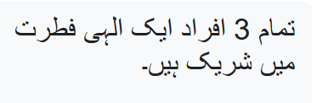

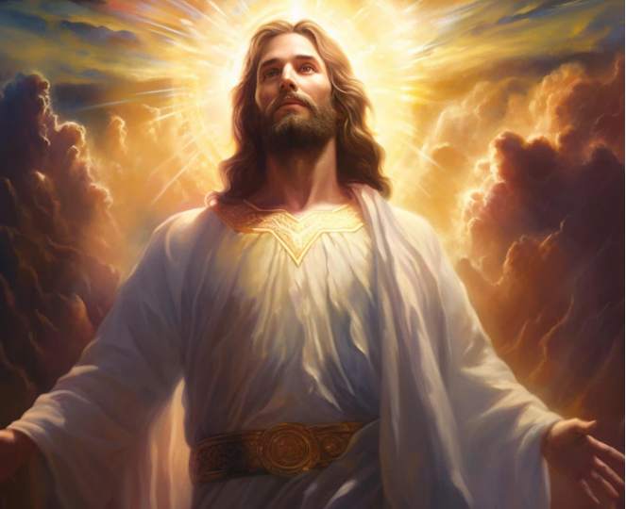

All 3 persons share a divine nature
The Son added a human nature and became man
Jesus is the Son in his added human nature

Slide 17


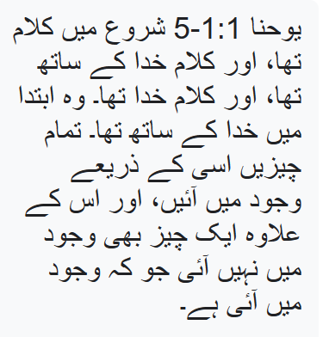
Bible verses - Incarnation
Divine nature as God
John 1:1-5
In the beginning was the Word, and the Word was with God, and the Word was God.
He was in the beginning with God. All things came into being through Him, and apart
from Him not even one thing came into being that has come into being.

Slide 18

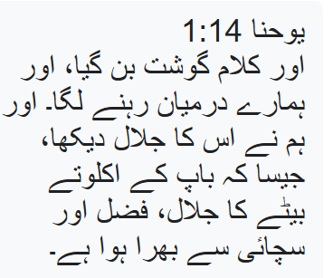
The Son added a human nature
John 1:14
And the Word became flesh, and dwelt among us; and we saw His glory,
glory as of the only Son from the Father, full of grace and truth.

Slide 19
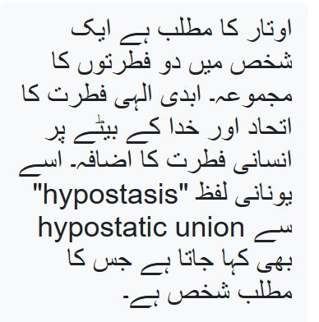
The Incarnation means the combination of the two natures in the single person. The union of the eternal divine nature and the added human nature onto the Son of God. This is also called the hypostatic union from the Greek word “hypostasis” which means person.

Slide 20
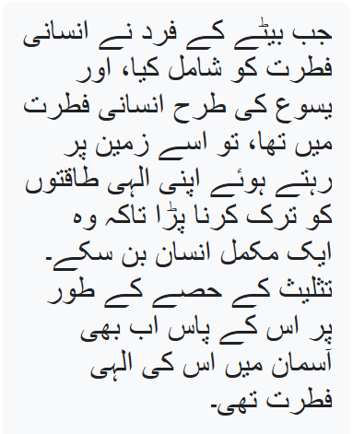
When the person of the Son added the human nature, and was in the human nature as Jesus, he had to give up his divine powers while here on earth so he could be a complete man.
He still had his divine nature in Heaven as part of the Trinity.

Slide 21
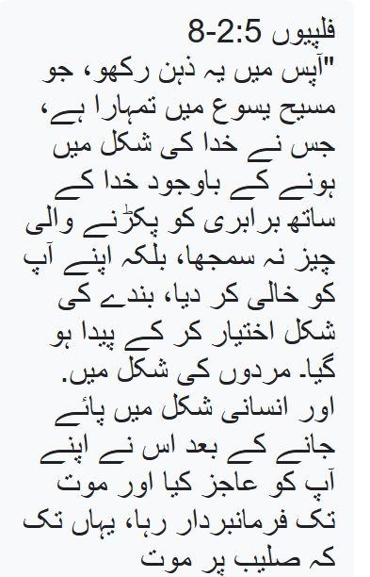
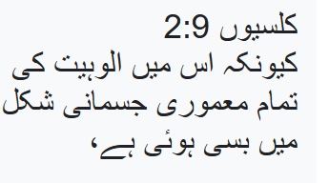
The Son added a human nature
Philippians 2:5-8
“Have this mind among yourselves, which is yours in Christ Jesus, who, though he was in the form of God, did not count equality with God a thing to be grasped, but emptied himself, taking the form of a servant, being born in the likeness of men. And being found in human form he humbled himself and became obedient unto death, even death on a cross
Colossians 2:9
For in Him all the fullness of Deity dwells in bodily form,

Slide 22
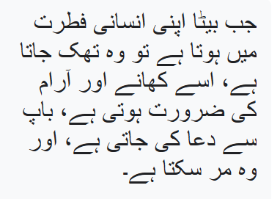
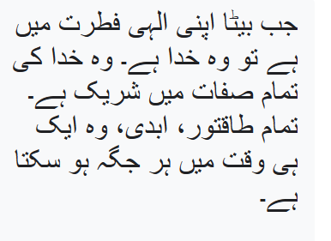
When the Son is in his human nature he got tired, needed food and rest, prayed to the father, and could die
When the Son is in his divine nature he is God. He shares all the qualities of God. All powerful, eternal, he can be everywhere at once

Slide 23
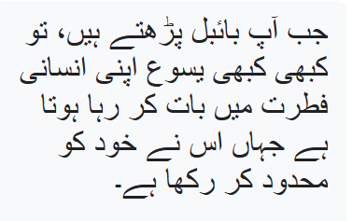
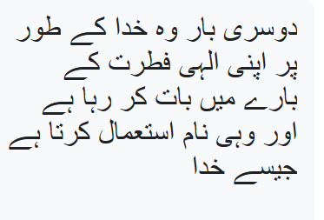
When you read the Bible, sometimes Jesus is talking in his human nature where he has limited himself
Other times he is talking about his divine nature as God and uses the same names as God

Slide 24
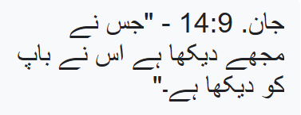
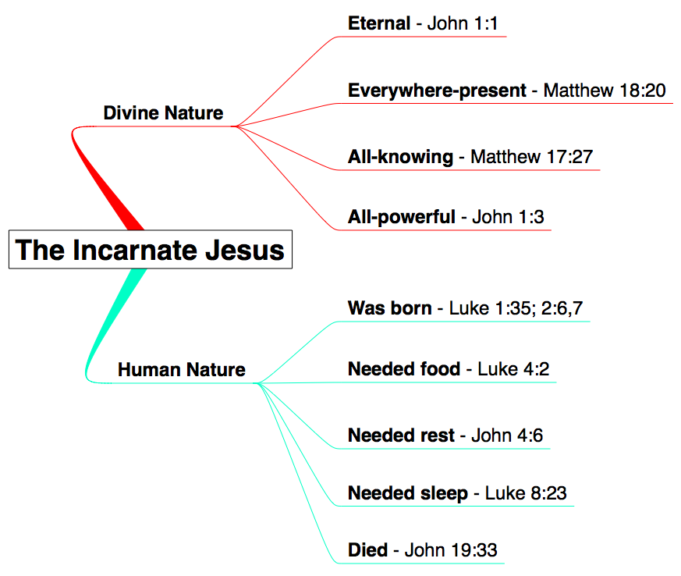

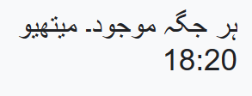
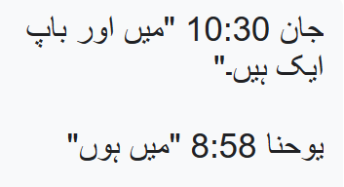












The Incarnation
Jn. 14:9 —“He who has seen Me has seen the Father.”
John 10:30 “I and the Father are one.“
John 8:58 “I AM”
John 16:30, John 21:17
John 14:28 “….for the Father is greater than I”
Matt 24:36-"But about that day or hour no one knows, not even the angels in heaven, nor the Son, but only the Father.

Slide 25


The absolute Deity of Jesus Christ.

Slide 26
Verses –God and Jesus creates
Isaiah 44:24- "This is what the LORD says-- your Redeemer, who formed you in the womb: I am the LORD, the Maker of all things, who stretches out the heavens, who spreads out the earth by myself"
Col. 1:15-20
The Son is the image of the invisible God, the firstborn(preeminent) over all creation. For in him all things were created: things in heaven and on earth, visible and invisible, whether thrones or powers or rulers or authorities; all things have been created through him and for him. He is before all things, and in him all things hold together. And he is the head of the body, the church; he is the beginning and the firstborn from among the dead, so that in everything he might have the supremacy. For God was pleased to have all his fullness dwell in him, and through him to reconcile to himself all things, whether things on earth or things in heaven, by making peace through his blood, shed on the cross.
John 1:3: “All things were made through Him, and without Him
nothing was made that was made.”

Slide 27






Slide 28


Who is Jesus?
Names
Deeds
Attributes
Seat
Honor
HANDS- Jesus shares Honor with God, Attributes of
God, Names of God, Deeds of God and sits on the Seat of God
Matt 28:18-20
And Jesus came up and spoke to them, saying, “All authority in heaven and on earth has been given to Me. Go, therefore, and make disciples of all the nations, baptizing them in the name of the Father and the Son and the Holy Spirit, teaching them to follow all that I commanded you; and behold, I am with you always, to the end of the age.”

Slide 29









Slide 30
Verses
"No Greater love has no one than this: to lay down one's life for one's friends".(Jn. 5:13).
God is the greatest being so he must demonstrate the greatest kind of love which is self-sacrifice. The incarnation provides this.
Jesus calls Himself “the Alpha and Omega,” the title of Almighty God.
Revelation 22:12-13: “Behold, I am coming quickly, and My reward is with Me, to render to every man according to what he has done. “I am the Alpha and the Omega, the first and the last, the beginning and the end.”
Revelation 1:8: “I am the Alpha and the Omega,” says the Lord God, “who is and who was and who is to come, the Almighty.”
Rev 1:18 “….I was dead, and now look, I am alive for ever and ever..”. When did God die? Its when God added the human nature (Jesus incarnate) and died on the cross. Jesus = Yahweh = alpha/omega
John 5:18: “Therefore the Jews sought all the more to kill Him, because He not only broke the Sabbath, but also said that God was His Father, making Himself equal with God.”

Slide 31




Slide 32
Session 2

Slide 33

Holy Trinity

Slide 34
Who is the Holy Trinity? Why do we need a Holy Trinity?
Where do we read the words “Holy Trinity” in the Bible?
What is the nature of God?
How do we interact and pray to God as Father, Son, and Holy Spirit?

Slide 35


Slide 36
The early church wanted people to give a consistent message when they were asked what they believed in.
They developed statements of belief so everyone would say the same thing. These statements are called Creeds
They developed over time and provided basic information for what Christians believed and
what they considered wrong teaching or a Heresy
The earliest ones had a lot of Biblical support for the statements. Later creeds used other vocabulary to help explain
The beliefs based on tradition or theological understanding at the time.

Slide 37





Slide 38




Creeds, Testimonies, Traditions – 1 Cor. 11:2, Mark 7:3, 1 Tim. 1:15-16
Example creeds in the Bible:
Deuteronomy 6:4-9 – The Shema (hear) – “Hear, O Israel: The Lord our God, the Lord is one.”
Romans 10:9; 1 Corinthians: 12:3; 2 Corinthians. 4:5; Philippians. 2:11- “Jesus is Lord”
Saying “Jesus is Lord” (Kyrios Iesous) was the New Testament Greek equivalent of saying “Jesus is
Yahweh (The Lord God).
1 Corinthians 15:3 - written within a few years after the death of Jesus:
“For I delivered to you as of first importance what I also received, the Christ died for our sins according to Scriptures, and He was buried, and that He was raised on the third day according to the Scriptures, and that He appeared…”

Slide 39
WHO IS THE HOLY TRINITY? – NICENE CREED
We believe in one God. God the Father, the Almighty. Creator of Heaven and Earth and all things visible and invisible.
- We believe in one Lord, Jesus Christ, the only-begotten Son of God, begotten of the Father before all
ages; Light of Light, true God of true God, begotten, not created, of one essence with the Father through Whom all things were made. Who for us men and for our salvation came down from heaven and was
incarnate of the Holy Spirit and the Virgin Mary and became man. He was crucified for us under Pontius
Pilate, and suffered and was buried; And the third day, He rose from the dead, according to the Scriptures.
He ascended into heaven and is seated at the right hand of the Father; And He will come again with glory
to judge the living and dead. His kingdom shall have no end.
- We believe in the Holy Spirit, the Lord, the Giver of life, Who proceeds from the Father and the Son who together with the Father and the Son is worshipped and glorified, Who spoke through the prophets.

Slide 40






Slide 41
WHY DO WE NEED A HOLY TRINITY?
God revealed Himself to us as Holy Trinity
- The Church did not create God or her own teaching of God
- First came the belief in One God, not many gods
- the God of Abraham, Isaac and Jacob
- Then came Jesus Christ, who was prophesied about in the Old Testament
- “God, who at various times and in various ways spoke in time past to the fathers
by the prophets, has in these last days spoken to us by His Son, whom He has
appointed heir of all things, through whom also He made the worlds; who being the
brightness of His glory and the express image of His person…” Hebrews. 1:1-3
- Then came the Holy Spirit, the Paraclete, on Pentecost

Slide 42





Slide 43
WHY DO WE NEED A HOLY TRINITY
Not only did God reveal Himself as the Father, Son and Holy Spirit, but we were saved by the Holy Trinity
- God created us to be with Him in Paradise, and then we fell from eternal life and from union with Him
- He did not abandon us…in the last days He appeared to us through His only begotten Son, Jesus
- Jesus Christ does two major things for us
- He comes as God and unites His Divine nature with a Human nature
- He teaches us about God
- Then He sent the Holy Spirit, to remind them of all things that He taught them (John 14:25-26).

Slide 44




Slide 45
The Holy Spirit –
- John 14:26 But the Paraclete, the Holy Spirit, whom the Father will send in my name,
will teach you everything, and remind you of all that I have said to you.
- John 15:26 - “When the Paraclete comes, whom I will send to you from the Father,
the Spirit of truth who comes from the Father, he will testify on my behalf.”
- John 16:13-15 - When the Spirit of truth comes, he will guide you into all the truth;
for he will not speak on his own, but will speak whatever he hears, and he will declare to
you the things that are to come. He will glorify me, because he will take what is mine
and declare it to you. All that the Father has is mine. For this reason I said that he will
take what is mine and declare it to you.
The Holy Spirit indwells the believer and reminded them about what Jesus taught
to help them write Scripture

Slide 46




Slide 47
HOLY TRINITY” IN THE BIBLE?
At the Baptism of Christ:
Matthew 3:13–17; Mark 1:9–11;
Luke 3:21– 23
When God the Father spoke and said: "This is my beloved Son, in whom I am well pleased”
Jesus Christ was there in the flesh
The Holy Spirit came upon Him as a dove

Slide 48



Slide 49
HOLY TRINITY IN THE BIBLE
Matthew 28:19: “Go therefore, and teach all nations, baptizing them in the
name of the Father, and of the Son, and of the Holy Spirit.”
Notice Jesus Christ does not say, “In the names” but in the single “name”.
2 Corinthians 13:14: “The grace of the Lord Jesus Christ, and the love of God, and the communion of the Holy Spirit, be with you all. Amen.”
Listing all 3 on the same line shows they are equal. You could never say you baptize in the single name of God, a created angel, and a created prophet. By listing the single name of the Father, Son, and Spirit they show 3 persons share single divine name as God.

Slide 50



Slide 51
Genesis 1:1 and the following verses: the name of God (“Elohim”) in the Hebrew text
has the grammatical form of the plural number.
Genesis 1:26: “And God said, Let us make man in our image, after our likeness.”
The plural number here indicates that God is not just one Person. Angels do not create.
Only God creates (Isaiah 44:24).
Genesis 3:22: “And the Lord God said, Behold, Adam is become as one of us, to
know good and evil.”
Genesis 11:6-7: Prior to the confusion of tongues at the building of the tower of
Babylon, the Lord said: “Let us go down, and there confound their language.”

Slide 52



Slide 53


When we refer to God we use the pronoun “He” because God is one being
When we talk about the 3 persons we can use the pronoun “they.”

Slide 54


Deuteronomy 4:35
"Yahweh, He is God; there is no other besides Him.“
Deuteronomy 4:39
"Yahweh, He is God in heaven above and on the earth below; there is no other.“
Deuteronomy 32:39
"See now that I, I am He, And there is no god besides Me"
Deuteronomy 6:4
"Hear, O Israel! Yahweh is our God, Yahweh is one!"
Those Bible verses are referring to one Being. Trinity is not 3 beings or 3 gods

Slide 55
HOW DO WE INTERACT AND PRAY TO GOD AS TRINITY?
We pray to God the Father, through the Son, in the Holy Spirit
-The prayers to the Son, Jesus Christ, are not separate from the Father and the Holy Spirit.
- Nor are the prayers to the Holy Spirit separate from Father or the Son
- We do not divide them in our mind, but always focus on the One God

Slide 56



Slide 57
Session 3

Slide 58



The 3 persons of the trinity are equal but sometimes take on different roles. This does not mean they are not equal
While on earth, the Son (Jesus) humbled himself(Phil. 2:8), taking on role of servant. As a man he submitted to the Father. The Father was greater only in position, role or rank (function) but the Father is not greater in nature or essence or being.
Just like you may help a friend or work for a person. You submit to them but they are still equal as human beings.
.

Slide 59


In the Trinity there is a type of mutual submission in which
one member of the Trinity submits to the other out of respect
not because one is greater than the other
Roles:
The Father initiates salvation by sending the Son
The Son achieves salvation by submitting to the Father and dying on the cross
The Holy Spirit employs salvation by dwelling inside us

Slide 60

All 3 persons are referred to as God
All 3 persons have the divine qualities and attributes
All 3 persons do the work that only God can do

Slide 61

In his human nature, Jesus was a real human man
A real Jewish man is not greater than God.
A real Jewish man is to confess that the God of scripture is the one true God.
A real Jewish man cannot claim to know things that God does.
A real Jewish man prays to God
A real Jewish man submits to the Father

Slide 62
In his divine nature Jesus was God
He shares glory with God from all eternity. (John 17:5)
He calls Himself "Lord of the Sabbath" (Matt 12:7-8; Mark 2:27-28)
He calls Himself “Alpha and the Omega/First and Last)" (Is. 44:11; Rev 1:8; Rev. 18, Rev. 22:12-13)
He lays down his life down and takes it up again (John 10:17-18)
He says that being in his hands is the equivalent of being in the hand of God (John 10:27-30)
God refers to the Son as God (Psalm 45:6 and Heb.1:8 )
God refers to the Son as God and Lord (Psalm 102:25-28)
The Son created all things (John 1:3; Colossians 1:16; Hebrews 1:8-11)
The Son can raise whomever he wills from the dead (John 5:21-3)
The Son is referred to as "Mighty God" and "Everlasting Father" by God Himself (Isaiah 9:6)
The Son is both God and man

Slide 63




Slide 64



Questions
Most of the time people will quote Jesus in his human nature to show he is not God.
The only thing you need to do is recognize when Jesus is talking in his humbled human nature or his
Eternal divine nature.
You can then point to the verses where Jesus claims to be God and receives the same honors as God, has the
Same attributes of God, uses the same names as God, does the deeds only God can do and sits on the same
Throne as God

Slide 65


Questions
God’s name is Yahweh and Yahweh is referred to as one God,
does that mean Yahweh is only one person?
Answer- No. that means God is one being.

Slide 66


Questions
When Jesus prays to the Father and tells people the Father is the one true God,
does that mean Jesus is not God or the Father is a greater person?
Answer-
No. As a man, it was proper for Jesus to pray to the Father.
When the Son is in his human nature, his position is lower because
of the role he is playing, but the Son is always equal with the Father in essence.

Slide 67


Questions
John 14:28
Jesus said “The Father is greater than I
Does that mean he is not equal to God the Father?
Answer:
When the Son humbled himself and became a man (Jesus),
He was lower in rank or position but he was never lower
In essence or nature. In his divine nature He is equal with the
Father.

Slide 68



Questions
Jesus never said “I am God.” Does that mean he is not God?
Answer:
Jesus said he was God in a way the Jews would understand it by using the old testament
verses about God and applying them to himself.
Lets look at a few examples

Slide 69



God said:
Isaiah 48:12-16
“Listen to Me, O Jacob, even Israel whom I called;
I am He, I am the first, I am also the last…
Revelation 1:8: “I am the Alpha and the Omega,” says the Lord God, “who is and who was and who is to come, the Almighty.”
Rev 1:18 “….I was dead, and now look, I am alive for ever and ever..”. When did God die? Its when God added the human nature (Jesus incarnate) and died on the cross

Slide 70



Jesus said:
John 8:24 "Therefore I said to you that you will die in your sins; for unless you believe that I am He, you will die in your sins."
John 8:59 “Therefore they picked up stone to throw at Him.”
John 10:33
The Jews answered Him, “We are not stoning You for a good work, but for blasphemy; and because You, being a man, make Yourself out to be God.”

Slide 71


Questions
Question
Jesus was begotten so he cannot be God
The Greek word for begotten is “monogenes” which comes from two Greek terms: monos meaning “one” and the noun “genes” which means “kind” or “type.” So, you put these two words together and you have monogenes which means: “unique,” “only,” or “one of its kind.” That’s what Jesus is talking about in John 3:16. He is not saying that God the Father created Him. He’s saying that He is God’s only, unique, one of a kind Savior

Slide 72


Questions
Question
The word Trinity is not in the Bible
Answer:
Trinity means 3 in 1. The word is used to describe the teaching that the Bible says there is one God but each person is referred to as God

Slide 73


Questions
Question
How can God die?
Answer:
The second person of the trinity (the Son) added a human nature so he could live as a man to be our perfect sacrifice.
(John 1:1-14; Philippians 2:8-11).

