Slide 1


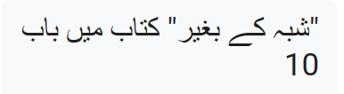
Evidence for the Resurrection
Chapter 10 in “Without a Doubt” book
Samples, Kenneth Richard. Without a Doubt: Answering the 20 Toughest Faith Questions,
Grand Rapids, Michigan: Baker Books, 2004.

Slide 2
First, the New Testament stands the most reliable source of information on the resurrection from any book in the ancient world.
The New Testament contains the most manuscript attestation to the history it records (28,000+ copies in various languages, over 5,800 of these are in the Greek language),
The earliest records of the resurrection were written down close to the actual event and the Bible is the most accurately copied manuscripts of any book from the ancient world (99.9% copy accuracy). The early dates and sheer manuscript quantity prohibits myth, distortion and embellishment to filter into the history recorded in the New Testament text.
The Bible is reliable and written sources outside the Bible confirm many of the same claims the Bible makes

Slide 3
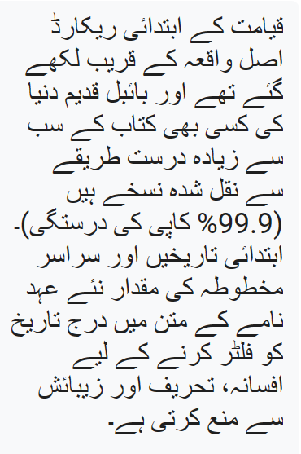
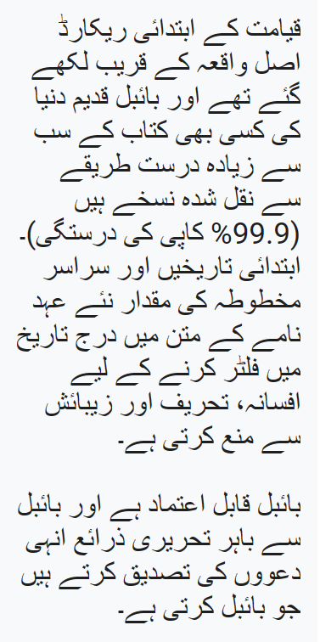
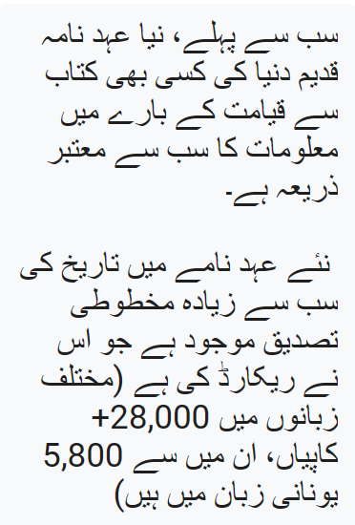

Slide 4
Thomas wanted to touch Jesus hands and place his fingers in the holes on Jesus before he would believe. Jesus spoke to Thomas after the resurrection and said: “Because you have seen Me, have you believed? Blessed are they who did not see, and yet believed” (John 20:29).
Why did Jesus say this to Thomas?
In the next verse, John writes “Therefore many other signs Jesus also performed in the presence of the disciples, which are not written in this book; but these have been written so that you may believe that Jesus is the Christ, the son of God; and that believing you may have life in His name.” (John 20:30-31)
In Mark 16:14, Mark writes a similar account “Afterward He appeared to the eleven themselves as they were reclining at the table; and He reproached them for their unbelief and hardness of heart, because they had not believed those who had seen Him after He had risen.
The answer is that Thomas’s demand that he first poke his fingers in Jesus’ wounds before believing was asking to much. His friends’ report should have been adequate evidence
While we’re here on earth, Paul says, we don’t see Jesus. Some people want to see the evidence and believe, and there are those who read the evidence and believe.” Why? Because what they read is a reliable record of what others actually saw.

Slide 5
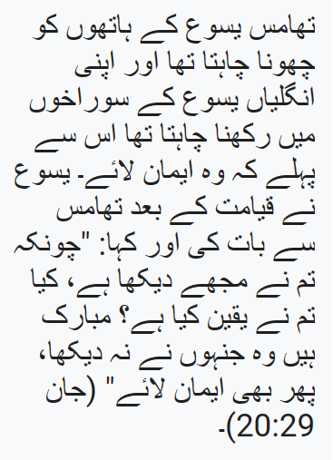
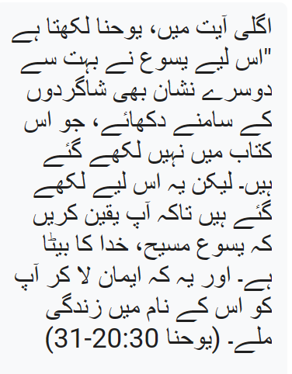
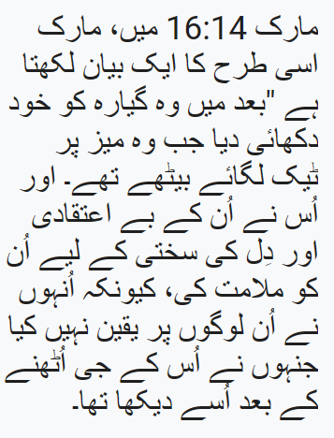
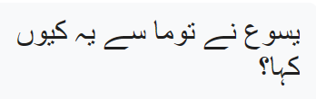

Slide 6
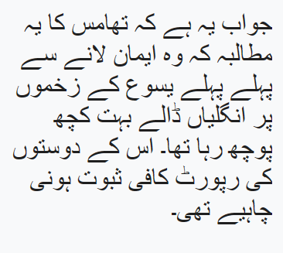
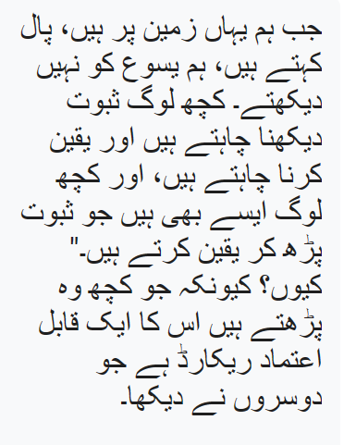

Slide 7

Lets look at the evidence

Slide 8
12 commonly accepted facts (among all scholars) surrounding the event:
1) Jesus died by crucifixion,
2) Jesus was buried,
3) Disciples doubted and were despaired after Jesus died but later were bold and brave,
4) The tomb in which Jesus was buried was discovered empty a few days later,
5) Disciples had experiences that they believed to be actual appearances of the risen Christ,
6) Disciples were transformed and willing to die for the truth,
7) Gospel message was the center of preaching in the early church,
8) Gospel proclaimed in Jerusalem where Jesus died,
9) Church was established by these disciples,
10) Day of worship was changed to Sunday, the same day Jesus was reported risen,
11) Skeptical James (Jesus’ brother) was converted when he believed he saw the risen Christ, and
12) Paul, a persecutor of the church, was converted when he believed he saw the risen Christ.
Source: Gary Habermas

Slide 9
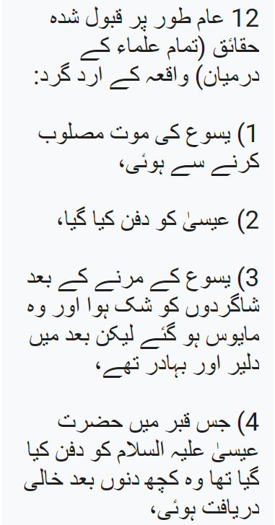
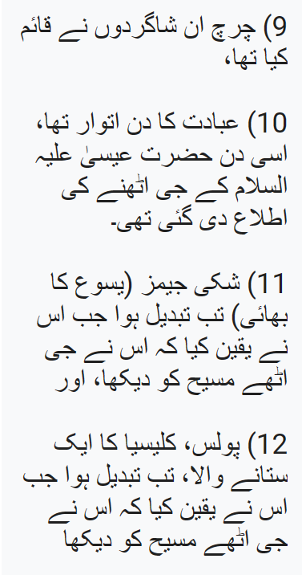
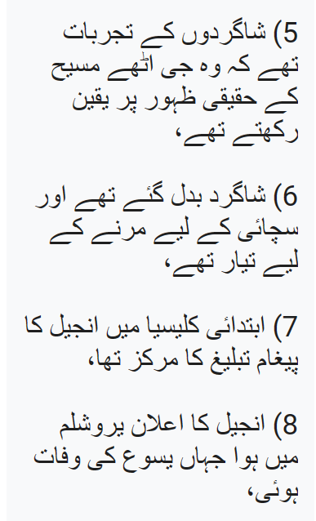
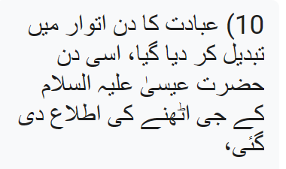

Slide 10

Let’s look at 6 examples

Slide 11
First – Jesus died by crucifixion. The Gospels writers provide evidence of this as well as first century historian Josephus.
In AD116 The Roman historian and senator Tacitus referred to Jesus’ execution by Pontius Pilate
“Christus, from whom the name had its origin, suffered the extreme penalty during the reign of Tiberius at the hands of one of our procurators, Pontius Pilatus”

Slide 12
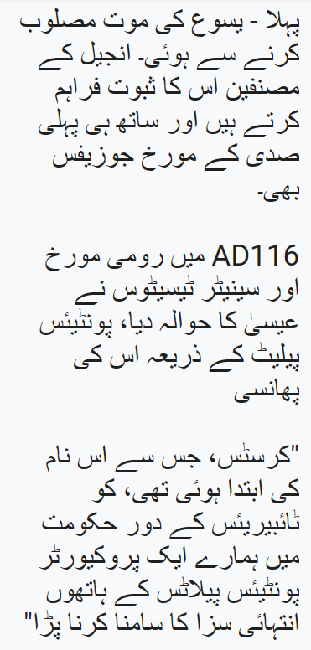
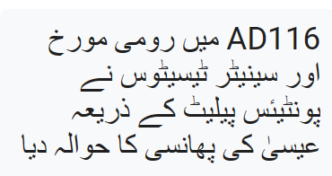

Slide 13
Second, Jesus appeared to eyewitnesses on at least 12 different occasions, with Paul declaring some 500 witnesses saw the risen Christ (1 Cor. 15:1-8).
These appearances resulted in witnesses seeing, hearing, and/or touching his physical body. The commonly understood and well-practiced legal approach to establishing fact draws upon the testimony of numerous witnesses of any given event. Even the Scripture says, “On the evidence of two or three witnesses a matter shall be confirmed” (Deut. 19:15).
The New Testament has 9 different authors who wrote 27 books that either explicitly or implicitly affirm the resurrection.
Third, the best explanation for the empty tomb that was guarded and sealed, is that Christ rose. The Romans or Jews could have destroyed Christianity by simply producing the body. They never found a body.
Fourth, the apostles died for what they believed to be the resurrected Christ. They were afraid when Jesus died but after he rose, the Disciples were brave and stood up against the Romans and Jewish leadership and were willing to die. Paul was a Jewish leader who was hostile to Christians but after seeing the risen Jesus, wrote most of the New Testament and was one of the most important figures in the History of the Christian faith.

Slide 14
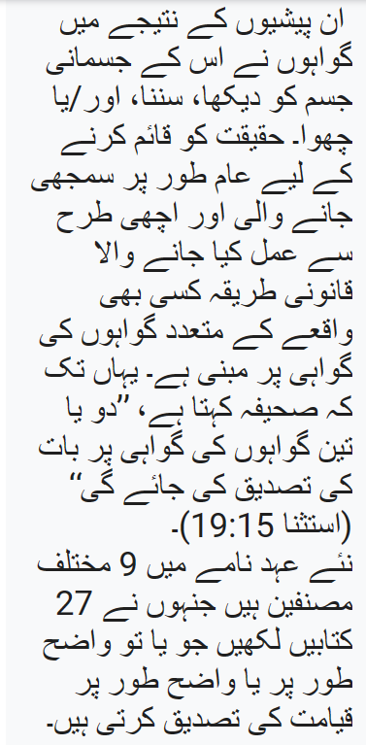
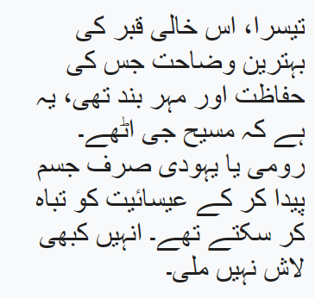
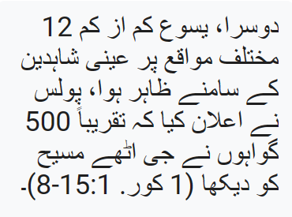

Slide 15
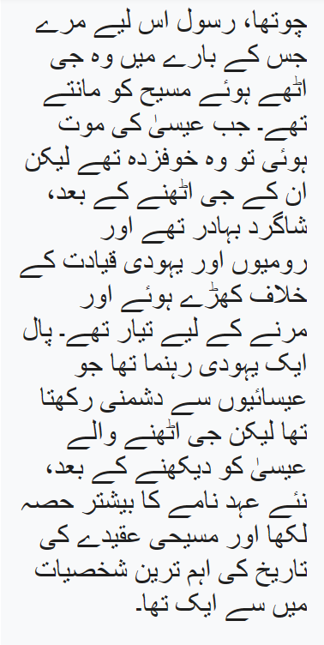

Slide 16
Fifth, the widespread, sudden, and dramatic change in the lives and religious practice of devoted Jews who kept the Mosaic Law for centuries. In other words, how do fervent religious Jews suddenly shift from Saturday to Sunday worship, and from abstaining from unclean foods to eating pork with gentiles?
What possibly could transform a group of disappointed and afraid disciples who were devastated at the crucifixion, in hiding for fear of death, and contemplating a rapid escape and/or abandonment of their calling, and return to their former activities, into the most prolific missionary movement of all time?
The resurrection would have the power to do just that, and provide the crowning proof that Jesus was indeed the Son of God (Rom. 1:4).

Slide 17
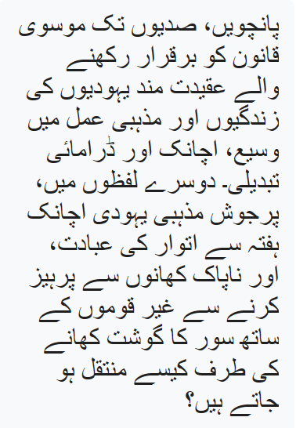
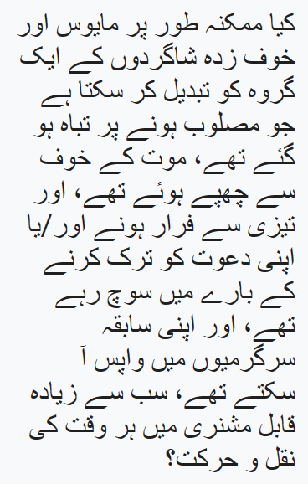
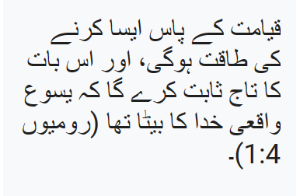

Slide 18
Finally, the presence of counter-productive features within the gospel accounts of the death and resurrection of Christ further demonstrates its reliable history. For example, the gospels reveal Christ’s humiliating trial, shameful death at the hands of his persecutors, Christ appears powerless to effect change, disciples are hiding in fear and appear cowardice, lack of strength to carry his own cross, those closest to Jesus betray and deny Him, the disciples are slow in understanding, the disciples do not believe, after rising from the dead Jesus appears first to women who have little legal standing and credibility in the eyes of their culture and law.
According to historians, these crucial features reveal that the writers of the New Testament were more interested in reporting accurate history than deceiving their readers by writing a flawless account of Christ and His followers. We have seen that we have good reason to believe the resurrection of Christ is a historical event. Attempts to explain the resurrection away fails to account for all the data and leave irreconcilable flaws in their argument.

Slide 19
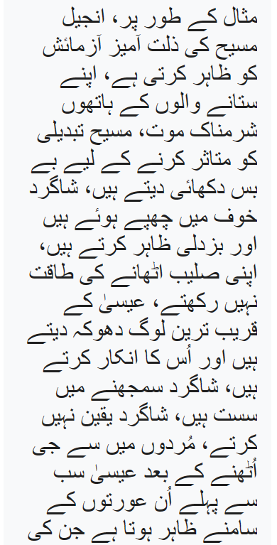
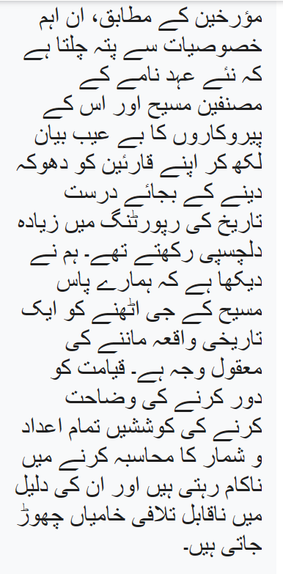
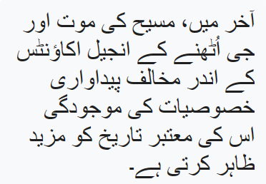
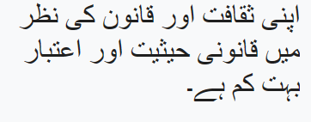

Slide 20
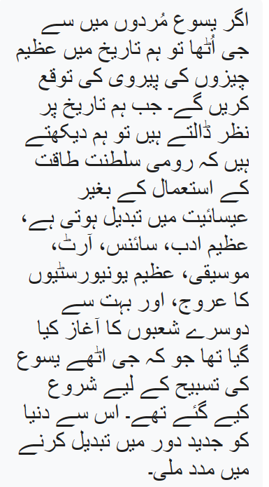
We would expect great things in history to follow if Jesus rose
from the dead.
When we look at history, we see the Roman empire converting
to Christianity without the use of force, the rise of great literature,
science, art, music, great universities, and many other areas that were started to glorify the risen Jesus.
This helped to transform the world to the modern era.

