Slide 1
Understanding and Answering
Prosperity Gospel
Source: Veritas International University RE505 course notes.
Source: https://www.ligonier.org/learn/articles/field-guide-on-false-teaching-prosperity-gospel?srsltid=AfmBOoq88U3m0UUFEB9k8l7T01_gAT_tQb-oUsfBB0XcgZaggvhiWeWf

Slide 2
Great Mike Winger You Tube series on refuting Word Faith/Prosperity gospel :
https://www.youtube.com/playlist?list=PLZ3iRMLYFlHv8qF8ajudjyT8hOTdK7CXP
Mike Winger Series on Benny Hinn:
https://www.youtube.com/watch?v=X2Ip_3A32W0&list=PLZ3iRMLYFlHujAK-ADyDk9Cc4s9gzDq-5

Slide 3
2 Timothy 4:3-4
“For the time will come when they will not tolerate sound doctrine; but wanting to have their ears tickled, they will accumulate for themselves teachers in accordance with their own desires, and they will turn their ears away from the truth and will turn aside to myths.”

Slide 4
1. Biblical Interpretation:
Progressive Christianity: Views the Bible as a historical and cultural document open to multiple interpretations, and emphasizes applying its teachings in the context of contemporary life. This approach acknowledges potential inconsistencies and contradictions in the Bible, and may reject passages considered to be promoting injustice or negativity.
Word of Faith Movement: Generally interprets the Bible literally, often emphasizing specific verses to support its teachings on health, wealth, and prosperity. Another related term is the Prosperity Gospel.
AI Summary

Slide 5
2. Emphasis and Focus:
Progressive Christianity: Prioritizes social justice, inclusivity, and compassion, seeking to reinterpret Christian teachings in light of modern societal values. Progressive Christians actively engage in social action to address issues like poverty, inequality, and environmental concerns.
Word of Faith Movement: Focuses on the power of spoken words, positive confession, and faith as means to achieve health, wealth, and success. This is also known as the "Health and Wealth Gospel" or "Prosperity Gospel".
AI Summary

Slide 6
3. Faith and the Spoken Word:
Progressive Christianity: Faith is understood as trust in God's promises and sovereign will, emphasizing submission to God's will.
Word of Faith Movement: Faith is seen as a force or tool that can be manipulated through spoken words (positive confession) to achieve desired outcomes. The belief is that speaking in agreement with God's promises can release God's power in your life.
AI Summary

Slide 7
4. View of Suffering and Trials:
Progressive Christianity: Recognizes that suffering is a natural and often expected part of the Christian life, and that God uses it for growth and development.
Word of Faith Movement: Often teaches that sickness and poverty are consequences of sin or a lack of faith, and that material blessings are a sign of God's favor.
AI Summary

Slide 8
5. Role of Jesus:
Progressive Christianity: Views Jesus as a model of inclusivity, peace, and social justice, emphasizing his teachings and example. Some progressive Christians view Jesus more as a moral example to follow rather than the divine Son of God.
Word of Faith Movement: Often portrays Jesus as a model of wealth and power, suggesting believers can imitate him by claiming their inheritance of prosperity and health. This view can diverge from the traditional understanding of Jesus' humble life and suffering.
AI Summary

Slide 9
In Summary:
These two movements represent contrasting perspectives within Christianity, differing significantly in their approach to biblical interpretation, their central focus, and their understanding of faith, suffering, and the role of Jesus.
Progressive Christianity emphasizes social justice and contextualized interpretation, while the Word of Faith movement centers on prosperity and health attained through faith and spoken words.
AI Summary

Slide 10

Progressive Christianity

Slide 11
The Bible is the Word of God
1 Thessalonians 2:13: “And we also thank God constantly for this, that when you received the word of God, which you heard from us, you accepted it not as the word of men but as what it really is, the word of God, which is at work in you believers?”
The Bible is the only thing that is infallible and is the source of teaching:
2 Timothy 3:16–17 declares, “All Scripture is breathed out by God and profitable for teaching, for reproof, for correction, and for training in righteousness, that the man of God may be competent, equipped for every good work”?

Slide 12
Progressive Christianity
Major topics to look for if the church is moving to a Progressive Christianity Teaching:
https://www.alisachildersblog.com/blog/5-signs-your-church-might-be-heading-toward-progressive-christianity
Paul wrote to the church of Galatia in Galatians 1:6-7, “I am astonished that you are so quickly deserting the one who called you to live in the grace of Christ and are turning to a different gospel—which is really no gospel at all. Evidently some people are throwing you into confusion and are trying to pervert the gospel of Christ.”

Slide 13
Allan Parr brings clarity to the quest to understand progressive Christianity and why it is dangerous: “The progressive Christian movement says that the church needs to revisit and adjust its methods, practices, and beliefs as the culture changes. In other words, the church should conform to culture rather than holding to the transformative power of the gospel to point culture to Jesus.”
https://www.summit.org/resources/articles/the-dangerous-progression-of-progressive-christianity/

Slide 14
Theology
The prosperity gospel, also known as the health and wealth gospel, is a Protestant Christian belief that faith can lead to wealth, health, and happiness. It teaches that God wants believers to be blessed in this life, and that material riches and physical well-being are God's will for the faithful.

Slide 15
Theology
The prosperity gospel is based on the idea that believers can use faith, positive thoughts, and donations to the church to break the curses of poverty and illness. It also teaches that material success is a sign of God's favor and blessings

Slide 16
Theology
The prosperity gospel has been a significant influence in Christianity since the early 20th century. It is popular in impoverished communities. However, it can also be criticized for being predatory and manipulative, especially when churches require heavy tithing

Slide 17
Theology
The prosperity gospel was influenced by the New Thought movement, an early 20th-century mind-healing movement that taught that individuals were responsible for their own happiness and health.

Slide 18
Word Faith (WF) Movement
Source: Ron Rhodes slides from Veritas International University RE505 course notes.

Slide 19
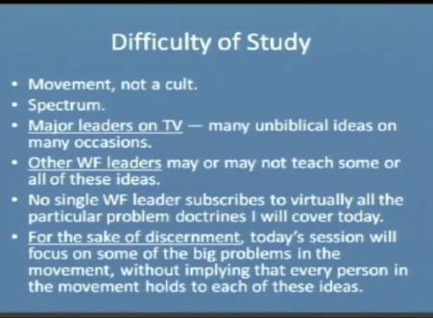
Source: Ron Rhodes slides from Veritas International University RE505 course notes.

Slide 20
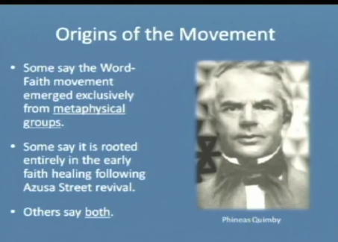
Source: Ron Rhodes slides from Veritas International University RE505 course notes.

Slide 21
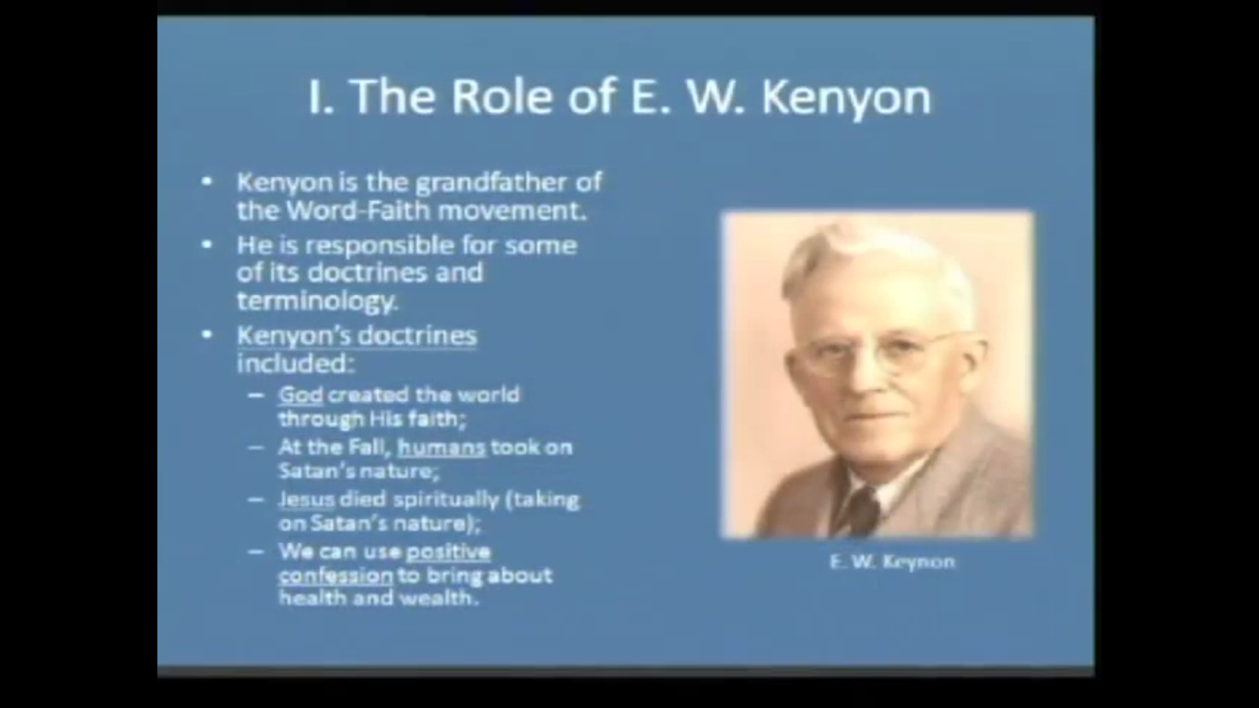
Source: Ron Rhodes slides from Veritas International University RE505 course notes.

Slide 22
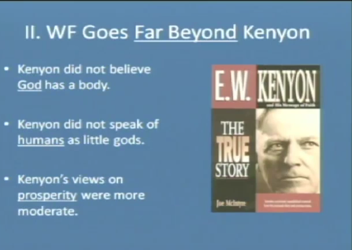
Source: Ron Rhodes slides from Veritas International University RE505 course notes.

Slide 23
Main Leaders
Founders: E.W. Kenyon. Later Kenneth Hagin.
Today: Kenneth Copeland, Benny Hinn, Joel Osteen, T.D. Jakes, John Hagee, Creflo Dollar, Paula White, Joyce Meyer, and Juanita Bynum are a few of the leading televangelists who have commercialized the teaching of the prosperity gospel in our day. For decades, these men and women have broadcast a false gospel over the radio and on television channels such as the Trinity Broadcast Network (TBN). In this way, they have exported their false teaching to Africa, South America, and Asia as well.

Slide 24
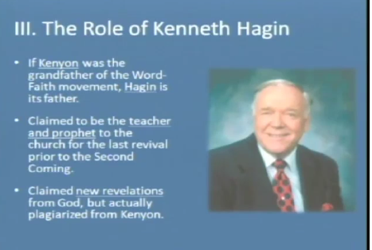
Source: Ron Rhodes slides from Veritas International University RE505 course notes.

Slide 25
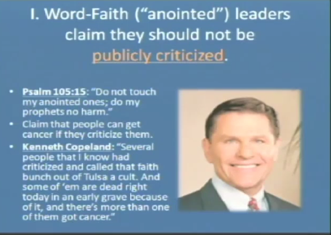
Source: Ron Rhodes slides from Veritas International University RE505 course notes.

Slide 26
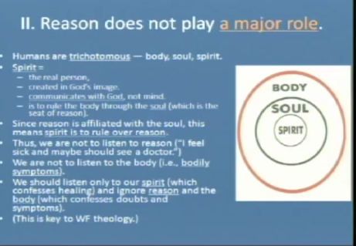
Source: Ron Rhodes slides from Veritas International University RE505 course notes.

Slide 27
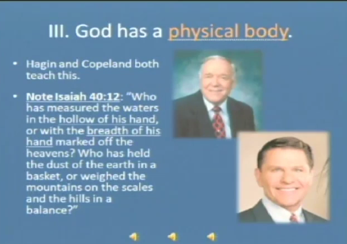
Source: Ron Rhodes slides from Veritas International University RE505 course notes.

Slide 28
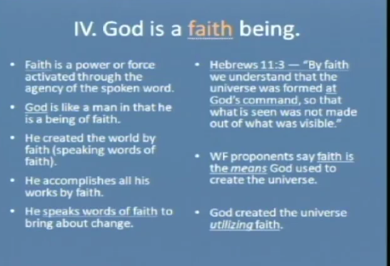
Source: Ron Rhodes slides from Veritas International University RE505 course notes.

Slide 29
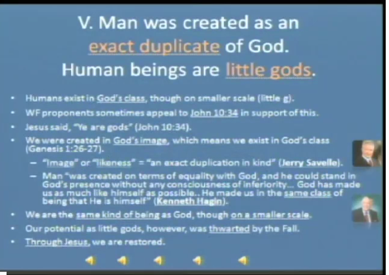
Source: Ron Rhodes slides from Veritas International University RE505 course notes.

Slide 30
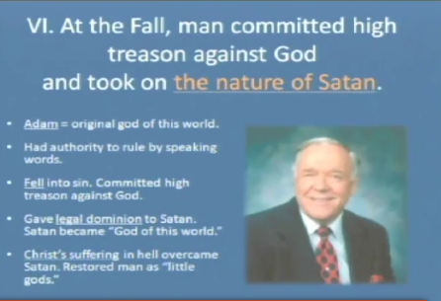
Source: Ron Rhodes slides from Veritas International University RE505 course notes.

Slide 31
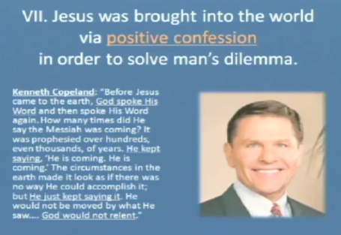
Source: Ron Rhodes slides from Veritas International University RE505 course notes.

Slide 32
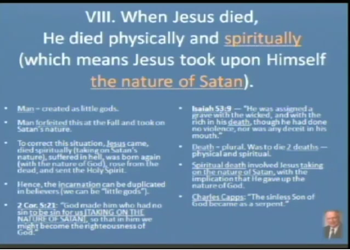
Source: Ron Rhodes slides from Veritas International University RE505 course notes.

Slide 33
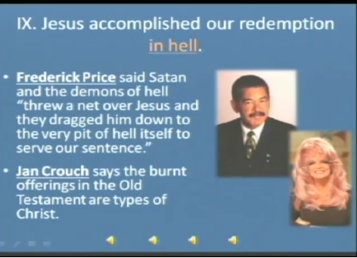
Source: Ron Rhodes slides from Veritas International University RE505 course notes.

Slide 34
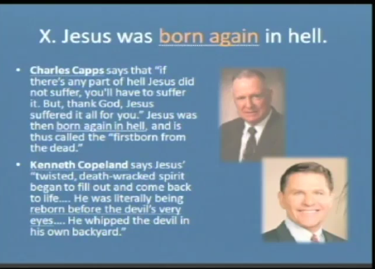
Source: Ron Rhodes slides from Veritas International University RE505 course notes.

Slide 35
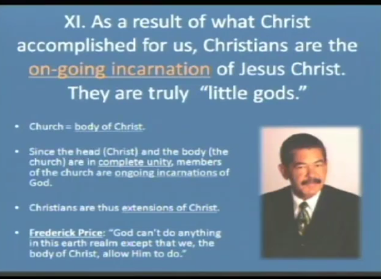
Source: Ron Rhodes slides from Veritas International University RE505 course notes.

Slide 36
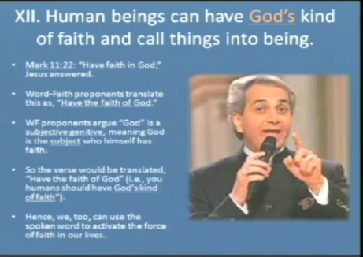
Source: Ron Rhodes slides from Veritas International University RE505 course notes.

Slide 37
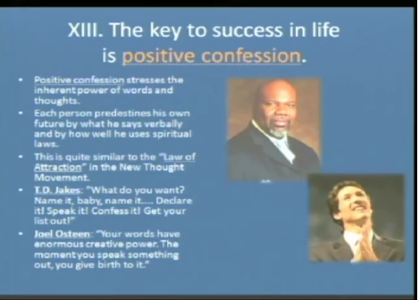
Source: Ron Rhodes slides from Veritas International University RE505 course notes.

Slide 38
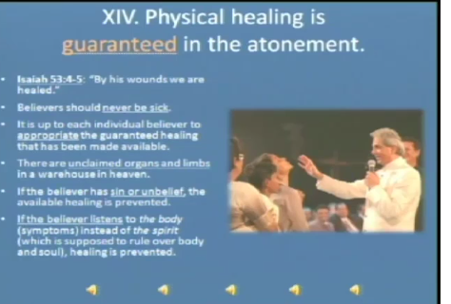
Source: Ron Rhodes slides from Veritas International University RE505 course notes.

Slide 39
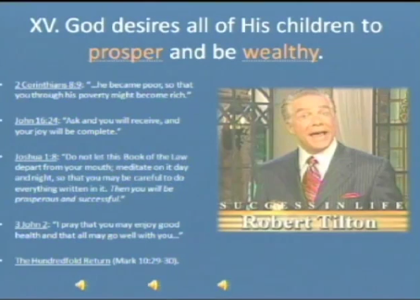
Source: Ron Rhodes slides from Veritas International University RE505 course notes.

Slide 40
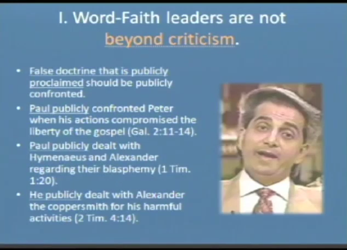
Source: Ron Rhodes slides from Veritas International University RE505 course notes.

Slide 41
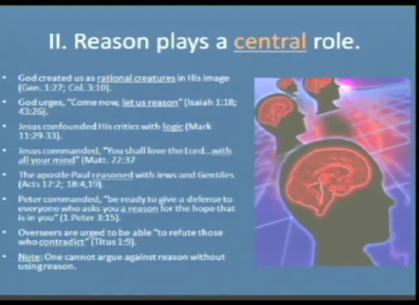
Source: Ron Rhodes slides from Veritas International University RE505 course notes.

Slide 42
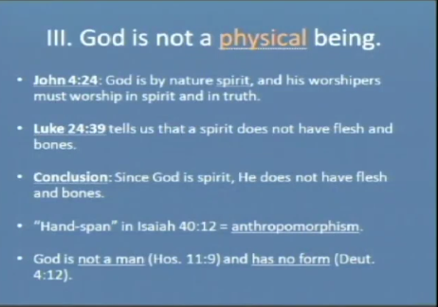
Source: Ron Rhodes slides from Veritas International University RE505 course notes.

Slide 43
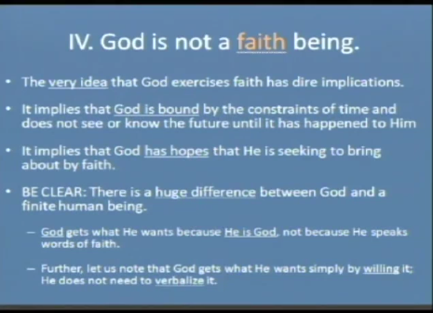
Source: Ron Rhodes slides from Veritas International University RE505 course notes.

Slide 44
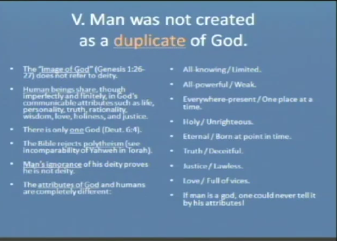
Source: Ron Rhodes slides from Veritas International University RE505 course notes.

Slide 45
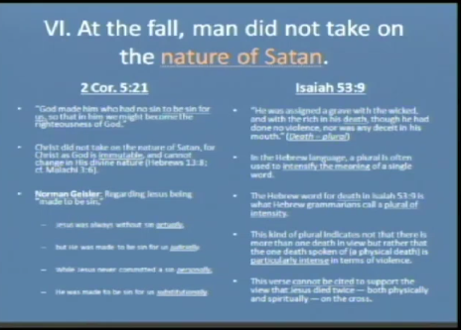
Source: Ron Rhodes slides from Veritas International University RE505 course notes.

Slide 46
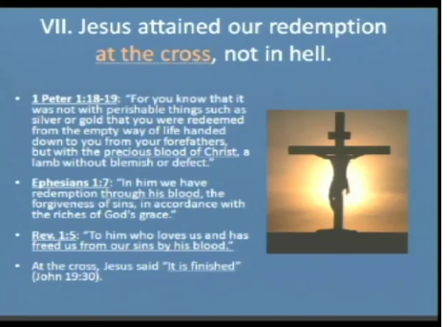
Source: Ron Rhodes slides from Veritas International University RE505 course notes.

Slide 47
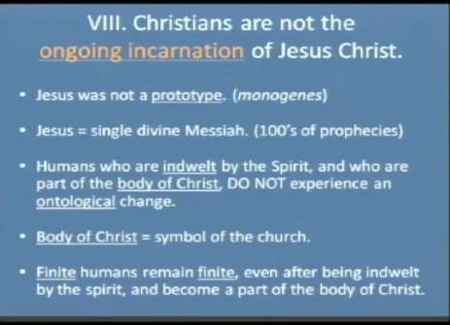
Source: Ron Rhodes slides from Veritas International University RE505 course notes.

Slide 48
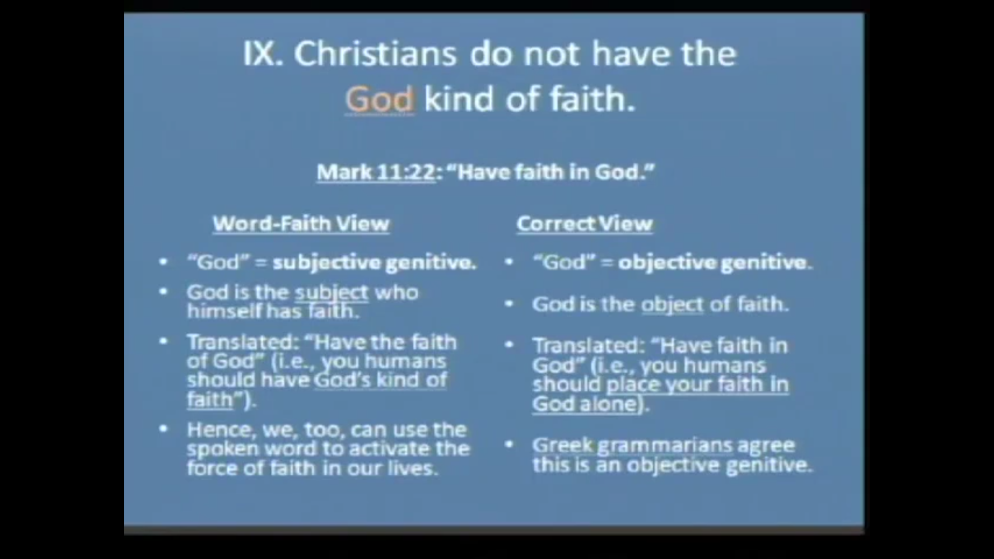
Source: Ron Rhodes slides from Veritas International University RE505 course notes.

Slide 49
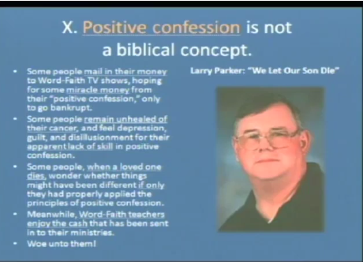
Source: Ron Rhodes slides from Veritas International University RE505 course notes.

Slide 50
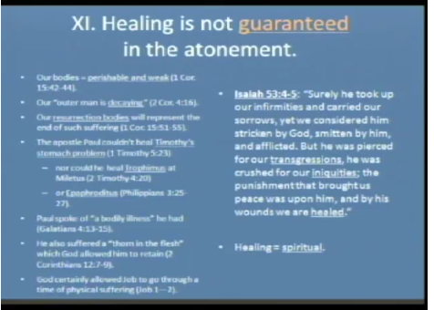
Source: Ron Rhodes slides from Veritas International University RE505 course notes.

Slide 51
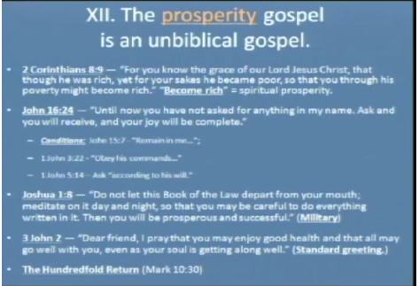
Source: Ron Rhodes slides from Veritas International University RE505 course notes.

Slide 52
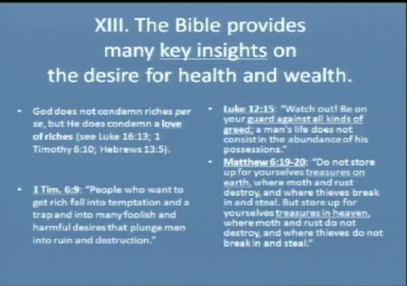
Source: Ron Rhodes slides from Veritas International University RE505 course notes.

Slide 53
Comparison
 | Prosperity Gospel | Christian
Jesus Atoning Death | Jesus purchased all the benefits of salvation for this life. Jesus purchased complete physical healing for His people in this life through His death on the cross. Jesus died to take away every sickness in this life and to atone for the “sin” of financial poverty. | God calls people to come to Christ for the forgiveness of sins. Jesus died to atone for the sins of His people (Acts 2:38; 5:31; 10:43; 13:38; 26:18). The focus is never on physical, financial, or material prosperity in this life. Believers will come to enjoy the full benefits of the death of Christ only in the resurrection on the last day.
Source: https://www.ligonier.org/learn/articles/field-guide-on-false-teaching-prosperity-gospel?srsltid=AfmBOoq88U3m0UUFEB9k8l7T01_gAT_tQb-oUsfBB0XcgZaggvhiWeWf

Slide 54
Comparison
 | Prosperity Gospel | Christian
Abrahamic Covenant Blessing | A present-day inheritance. In the Abrahamic covenant, God promised a vast material and financial inheritance for believers in this life. If a person believes in Jesus, he will inherit great possessions and tangible blessings in this life. | God promised Abraham that he would inherit the world (Rom. 4:13). This promise was fulfilled in the person and work of the Son of Abraham, Jesus Christ (Gal. 3:16). Everyone who believes in Jesus Christ is a son or daughter of Abraham and coheir of the inheritance promised to him (Gal. 3:29). By the same faith Abraham exercised, we receive the blessings of salvation—justification, adoption, the promised Holy Spirit, and the guarantee of the everlasting inheritance (Gal. 3:7–9). Believers will not fully possess the inheritance until the resurrection on the last day (Heb. 11:39–40; 13:14).

Slide 55
Comparison
 | Prosperity Gospel | Christian
Financial Giving | Give to get. Prosperity gospel preachers teach their followers that the way to gain riches is to give more money to the kingdom, especially by giving to their churches and ministries. The quantity of material and financial prosperity one expects to gain is in proportion to what one gives. | Believers have the duty and privilege of giving generously to the work of God’s kingdom in this life. God makes His grace abound toward His people when they give generously so that they will be equipped to continue giving generously (2 Cor. 9:8–11). Scripture never teaches us to give in order to gain and lay up treasure for ourselves.

Slide 56
Comparison
 | Prosperity Gospel | Christian
Financial Giving | “Name it and claim it.” Faith and prayer empower people to lay hold of physical and material blessings in this life. Certain leaders in this movement have popularized the term Word of Faith to capture the essence of their teaching. Accordingly, if someone exercises enough faith, he will no longer have to be subject to the crippling effects of sickness and disease. If individuals continue to suffer afflictions or poverty, it is due to their lack of personal faith. When we pray in faith, we compel God to make us prosperous, particularly when we declare that we already possess the desired blessing. Likewise, some teachers discourage their followers from speaking negative words, lest they bring negative things into being. | The Apostle Paul prayed fervently to the Lord for personal healing, only to have Jesus tell him, “My grace is sufficient for you, for my power is made perfect in weakness” (2 Cor. 12:7–9). This was not a lack of faith on Paul’s part. God has not promised complete healing in this life. He promises complete healing for individuals only in the resurrection on the last day.

Slide 57
Biblical Response
Luke 12:15
But He said to them, “Beware, and be on your guard against every form of greed; for not even when one is affluent does his life consist of his possessions.”
There will be suffering in this life:
Matthew 5:10
“Blessed are those who have been persecuted for the sake of righteousness, for theirs is the kingdom of heaven.
1 Peter 3:14
But even if you should suffer for the sake of righteousness, you are blessed. AND DO NOT FEAR THEIR INTIMIDATION, AND DO NOT BE IN DREAD,

Slide 58
Biblical Response
Sometimes you will experience suffering and sometimes your life will have blessings:
Philippians 4:12
I know how to get along with little, and I also know how to live in prosperity; in any and every circumstance I have learned the secret of being filled and going hungry, both of having abundance and suffering need.
Psalm 62:10
Do not trust in oppression, And do not vainly rely on robbery; If wealth increases, do not set your heart on it.
1 Timothy 6:17
Instruct those who are rich in this present world not to be conceited or to set their hope on the uncertainty of riches, but on God, who richly supplies us with all things to enjoy.
The only one of Jesus’ disciples to fall away was himself a lover of money (John 12:6).

Slide 59
Biblical Response
Luke 12:15
But He said to them, “Beware, and be on your guard against every form of greed; for not even when one is affluent does his life consist of his possessions.”
There will be suffering in this life:
Matthew 5:10
“Blessed are those who have been persecuted for the sake of righteousness, for theirs is the kingdom of heaven.
1 Peter 3:14
But even if you should suffer for the sake of righteousness, you are blessed. AND DO NOT FEAR THEIR INTIMIDATION, AND DO NOT BE IN DREAD,

Slide 60
Biblical Response
Isaiah 53:5 - The entire Chapter 53 is in regards to the Messiah who will bear our sins and rise from the dead to see his offspring and people will prosper spiritually by the atoning death. He will reign forever.
John 10:10 - The abundant life Jesus brings is not money. This verse is comparing Satan who is darkness and seeks to kill and destroy with Jesus who brings light and promise of eternal salvation (c.f. John 1:4- “In Him was life, and the life was the light of men”)
Almost every Disciple died as a Martyr. They suffered for Jesus and did not
enjoy a prosperous financial life. The early church is full of Martyrs who suffered
greatly and died for their beliefs. Entire books of the New testament are written to suffering Christians to strengthen them during suffering.
Philippian 1:29
For to you it has been granted for Christ’s sake, not only to believe in Him, but also
to suffer on His behalf,
We seek the eternal blessing and hope (Hebrews 13:14; 1 Peter 3:4).

Slide 61
Biblical Response
Paul had great faith and prayed to relieve his suffering but God said:
2 Corinthians 12:7-9
“So to keep me from becoming conceited because of the surpassing greatness of the revelation, a thorn was given me in the flesh, a messenger of Satan to harass me, to keep me from
becoming conceited. Three times I pleaded with the Lord about this, that it should leave me.
But he said to me, “My grace is sufficient for you, for my power is made perfect in weakness.”
Therefore, I will boast all the more gladly of my weaknesses, so that the power of Christ may
rest upon me.”
Jesus said we will have hardship and not financial blessings
John 16:33
“These things I have spoken to you so that in Me you may have peace. In the world you have tribulation, but take courage; I have overcome the world.”

Slide 62
John 16:23-24 .
“In that day, you will not question me about anything. Truly, truly, I say to you, if you ask the Father for anything in my name, He will give it to you. Until now, you have asked for nothing in my name; ask and you will receive, so that your joy may be made full.”
This is not a verse to ask for your own personal gain!
This is what we pray for:
“In the same way the Spirit also helps our weakness; for we do not know how to pray as we should, but the Spirit Himself intercedes for us with groanings too deep for words; and He who searches the hearts knows what the mind of the Spirit is, because He intercedes for the saints according to the will of God. And we know that God causes all things to work together for good to those who love God, to those who are called according to His purpose.” (Romans 8:26-28, NASB )
Resource: https://mamabearapologetics.com/recovering-from-the-word-of-faith-movement/

