Slide 1
Major Catholic Doctrines and Dogmas

Slide 2
Week 1

Slide 3
Sessions
1. Review of Relevant Christian Biblical Doctrines
2. Scripture vs Tradition
3. Infallible Popes, Priests, Bishops, Magisterium
4. Catholic Apocrypha
5. Forgiveness of Sins
6. Mary and Praying to the Dead
7. Justification by Faith & Purgatory
8. The Mass and Transubstantiation
9-10. Review

Slide 4
Relevant Christian Biblical Doctrines
Review
https://bfm.sbc.net/bfm2000/

Slide 5
Topic | Christian Belief
Bible | The 66 books of the Bible is the inspired Word of God, His revealed truth and is the infallible rule of faith for our lives and the standard we test truth claims. Generally, most affirm the Chicago Statement on Inerrancy. 2 Peter 1:20-21; 2 Peter 3:16; 1 Corinthians 14:37; 1 Thessalonians 2:13; 2 Timothy 3:16-17; Hebrews 1:1-2; Deuteronomy 18:18; 1 Corinthians 2:18; John 14:26; John 16:13; Acts 17:11; Matthew 15:3

Slide 6
Topic | Christian Belief
Salvation | Man can be saved from the consequence of sin, which is eternal death, by the grace of God through faith in Jesus Christ and in repentance of sin. Man cannot earn nor work for his salvation. When one is saved he is said to be “born again” by the indwelling presence of the Holy Spirit. We affirm the 5 Solas: sola scriptura (Scripture alone), solus Christus (Christ alone), sola fide (faith alone), sola gratia (grace alone), and soli Deo gloria (glory to God alone). John 1:11, 12; Ephesians 2:8, 9; 2 Peter 3:9; Romans 5:1-2; Romans 4:1-8; 2 Corinthians 5:21; Galatians 2:15-3:14

Slide 7
Topic | Christian Belief
Substitutionary Atonement | Isaiah 53:5; Hebrews 1:3; 1 Cor. 5:21; 1 Pet. 2:24;1 Pet. 3:18;
The Church | The Greek word for church is Ekklesia which is an assembly of believers (followers of Jesus). The assembly of believers joined to Christ's spiritual body by the Holy Spirit (1 Cor. 12:13) at the moment of regeneration (Titus. 3:3-6), when an individual place their faith in the Lord Jesus as their savior (Acts 16:31). If still on earth they are members of a local church that meet regularly (Heb. 10:25) for edification (Eph. 4:12), worship (John 4:24), and participation in the ordinances. Paul addresses most of these in his epistles (e.g. "to the church of God which is in Corinth"- 1 Cor. 1:2). The local building is the physical church and the invisible Church is the Spiritual House – Christ is the chief cornerstone and the apostles are the foundation. 1 Corinthians 12:13; Ephesians 2:11-21; Matthew 16:18; Acts 1:8; Eph. 2:20

Slide 8
Terms and Definitions

Slide 9
Justification
It is “an act of God whereby He pronounces a sinner to be righteous
because of that sinner’s faith in Christ.”
We are justified, or declared righteous, at the moment of our salvation.
Rom 5:1-2-notice the term is past tense and not an on going process:
“Therefore, since we have been justified through faith, we have peace with God through our Lord Jesus Christ, through whom we have gained access by faith into this grace in which we now stand. And we boast in the hope of the glory of God.”
Also, Titus 3:5-6 and 2 Tim. 1:9- notice “saved” is past tense.
Notes:
https://www.gotquestions.org/justification-sanctification-glorification.html

Slide 10
Sanctify
Sanctification is “the process by which Christians are set apart for God from the rest of the world, or the
process by which Christians are made holy.” Progressive, or experiential, sanctification, as it is sometimes
called, is the effect of obedience to the Word of God in one’s life. It is the same as growing in the
Lord (2 Peter 3:18) or spiritual maturity. (1 Thess. 5:23-24).
Glorify
Glorification is “God’s final removal of sin from the life of the saints so that they stand faultless before Him in glory in eternity” (Romans 8:18; 2 Corinthians 4:17). We will have direct and unhindered access to God’s presence, and we will enjoy holy communion with Him throughout eternity.
As Christians, we were justified when we confessed Christ and believed (Romans 10:9), we are sanctified as we grow in holiness through the work of the Spirit (Ephesians 4:11–32; Galatians 5:16–24), and we will someday be glorified when we are resurrected into eternal life (Colossians 3:4). Justification is a one-time event, sanctification is a process, and glorification is a future event.
Notes:
https://www.gotquestions.org/justification-sanctification-glorification.html

Slide 11
Catholic Terms and Definitions
Sacrament -a religious ceremony or ritual regarded as imparting divine grace, such as baptism, the Eucharist and (in the Roman Catholic and many Orthodox Churches) penance and the anointing of the sick.
Liturgy -encompasses the entire service: prayer, reading and proclamation, singing, gestures, movement and vestments, liturgical colors, symbols and symbolic actions, the administration of sacraments and sacramentals.
The Mass is a long rite in two parts: the Liturgy of the Word and the Liturgy of the Eucharist. The former consists of readings from the Bible and a homily, or sermon, given by a priest or deacon. The latter, which follows seamlessly, includes the "Offering" of the bread and wine at the altar, their consecration by the priest through prayer, and their reception by the congregation in Holy Communion
Propitiatory -Propitiation is the act of appeasing a deity to gain divine favor or avoid divine retribution.
Expiation-The act of removing sin and its guilt, and restoring a person's relationship with God
Formal vs material sufficiency of Scripture. Sola Scriptura= formal. Formal means its all complete and no need for traditions or any other teachings.
RCC rejects formal and allows material sufficiency in Bible. Equipped (gives equipment, but not how to use it).

Slide 12
Catholic Terms and Definitions
Tradition- direct teaching from apostles (e.g. 1 Cor.11:2-3; 2 Thess. 2:15 vs later assertion –We must compare “tradition” to scripture since Scripture is what came from Apostles. Written apostolic instruction is same as their oral teaching but apostolic instruction/tradition/scripture is superior to non-apostolic tradition. RCC wants to say non-apostolic is same as apostolic.
Orthodoxy- prevailing religious opinion or the teaching
Heterodox- A collective term for opinions or doctrines that vary from orthodoxy
Heresy –outside the teachings.
Idolatry –”the worship of idols or excessive devotion to, or reverence for some person or thing” (Exodus 20:3; Exodus 23:13; Deut. 5:7; Isaiah 44:15-18;1 Samuel 5:1-5; 1 Kings 18:19-40; Isaiah 42:8; Jeremiah 10:1-16)
If you worship the true God with idols that is still idolatry- see Exodus 32- they made golden calf for Yahweh and were worshipping it.
https://www.gotquestions.org/heterodoxy-heterodox.html
https://www.gotquestions.org/idolatry-definition.html
https://www.gotquestions.org/heresy-definition.html;

Slide 13
Hebrew- Knesset (Greek Synagogue ) –assembly. Not highly centralized like the temple.
Led by Scribes(teachers of the law)- Rabbis
Greek- synagogue is used the same as Ekklesia –”Those called out.” Synagogue refers to a place of worship, while Ekklesia was used for a political assembly or a group of people called to salvation. Assembly of citizens, not a building. Christian buildings were outlawed. Jews used Synagogue and Christians used Ekklesia.
Church- plural (the church), singular- a church
Body of Christ- unity to demonstrate “one Lord, one faith, one baptism” (Eph 4:5).
Jesus mentions Holy Spirit coming to guide them, but doesn’t mention church. (John 13-17)

Slide 14
Church = "kuriakos" appears in the New Testament only twice. It is found once in I Corinthians 11:20 where it refers to "the Lord's supper," and once again in Revelation 1:10 where it refers to "the Lord's day." In both of those cases, it is translated "the Lord's..." - not "church." It means "pertaining to the lord." It refers to something that pertains to, or belongs to, a lord and is not the translation of Ekklesia.
The phrase kūrikón oikía meant “the Lord’s house.” In the Middle Ages, the Greek term for “house of worship” was shortened to kūrkón. And that’s the word that was loaned to West Germanic as kirika and eventually to Old English as cirice. Etymologically speaking, the word church means “house of the Lord.”
Old Norse borrowed the Old English word cirice to form kirkja, and that’s where the Scottish word kirk came from. During the Middle English period, the word kirk was borrowed from the Scots, so now Modern English has both church and kirk as synonyms.

Slide 15
Household of faith (McGrath p/ 25). Early church was not well organized. (Bray p. 43-45)
  Episopos (bishop)- domestic supervisor. Greek word for “overseer.” (Geisler P. 111) Strongs 1985) Acts 20:28; Phil. 1:1; 1 Tim. 3:2; Titus 1:7; 1 Peter 2:25
  Diakonos (deacon) –a servant. (strongs 1249) 1 Tim 3:11
  Presbyteros (elder) – senior member of a household. Jewish term for overseer. (Strongs 4245) Acts 15:6
  Pastors or shepherd is poimén (strongs 4166) Eph 4:11
  Priest is the Greek word hiereus (strongs 2409). Rev: 1:6
  High priest archierea (strongs 749) Heb 4:15

Slide 16
New Testament:
Elder and bishop seem to be used interchangeably in NT (Greek vs Jewish term-Acts 20:17,28; Phil. 1:1;Titus 1:5,7)).
Qualifications (1 Tim. 2:12; 3:1-7; Titus 1:5-9; 1 Cor. 14:34) Notice Acts 20:17/28 he calls elders (Presbyteros) and made them Overseers (v 28)
2) Deacons – Acts 6:1-6 can be younger in faith. Assist elders. Social and physical ministries. (Romans 16:1-”worker/Deacon).
3) Apostleship was a gift, elder was an office. All apostles were elders but not all elders were apostles.
4) Pastoring is a gift and elder is an office. Not all elders are pastors. Elders are teachers(1 Tim. 3:2)
5) Pastor (poimen) is not used for church officers. The verb “poimaino) is to shepherd is used (Acts 20:28; 1 Pet. 5:2; Eph 4:11)).
They are Elders with a gift to shepherd the flock. Jesus is called the chief shepherd/pastor (archipoimen) in 1 Pet. 5:4. Grudem. P. 1124.
6) Acts 14:23- Apostles ordained (not elected elders).
7) The congregation exercised church discipline and chose deacons. It seemed that elders guided, but did not rule.
The congregation did (Geisler p. 122).
If bishop were higher than elder why does Paul use them interchangeably in Acts 20:17/28 and call the supposed
lower office to the meeting?
Ministry of the Church (Geisler p. 202)
  Pastor- feeding the flock (1 Pet. 5:1; Acts 20:28).
  Teacher- Connected to pastor
  Evangelist -2 Tim. 4:5). Special gift (Acts 21:8; cf. 8:4-8; 26-40).

Slide 17
Early Worship
Met in homes (Acts 12:12; Rom. 16:5; Col. 4:15; Philemon 1-4), the temple (Acts 5:12), public auditoriums/schools (Acts 19:9) and some synagogues (Acts 14:1, 3;17:1, 18:4). The place was not as important as the manner of the meeting for fellowship and worship of God. Cairns P. 84
Met on first day of the week (Sunday) –Acts 20:7; 1 Cor. 16:2; Rev, 1:10).
Read scripture and Sang songs (Col. 3:16; Eph. 5:19)
Took communion (1 Cor. 11:20-22);
Early practices found in “First Apology”-Justin Martyr and the Didache. Read p. 84 Carns. Baptism and communion were two sacraments and you had to be baptized (normally by dunking) to receive communion.

Slide 18
General Topics to Look For
Use of early Fathers- some Fathers make good and bad quotes. Good ones are backed up by scripture. Bad ones are not. Example: Athanasius defended Trinity with Scripture. He also made references to Mary that are not found in the Bible.
Allusions to later dogmas are not evidence for the existence of later dogmas. Later Catholic dogmas are the result of large developments and cannot be read back into early father quotes
Early Fathers are not infallible. They do not carry the authority of New Testament writers which is why their writings are not canonical. They often disagreed with each other. We can learn from them but, like Paul (Acts 17), we need to test their teachings to Scripture.
Catholic teachings results in Sola Ekklesia –church is the final authority
These terms can be confusing and do not appear until much later to try and, in some cases, to explain the teachings not found in the clear teachings of the Bible.

Slide 19
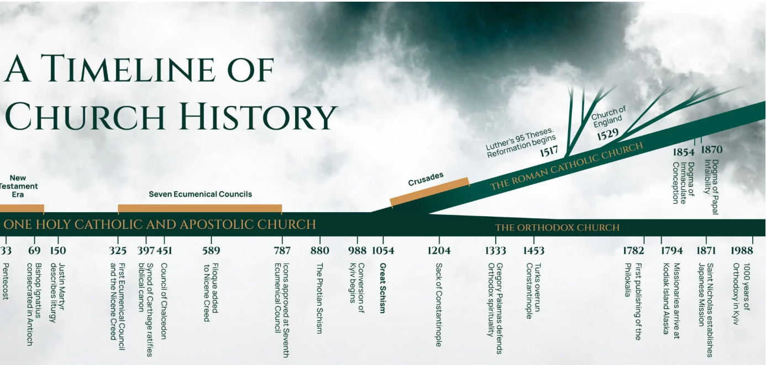
Mary bodily assumption Pope Pius XIII 1950

Slide 20
The Early Church- 33AD-590AD
Ancient Church History- 5BC to AD590
Spread of Christianity-to AD100
Persecution and internal heresy-100-313
  Roman Catholic Church- 313-590
The Middle Ages and Renaissance, c 500- c. 1000
Rise of the Empire – 590-800
Church and State-800-1054
The Middle Ages and Renaissance, c 1000- c. 1500
Supremacy of the Papacy-1054-1305
Only educated people could read Latin
Indulgences to pay for sin removal.
1382 – John Wycliffe’s English Bible. The Bible was burned and reform stopped.
Martin Luther 1517 -95 theses. Excommunicated 1521
William Tyndale Bible- 1525

Slide 21
Major Problematic Topics for this Study
1.Presbyters first called priests by Lucian 2nd c.
2. Sacerdotal mass instituted by Cyprian 3rd c.
3. Prayers for the dead A.D. 300
4. Making the sign of the cross A.D. 300
5. Wax candles A.D. 320
6. Veneration of angels, dead saints, and images A.D. 375
7. Mass became a daily ritual A.D. 394
8. Beginning of exaltation of Mary, term "Mother of God" first applied to her by Council of Ephesus A.D. 431
9. Priests began to wear special clothing A.D. 500
10. Extreme Unction (Rite of Healing) A.D. 526
11. The doctrine of Purgatory by Gregory I A.D. 593
12. Latin used in worship A.D. 600
13. Prayers offered to Mary, dead saints and angels A.D. 600
14. First man to be proclaimed Pope (Boniface III) A.D. 610
15. Kissing the Pope's feet A.D. 709
16. Temporal power of Popes, conferred by Pepon, King of the Franks A.D. 750
17. Veneration of cross, images, relics authorized A.D. 786
18. Holy water, mixed with pinch of salt, chrism, and blessed by a priest A.D. 850
19. Veneration of St. Joseph A.D. 890
20. College of Cardinals begun A.D. 927

Slide 22
Major Problematic Topics for this Study
21. Baptism of bells instituted by Pope John XIII A.D. 965
22. Canonization of dead saints by Pope John XV A.D. 995
23. Fasting on Fridays and Lent A.D. 998
24. The Mass developed gradually as a sacrifice, attendance made obligatory 11th c.
25. Celibacy of priests declared A.D. 1079
26. Rosary adopted (pagan) by Peter the Hermit A.D. 1090
27. The Inquisition instituted by Council of Verona A.D. 1184
28. Sale of indulgences A.D. 1190
29. Seven Sacraments, defined by Peter Lombard 12th c.
30. Transubstantiation, defined by Innocent III A.D. 1215
31. Auricular confession (Rite of reconciliation) of sins to a priest instead of God, instituted by Innocent III A.D. 1215
32. Adoration of the wafer (called the Host), decreed by Pope Honorius III A.D. 1220
33. Scapular invented by Simon Stock of England A.D. 1251
34. The cup forbidden to the laity at communion by Council of Constance A.D. 1414
35. Purgatory proclaimed as a dogma by the Council of Florence in A.D. 1439
36. Tradition declared of equal authority with the Bible by the Council of Trent A.D. 1545
37. Apocryphal books are added to the Bible by the Council of Trent A.D. 1546
38. Creed of Pope Pius IV imposed as the official creed in place of the original Apostolic Creed A.D. 1560
Pope infallibility- first Vatican Council-1870
ex cathedra- Mary’s immaculate conception (Pope Pius IX in 1854, Mary bodily assumption Pope Pius XIII 1950).

Slide 23
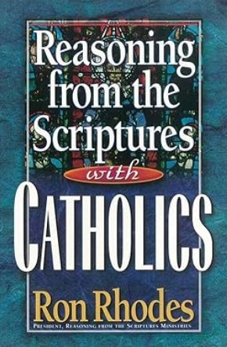
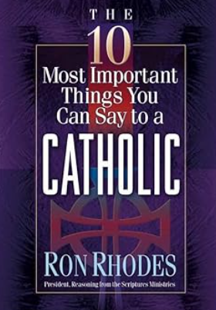
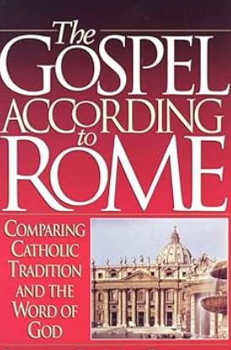
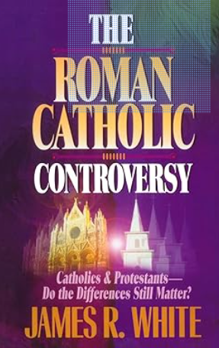
Resources
Debates: James R. White Alpha and Omega Ministries debates with Roman Catholics-
https://www.youtube.com/playlist?app=desktop&list=PLJFEiE4GKkvDr831A618UmVCGnMB43P9G
https://carm.org/world-religions/roman-catholicism/
Gavin Ortlund- https://www.youtube.com/@TruthUnites
Gavin Ortlund-Canon https://www.youtube.com/watch?v=hwfq4r4yi6M&t=1s
Wes Huff - https://www.youtube.com/@WesHuff

Slide 24
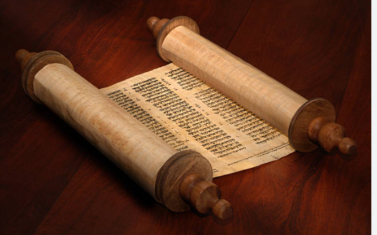

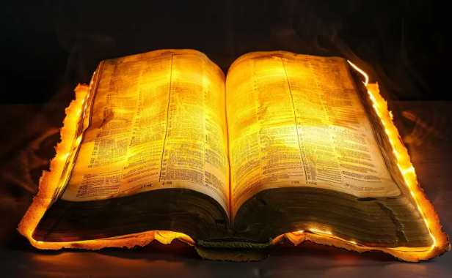
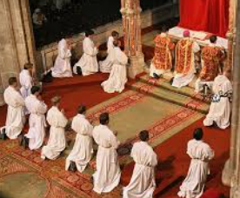
Week 2
Scripture vs Tradition
Tradition declared of equal authority with the Bible by the Council of Trent A.D. 1545
Our Lord Jesus Christ… promulgated… truth, and moral discipline… [which] are contained in the written books, and the unwritten traditions which, received by the Apostles from the mouth of Christ himself, or from the Apostles themselves,… have come down… to us, transmitted as it were from hand to hand. (Session 4, 1546)

Slide 25
Sola Scriptura
“The doctrine of Sola Scriptura simply states that the Scriptures, and the Scriptures alone, are sufficient to function as the rule of faith, for the Church. All that one must believe to be a Christian is found in Scripture and in no other source. That which is not found in Scripture is not binding upon the Christian conscience. To be more specific, I provide the following definition. The Bible claims to be the sole, infallible and sufficient rule of faith for the Christian Church. The Scriptures are not in need of any supplement. Their authority comes from their nature as God-breathed revelation. Their authority is not dependent upon man, church or council. The Scriptures are self-consistent, self-interpreting and self-authenticating. The Christian Church looks to the Scriptures as the only and sufficient rule of faith and the Church is always subject to the Word and is constantly reformed thereby.”
Source: https://www.aomin.org/aoblog/roman-catholicism/transcript-does-the-bible-teach-sola-scriptura-james-white-vs-jerry-matatics/

Slide 26
Catholic View
-Bible does not teach Sola Scriptura
-Bible teaches the authority of Tradition (2 Thess. 2:15;
2 Thess. 3:6; 3 John 13) and Scripture
-The Bible cannot be correctly interpreted without tradition and
with the Magisterium as the methodology
-The Bible is a product of the Roman Catholic Church(RCC)
-Sola Scriptura means Protestants can only believe or practice
what is in the Bible. It is all their individual interpretation so
there is nothing behind the methodology

Slide 27
Biblical View
-Catholics argue in a circle- “We know tradition is true because
tradition tells us so.”
-Tradition is to be respected, but not exalted.
-The Church is a product of Scripture (Christianity) not the reverse.
-Only the Bible is inspired. All apostolic tradition in regard to
faith and practice is recorded in the New Testament
-The Bible can be interpreted apart from tradition
-Scripture sets parameters beyond which we are not to go.
-Just like the Trinity, Sola Scriptura is not explicitly taught
(i.e. “God is a Trinity”), but it is implicitly taught. Bible does not have
to use exact words that Catholics say it must say about Sola Scripture
Source – debate: https://www.youtube.com/watch?v=CV01DNwNmig

Slide 28
Biblical View
Catholic view was not taught by the apostles but Catholicism defines “apostolic tradition”
as what the church teaches regardless of whether the apostles taught it.
By changing the definition you can make it seem like you mean one thing but you mean
something completely different.

Slide 29
Biblical View
-The Bible makes the Church. The Church recognized the
authoritative books just like you recognize your parents. The
Church is a product of divine revelation. The church recognized
the books which had authority based on who wrote them.
-No other books after the New testament authors died were
recognized as scripture because those early church fathers did not
received the authority to write scripture.
-The Bible is not an authoritative list of books; it is a list of
authoritative books. Books that had authority based on the authors.
We Huff https://www.facebook.com/reel/966084265312364

Slide 30
History
-When the early church fathers referred to “tradition” they nearly
always referred to known documents, not unwritten tradition.
Examples are baptism by dunking 3 times in the Didache and facing
east while praying.
-Apostolic tradition (e.g. establishment of episcopal offices), we can
show the tradition.
-Apostolic offices (new apostles) we cannot demonstrate.
-Apostles saw the risen Christ and was commissioned and Paul was
the last one (1 Cor. 15:8-9).

Slide 31

History
-Scripture had primary authority. Other traditions had some
authority but sola Scriptura says scripture has final authority.
Scripture is the only INFALLIBLE rule of faith. Other rules of faith
(e.g. councils, creeds, confessions) have authority but are not
infallible and are subject to correction by Scripture.
-When early fathers, such as Irenaeus, referred to tradition,
they are were referring to those found in the old and new
testaments

Slide 32
What does the Bible say about Scripture and its Role?

Slide 33
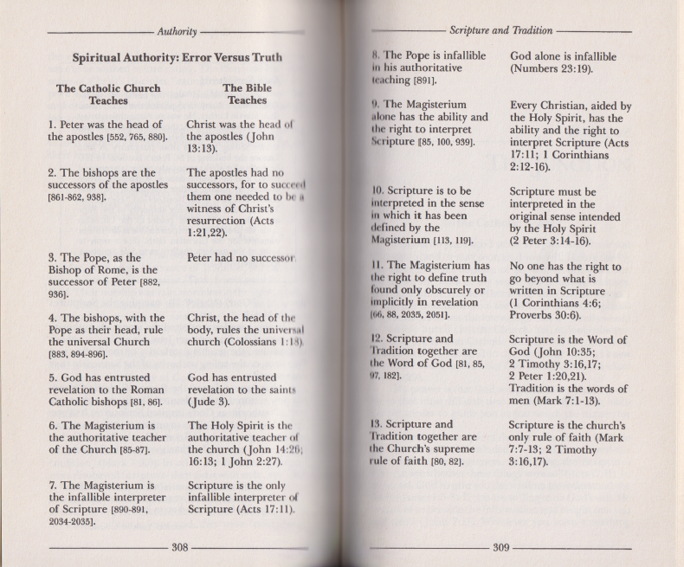
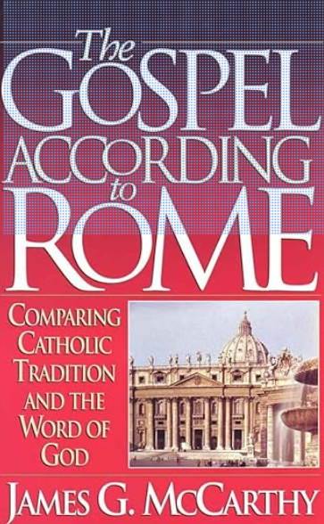

Slide 34
When the apostles wrote the New Testament documents, they were inspired by the power of the Holy Spirit. There wasn’t any real issue of whether or not they were authentic. Their writings did not need to be deemed worthy of inclusion in the Canon of Scripture by a later group of men in the so-called Roman Catholic Church. To make such a claim is, in effect, to usurp the natural power and authority of God himself that worked through the Apostles.
The Scripture says, “But know this first of all, that no prophecy of Scripture is a matter of one’s own interpretation, for no prophecy was ever made by an act of human will, but men moved by the Holy Spirit spoke from God,” (2 Pet. 1:20-21). The Bible tells us that the Scriptures are inspired by the Holy Spirit. Therefore, the very nature of the inspired documents is that they carry power and authenticity in themselves. They are not given the power or the authenticity of the ecclesiastical declaration.
https://carm.org/roman-catholicism/did-the-roman-catholic-church-give-us-our-bible/?fbclid=IwAR3J48q2x0ZJhDBQwVkoIosZkbcBwERLFstmqY0Ojj2Vg0FhpGGbewYhlIY

Slide 35
The Jew ADDED to Scripture with tradition and Jesus scolded them for it:
Matt 15:3- “And why do you break the command of God for sake of your tradition?”…..verse 6 “Thus you nullify the word of God for the sake of tradition”.. He goes on to quote Isaias 29:13 “…they worship me in vain; their teachings are merely human rules”.
This assumed they had Old Testament Scripture to compare tradition to.

Slide 36
Oral tradition is regarding the Gospel (e.g. 1 Cor 15:3).
In 1 Thess. 4:1 – Paul is referring back to tradition he already gave them in writing about those that were idle.
2 Thess. 2:15 talking about gospel already taught or the tradition regarding the great apostacy which is what the passage is discussing. No future traditions were in view. Every time they talk about oral tradition its about what had already been taught and written.

Slide 37
Matt. 23:2-The person sitting on Moses seat was not given authority because of the tradition of the seat, he was given authority by the Scripture he was reading. The Scripture was the authority. This starts in Duet 17:9 where they were to judge according to the law (Duet 17:11). That passage in Matthew goes on to say the Pharisees abused the seat by adding to the law thereby adding heavy burdens on them (Matt 23:4). It then goes on to instruct them not to call any earthly person your “father” which RCC does.

Slide 38
The fact is that the Disciples built the church and gave them God-breathed Scripture to use and test. They did not tell them to add to Scripture with organizational teachings that add burdens and change the Gospel.
If RCC teachings are not in Scripture, it is not an interpretation debate. An interpretation debate assumes a teaching is in the Bible to interpret. No where is praying to Mary, dead saints, purgatory, works, indulgences, Popes, infallibility, confession to a priest for forgiveness, Mary is an intermediary, etc, etc. found in Scripture. If it was important, it would be in Scripture so it could "adequately equip“(2 Timothy 3:16).

Slide 39
Luke 24:13-29
And He said to them, “O foolish men and slow of heart to believe in all that the prophets have spoken! “Was it not necessary for the Christ to suffer these things and to enter into His glory?” Then beginning with Moses and with all the prophets, He explained to them the things concerning Himself in all the Scriptures.
Jesus did not hold them accountable to the church leaders or tradition.
He held them accountable to know scripture for themselves.

Slide 40
Isaiah 34:16
Seek and read from the book of the LORD: Not one of these shall be missing; none shall be without her mate. For the mouth of the LORD has commanded, and his Spirit has gathered them.
John 5:39
You search the Scriptures because you think that in them you have eternal life; and it is they that bear witness about me,
Only Scripture is God breathed (2 Tim 3:16). "
"...All Scripture is inspired by God and profitable for teaching, for reproof, for correction, for training in righteousness so that the man of God may be adequate, equipped for every good work"
That is talking about the nature of Scripture. Tradition is man-made and of a different nature. Scripture is used to test.

Slide 41
The Christian is obligated to start with the starting point that Scripture originates from God rather than men or even the Church.
Theologian Norman Geisler said “First, a book is not the Word of God because it is accepted by the people of God. Rather, it was accepted by the people of God because it is the Word of God. That is, God gives the book its divine authority, not the people of God. They merely recognize the divine authority which God gives to it.”
God gives the church teachers, apologists, etc. but still knows he can speak to his creatures with clarity without them going to an “infallible” human authority. Jesus holds them accountable.

Slide 42
Acts 17
Now these Jews were more noble than those in Thessalonica;
they received the word with all eagerness,
examining the Scriptures daily to see if these things were so.
This assumed they had Old Testament Scripture to test to.
They tested an inspired apostle, Paul, to Scripture not tradition.
They tested to ensure consistency.

Slide 43
Galatians 1:8
But even if we, or an angel from heaven, should preach to you a gospel contrary to what we have preached to you, he is to be accursed!
Even Paul and angels can be tested with Scripture and the true Gospel

Slide 44
Holy Spirit Guided New Testament Authors
John 16:7
Nevertheless, I tell you the truth. It is to your advantage that I go away; for if I do not go away, the Helper will not come to you; but if I depart, I will send Him to you.
John 16:13
However, when He, the Spirit of truth, has come, He will guide you into all truth; for He will not speak on His own authority, but whatever He hears He will speak; and He will tell you things to come.
John 14:26
But the Helper, the Holy Spirit, whom the Father will send in My name, He will teach you all things, and bring to your remembrance all things that I said to you.

Slide 45
2 Tim. 3:16-17: “All Scripture is God-breathed and is useful for teaching, rebuking, correcting and training in righteousness, so that the servant of God may be thoroughly equipped for every good work
2 Peter 1:20-21: “Knowing this first, that no prophecy of Scripture is of any private interpretation, for prophecy never came by the will of man, but holy men of God spoke as they were moved by the Holy Spirit.”

Slide 46
2 Pet. 3:16 -…” as also in all his letters, speaking in them of these things, in which are some things hard to understand, which the untaught and unstable distort, as they do also the rest of the Scriptures, to their own destruction”
1 Cor. 14:37 - If anyone thinks he is a prophet or spiritual, let him recognize that the things which I write to you are the Lord’s commandment.
1 Thess. 2:13) - For this reason we also constantly thank God that when you received the word of God which you heard from us, you accepted it not as the word of men, but for what it really is, the word of God, which also performs its work in you who believe.

Slide 47
Canon Criteria
Was it written by a prophet of God? (2Pet. 1:20-21; Mt. 5:17-18; Lk. 24:27)
Was he confirmed by an act of God? (Ex. 4:1-9; Jn. 3:2; Heb. 2:4; 2 Cor. 12:12)
Did it tell the truth about God? (Duet. 13:1-3; 18:21-22; Acts 17:11; 1 Jn. 4:1-6)
Did it have the power of God? (Isa. 55:11; Heb. 4:12; Rom. 1:16; 2 Tim. 3:17)
Was it received by the people of God? (1 Tim 5:17-18; 1 Cor 11:23-26/Luke 22:19-20, 2 Pet. 3:16; 1 Cor. 14:37; 1 Thess. 2:13)

Slide 48
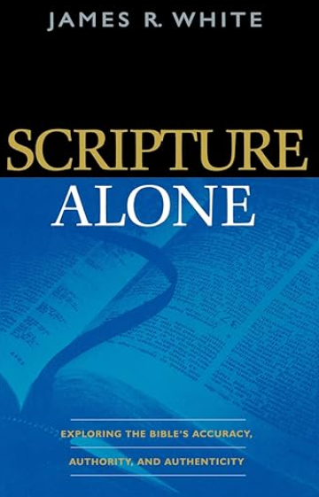
“How one views Scripture will determine the rest of one’s theology. There is no more basic issue: Every system of thought that takes seriously the claims in the Bible to be inspired, authoritative Word of God will share a commitment to a particular central truth, and that without compromise. Those systems that do not begin with this belief in Scripture will exhibit a wide range of beliefs that will shift over time in light of ever-changing whims and views of culture. Almost every single collapse involving denomination and churches in regard to historic Christian beliefs can be traced back to a degradation in that group’s view of the Bible as the inspired and inerrant revelation of God’s truth. Once this foundation is lost, the house that was built upon it cannot stand.”
James R. White, Scripture Alone, p. 43.

Slide 49
Catholics, Mormons, Jehovah Witness, Islam, Gnostics, all deny Sola Scriptura and are most unlike each other.
Protestants that affirm and practice Sola Scriptura agree on main things and differ on nonessentials.
Catholics inflate denominations to 30,000 because they include every religion and cult. There was never an expectation that every generation would wipe out false teachings. Even the apostles had to deal with false teachers and issues. Misuse of a valid source is not an argument against the source. People use good car manuals wrong is not a reflection on the manual.

Slide 50
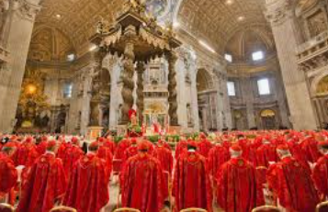
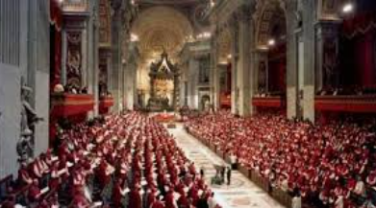
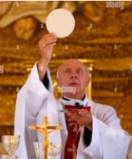
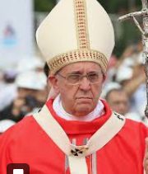
Week 3
Infallible Popes, Priests, Bishops, Magisterium
590 AD the bishop in the Rome(west) was the leader(Gregory the 1st) and refused title.
First man to be proclaimed Pope (Boniface III) A.D. 610
Kissing the Pope's feet A.D. 709
Temporal power of Popes, conferred by Pepon, King of the Franks A.D. 750

Slide 51
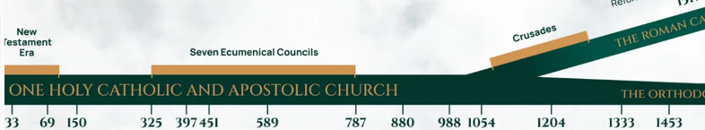
Pope Innocent III 1198AD – “Vicar of Christ”
Peak of Pope Power
A.D. 1054-1305
Temporal power of Popes, conferred by Pepon, King of
the Franks A.D. 750
Kissing the Pope's feet A.D. 709
First man to be proclaimed Pope (Boniface III) A.D. 610
590 AD the bishop in the Rome(west) was the leader(Gregory the 1st) and refused title.

Slide 52
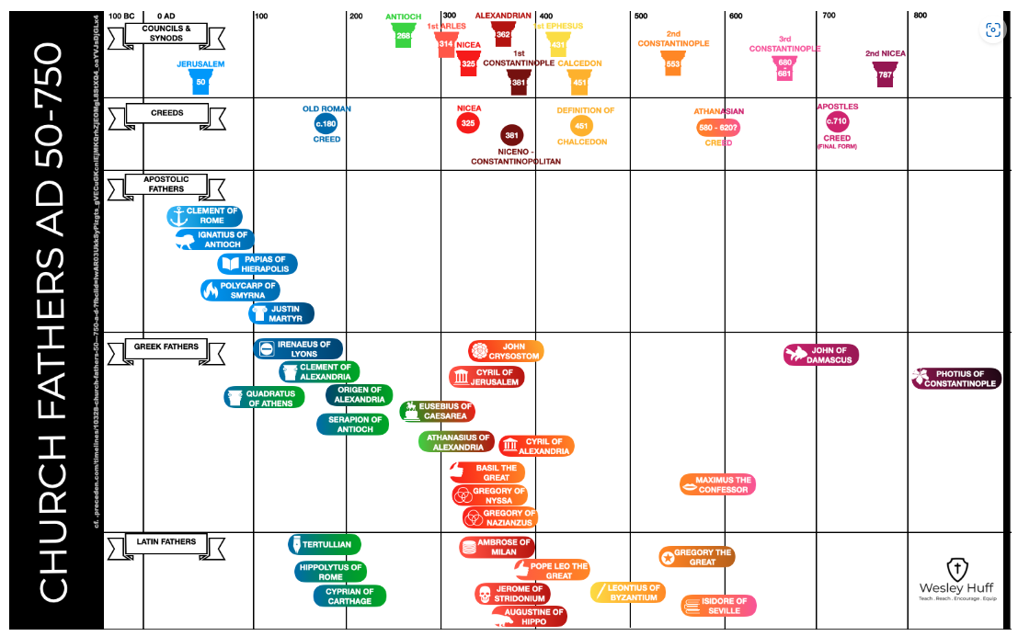
https://www.wesleyhuff.com/infographics

Slide 53
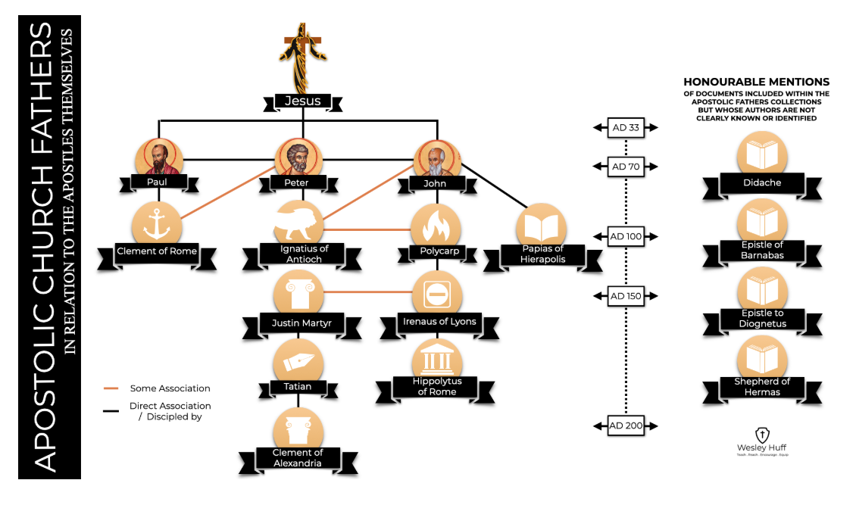
https://www.wesleyhuff.com/infographics

Slide 54
Household of faith (McGrath p/ 25). Early church was not well organized. (Bray p. 43-45)
  Episopos (bishop)- domestic supervisor. Greek word for “overseer.” (Geisler P. 111) Strongs 1985) Acts 20:28; Phil. 1:1; 1 Tim. 3:2; Titus 1:7; 1 Peter 2:25
  Diakonos (deacon) –a servant. (strongs 1249) 1 Tim 3:8-11; No authority or limited authority. Pheobe deaconess (Rom 16:1).
  Presbyteros (elder) – senior member of a household. Jewish term for overseer. (Strongs 4245) Acts 15:6
  Pastors or shepherd is poimén (strongs 4166) Eph 4:11. Feeding the flock (1 Pet. 5:1; Acts 20:28).
  Priest is the Greek word hiereus (strongs 2409). Rev: 1:6
  High priest archierea (strongs 749) Heb 4:15
  Evangelist -2 Tim. 4:5). Special gift (Acts 21:8; cf. 8:4-8; 26-40).

Slide 55
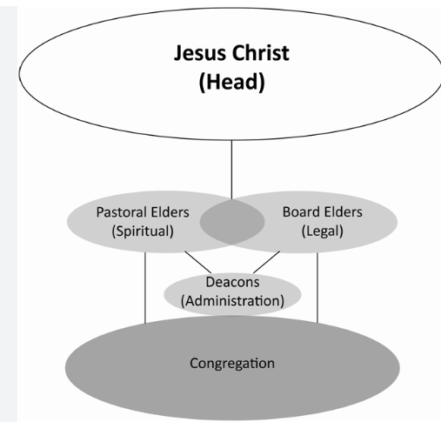
Structure
  Episopos (bishop/overseer)-Greek term for overseer
  Diakonos (deacon) –a servant
  Presbyteros-Greek- (elder/pastor) – older or senior member of a household. Jewish term for overseer. An office not a gift.
  Pastoring-a gift. Some elders are pastors and some are not. Pastor/elder feed the flock (1 Pet 5:1; Acts 20:28;2 Tim. 4:2-3; Eph. 4:12-13)
Bishop and elder often used interchangeably in the New Testament
Presbyters first called priests by Lucian 2nd c.
Celibacy of priests declared A.D. 1079

Slide 56
Example - Modern Structure
  Checks and balances
  Elders oversee Lead Pastor
  Lead Pastor oversees paid church staff.
  Congregation (members only) vote on Elders (yearly)
Note: Deacons are appointed by the Elder Board. Essentially, Deacon are a volunteer but given some extra duties. For example, a Deacon is allowed to baptize people and help with membership interviews. They are appointed as a Deacon after being faithful in taking care of increasing levels of responsibilities and meet the qualifications outlined in 1 Timothy 3:8-13. A Church can have deaconess’ as well but they do not do baptism interviews. However, they may lead a ministry such as greeting or children’s ministry.

Slide 57
New Testament:
Elder and bishop seem to be used interchangeably in NT (Greek vs Jewish term-Acts 20:17,28; Phil. 1:1;Titus 1:5,7)). Qualification (1 Tim. 2:12; 3:1-7; Titus 1:5-9; 1 Cor. 14:34)
Deacons – Acts 6:1-6 can be younger in faith. Assist elders. Social and physical ministries. (Romans 16:1-worker/Deacon).
Apostleship was a gift, elder was an office. All apostles were elders but not all elders were apostles.
Pastoring is a gift and elder is an office. Not all elders are pastors. Elders are
teachers(1 Tim. 3:2). Churches had elders who pastored/preached/taught. No “lead Pastor.”
5) Pastor (poimen) is not used for church officers. The verb “poimaino) is to shepherd is used (Acts 20:28; 1 Pet. 5:2; Eph 4:11)). They are Elders with a gift to shepherd the flock.
Jesus is called the chief shepherd/pastor (archipoimen) in 1 Pet. 5:4.
6) Acts 14:23- Elders appointed.
7) The congregation exercised church discipline and chose deacons. It seemed that elders
guided but did not rule. The congregation did.
Notes:
Grudem. P. 1124. and Geisler P. 122,

Slide 58
Catholic View
-Peter was the first Pope
-Peter’s name appears first in various lists of the Apostles
-Jesus called Peter the “rock” upon whom the church would be
built (Matthew 16:18). They assert Matthew was first written in Aramaic and uses Aramaic terms for “rock.”
-Jesus gave Peter the “keys of the kingdom” (Matthew 16:19).
Jesus placed Peter in authority over the church saying
“feed my sheep” (John 21:15-17).
-Jesus prayed that Peter’s faith would not fail, ensuring
Peter’s infallibility (Luke 22:31-32).

Slide 59
Biblical View
-No apostle attained a supreme position in New Testament times
-No New Testament epistle teaches that Peter became Pope.
-Paul affirmed he was not inferior to any other apostles
(including Peter). Gal 2:9
-The history of the early church in the Book of Acts argues against the existence of a papacy
-Peter was not infallible
-Peters name on a list may show importance, but not papacy.
-We have no evidence Peter was bishop of Rome. He was over
churches in Turkey. Paul and Peter set up many churches and were
never called bishop over them. Paul arrived in Rome and it was already
founded. No mention of Peter in his letter.

Slide 60
Biblical View
-The “rock” is not Peter, but rather his confession of faith that
Jesus is the Christ
-The keys to the kingdom relate to his privilege to preach the gospel
-Jesus’s prayer that Peters faith would not fail relates to Peter’s restoration following his denial (Luke 22:31-32)
Jesus instruction to “feed my sheep” was given to bring him back up to the other apostles level (Cyril of Alexandria (370-444AD).
Peter may not have ended up in Rome.
If Priests and Pope are high offices, why is there no mention of them in the New Testament?
- Luke 22:24- they debated who was greater and Jesus did not say Peter was.

Slide 61
Biblical View
-We have no copy of Matthew in Aramaic and the Church used
the Greek as canon and never modified the words to fit what the
RCC says the Aramaic meant.

Slide 62
History
By 590 AD the bishop in the Rome(west) was the leader(Gregory the 1st). Eastern church didn’t like that. He refused the Papal title:
“I confidently say that whoever calls himself or desires to call himself universal priest is in his elation the precursor to the antichrist because he proudly places himself above all others”
However, he functioned like he had power.
Notes:
Bray – P. 34.

Slide 63
History
-Cyprian (c 250AD) referred to Matthew 16:18 in the episcopal ordering of the church but did not connect Rome with a primacy.
-First council of Nicaea decided for jurisdictional (i.e. discipline) the 3 largest cities (Rome, Alexandria, and Antioch) in that order should enjoy precedence.
-When Constantine moved capital to Byzantium (future Constantinople) in 330, the power shifted to the east. Constantinople was placed in order under Rome which pushed Alexandria to position #3.
-Between 632-641 Alexandria, Antioch, and Jerusalem fell to Muslims.
Notes:
Bray P. 99.

Slide 64
History
-As the capital of the empire, Rome was always a place of prominence.
-Rome’s bishop was not the primary arbiter in the beginning. Not one ancient council summoned to resolve doctrinal conflicts occurred in Rome nor were its Bishops present at them.
Council of Chalcedon had a message read to the group from Bishop of Rome (Leo I) but they evaluated based on his arguments, not his position.
Notes:
Bray – P. 34.

Slide 65
History
-Rome clung to its claim that Peter was martyred in Rome and the east felt Rome overstepped its authority which caused a schism and Christians should seek guidance from Constantinople.
-Rome became more detached from the empire
Notes:
Bray P. 99.

Slide 66
Luke 22:24-30 – The Disciples are asking who would be the
greatest. This would have been the time where Jesus could have
recognized Peter but He did not.
1 Peter 5:1-2- Peter calls himself a “fellow elder” not a Pope.
Paul wrote Romans around AD 55-57 and no where mentions
Peter as being in the city. In 2 Tim. 4:16 Paul even says everyone had
abandoned him. If Peter were in Rome that would not make sense.
Paul said he was equal to the apostles (2 Cor. 12:11).

Slide 67
In all of Paul’s letters we see references to Apostles, bishops, deacons,
elders, etc. but no reference to the highest position of Pope.
Paul says he is the one with “daily pressure of concern for all the
churches” (2 Cor. 11:28).
Paul was to preach to the gentiles and Peter to the Jews (Gal. 2:7 )
and Paul opposed Peter to his face (Gal. 2:11).
Acts 15 it was James who directs the proceedings and stood and
gave final decision, not Peter.

Slide 68
Infallible Pope and Magisterium?
Catholic View
Catholic Pope is seen as the Vicar of Christ who acts for and in place of
Christ. A substitute or agent. Bishops are viewed as successors of Christ’s
apostles.
The gates of Hades (Matthew 16:18) will not overpower the church means
that there is a continuous apostolic successor of authority on earth
through bishops. The church is interpreted as Roman Catholic church.
Matthew 28:20- Christ promises to be with them means to Catholics that
there is a line of succession.

Slide 69
Matthew 16:13-20
“Now when Jesus came into the region of Caesarea Philippi, He was asking His disciples, “Who do people say that the Son of Man is?” And they said, “Some say John the Baptist; and others, Elijah; and still others, Jeremiah, or one of the other prophets.” He said to them, “But who do you yourselves say that I am?” Simon Peter answered, “You are the Christ, the Son of the living God.” And Jesus said to him, “Blessed are you, Simon Barjona, because flesh and blood did not reveal this to you, but My Father who is in heaven. And I also say to you that you are Peter, and upon this rock I will build My church; and the gates of Hades will not overpower it. I will give you the keys of the kingdom of heaven; and whatever you bind on earth shall have been bound in heaven, and whatever you loose on earth shall have been loosed in heaven.” Then He gave the disciples strict orders that they were to tell no one that He was the Christ.”
The church means all the believers. they will prevail in the end. It did not mean there would not be
disagreements or need for reforms. It meant in the end, we win.
Source: https://www.youtube.com/watch?v=qq1DTLsdloM

Slide 70
Biblical Response
Matthew 16:18 – the gates of Hades does not overpower the church
because of the divine power of Christ, not an apostolic succession.
It is Christ who owns the Church because He purchased it with
His blood (Acts 20:28) and since He owns it, He protects it. He is
called the head of the Church (Eph. 5:23) and it is His prerogatives
to protect it, not finite humans.
Since the gates of Hades/death are also mentioned in Job 38:17 & Psalm 9:13,
some scholars say that Jesus may just have been referring to His own
death would not stand in the way of His work building the Church
or any kind of death to Christians would get in the way. He would
become the head of the church (Eph 5:23) and build it through the ages.

Slide 71
Scripture View
Peter in 1 Peter 2:4 explained the rock upon which the Christian church is built: “Coming to Him as to a living stone, rejected indeed by men, but chosen by God and precious, you also, as living stones, are being built up a spiritual house, a holy priesthood, to offer up spiritual sacrifices acceptable to God through Jesus Christ.”
Jesus was a “Melchizedek” once for all(Heb. 7:3) without successors High Priest while
believers are a believer priesthood. There was no office of priest in the New Testament.
The Roman priest which can work miracle of transubstantiation is no where is Scripture.

Slide 72
1Cor 10:4 “and drank the same spiritual drink; for they drank from the spiritual rock that accompanied them, and that rock was Christ.”
Peter was a leading apostle of the early New Testament Church of God for many years, but not its chief cornerstone—that was, and is, Jesus Christ (Ephesians 2:20):
“built on the foundation of the apostles and prophets, with Christ Jesus himself as the chief cornerstone.”

Slide 73
The “rock” is not Peter but rather his confession of faith that Jesus is the Christ (Matthew 16:13-20). Peter also gives a similar declaration in John 6:68-69 where he tells Jesus that He has the words of eternal life and that Jesus is the Holy One of God.
Jesus is talking about himself and his church not the identity of Peter. Jesus goes on to tell them not to reveal his identity that He is the Christ.
Jesus does not say “Upon you, Peter, I will build my church.” Instead, he makes a distinction between Peter (Petros) and the demonstrative pronoun preceding (petra-rock), the confession of faith, on which the Church is built.
Notes:
James R. White, Roman Catholic Controversy, chapter 8.

Slide 74
Jesus gave Peter “the keys of the kingdom of heaven,” not the keys to heaven. A key was a badge of authority/knowledge ( Luke 11:52 ), and then as now was used to open doors. Peter used the keys Christ gave him to open the door to the Jews on the Day of Pentecost ( Acts 2 ), to the Samaritans after the preaching of Philip ( Acts 8:14-17 ), and to the Gentiles after the Lord had sent him a vision and an appeal from Cornelius ( Acts 10 ).
Jesus is source of life. The Keys are Gospel or eternal life

Slide 75
Infallible Pope and Magisterium?
Catholic View
Pope’s and Magisterium are infallible when speaking ex cathedra
(Pope) or with one voice (bishops in Magisterium-teaching body
of the church).

Slide 76
Biblical Response
Paul and the other Apostles did not think they were infallible.
Paul warned that even if an angel that preached another Gospel
that angel is to be accursed. (Gal. 1:8).
Paul was tested to Scripture in Acts 17:1.
Only Scripture is God-breathed (2 Tim. 3:16; John 10:35)
History shows Popes have errored, there have been more than one
Pope, up to 35 antipopes, they have committed atrocities, they have
contradicted each other, etc.

Slide 77
Biblical Response
There were no successors. The apostles were hand picked and
given sign gifts (2 Cor. 12:12; Matt. 10:8; John 9:1-7; Acts 16:16-18;
Acts 5:1-11).
The authority of apostolic writings has replaced the authority
of the first-century apostolic writers.
The faith was handed down “once for all” (Jude 3).
The church was built on the foundation of the apostles (Eph. 2:20).
Once a foundation is built, no further foundation is needed.
Notes:
Rhodes chapter 4

Slide 78
Biblical Response
We do not subject ourselves to an organization (the Magisterium).
We subject ourselves to Scripture. That is what we are held
accountable to.
1 Thess. 5:21- “but examine everything; hold firmly to that which
is good,”
1 John 4:1 -Beloved, do not believe every spirit, but test the spirits
to see whether they are from God, because many false prophets
have gone out into the world.
Matthew 28:20- I will be with you always- this says nothing about apostle succussion. In verse 19 Jesus says to
make disciples of all nations and v (2) Jesus will be with them.

Slide 79
Biblical Response
Holy Spirit is our guide. This does not mean every verses and every doctrine
in the Bible is equally clear. The main verses and main doctrines are clear.
The plain things are the main things. Close to 200 references in the
New Testament regarding salvation comes from faith in Christ alone is an
example.
The Magisterium teaching on Mary, tradition, and justification have been
interpreted differently by Magisterium’s through the years so even the
Magisterium teachings need interpretation. They have had disunity in the past.
The Holy Spirit has gifted the church with Pastors and teachers.

Slide 80
Sedevacantism is derived from the Latin phrase sede vacante, which means "the chair [of the Bishop of Rome] being vacant".
It is a traditionalist Catholic movement which holds that since the 1958 death of Pius XII the occupiers of the Holy See are not valid popes due to their espousal of one or more heresies and that, for lack of a valid pope, the See of Rome is vacant. Sedevacantism owes its origins to the rejection of the theological and disciplinary changes implemented following the Second Vatican Council (1962–1965).
Sedevacantists, however, claim that the infallible Magisterium of the Catholic Church could not have decreed the changes made in the name of the Second Vatican Council, and conclude those who issued these changes could not have been acting with the authority of the Catholic Church. Accordingly, they hold that Pope John XXIII and his successors have left the true Catholic Church and thus lost legitimate authority. A notorious heretic, they say, cannot be the Catholic pope

Slide 81
Questions:
If Peter was supreme, why did the disciples continue to debate among themselves who would be the greatest (Luke 22:24-30)?
Why did Paul say he was not inferior to any other apostles if Peter was supreme(2 Cor. 12:11)?
Why is Paul the prominent figure in Acts 13-28?
Why did God not include the papacy in the structure of the church in 1 Cor. 12:28?
If Peter was supreme, why was he sent by others instead of being the one who sends people in Acts 8:14?
If Peter was supreme, why was James the dominant person at the Jerusalem council in Acts 15:13-35?
If Peter was supreme, why did Paul correct him “to his face” in Gal. 2:11-14?
If Peter was in Rome, why didn’t Paul include him in his greeting to the Romans (Rom. 1:7; 16:1-16)?
Why didn’t Peter visit Paul when Paul was in prison in Rome?
Source: Reasoning from the Scriptures with Catholics, Ron Rhodes

Slide 82
Questions:
If Popes are infallible, why was Pope Honorius I (AD 625-638) condemned for teaching heresy by the sixth General Council?
There are different sects within Catholicism that disagree with one another. How can there be an infallible teaching Magisterium when these groups interpret in different ways? (Jesuits, Franciscans, Dominicans).
Why is Peter just called a “fellow elder” (1 Pet. 5:1).
Why did Paul write more letters than Peter?
All the apostles are the foundation of the church and the only unique one was Christ as the chief cornerstone (1 Pet 2:7)
How do you interpret 1 Cor. 3:11 regarding who is the foundation?
Since Christ himself built the church (Matt. 16:18), purchased it with his blood (Acts 20:28), and is the head over the church (Eph. 5:23), do you think he protects the ecclesia/church or apostolic successors?
Source: Reasoning from the Scriptures with Catholics, Ron Rhodes

Slide 83
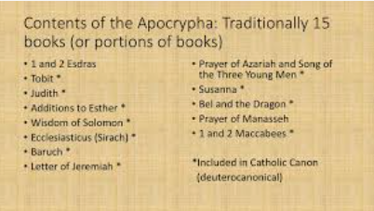
Week 4
Apocrypha
Apocryphal books are added to the Bible by the Council of Trent A.D. 1546

Slide 84
Resources
Wes Huff (8min): https://www.youtube.com/watch?v=7umE5uqpxPs
Wes Huff (1hr) https://www.youtube.com/watch?v=rjyuyfJPkzY
https://carm.org/roman-catholicism/reasons-why-the-apocrypha-does-not-belong-in-the-bible/
Gavin Ortlund-Canon https://www.youtube.com/watch?v=hwfq4r4yi6M&t=1s

Slide 85
The Biblical apocrypha (from Ancient Greek ἀπόκρυφος (apókruphos) 'hidden') denotes the collection of ancient books, some of which are believed by some to be apocryphal, thought to have been written some time between 200 BC and 100 AD. The Catholic, Eastern Orthodox and Oriental Orthodox churches include some or all of the same texts within the body of their version of the Old Testament, with Catholics terming them deuterocanonical books.
Traditional Protestant Bibles deem these useful for instruction, but non-canonical.

Slide 86
Catholic View
-Fourth century Septuagint contains the Apocrypha
-Some church fathers accepted them
-Early church catacombs scenes portray episodes from them
-Some apocryphal books were found at Qumran along with
-Old Testament canonical book
-Catholic church determines the
canon

Slide 87
Biblical View
-Many church fathers denied the Apocrypha
(those most familiar with Hebrew like Jerome and Athanasius)
-Jews were given authority for the Old Testament and they rejected
the books (Romans 3:1-2).
-The Apocrypha contain errors and contradictory teaching on
creation, sin atonement, worship and prayers to the dead,
purgatory, etc.
-May not have been in the earliest Septuagint

Slide 88
Biblical View
Jews were given authority by God to write Old Testament Scriptures:
"Then what advantage has the Jew?
Or what is the benefit of circumcision?
Great in every respect.
First of all, that they were
entrusted with the oracles of God," (Rom. 3:1-2).
Apostles and New testament writers were given the authority to write New Testament Scriptures. The Church recognized the Old Testament from the Jews and the New Testament by the authority of the writers. The Jews never accepted the apocrypha so the Church should never accept them.

Slide 89
Apocrypha (Greek for hidden/hard to understand)
Old testament
-No clear quotations from the Apocrypha (maybe allusions).
-Just like Paul quotes from pagan poets and philosopher (Acts 17:28; Titus 1:12; 1 Cor. 15:33) these are not cited as Scripture. They never use “thus saith the Lord” or “as it is written” like the canonical books are quoted.
Early Greek manuscripts that included these are from 4th century, but Jesus nor apostles ever quoted from them. Early Fathers acceptance is misleading. Some just used them for devotions or preaching but did not accept as canonical. Athanasius, Cyril of Jerusalem, Origen and Jerome all opposed the Apocrypha.
No Greek manuscript has same list of them

Slide 90
Local council approval did speak for entire church and approved different books.
Centuries before the books were rejected by Jews.
Augustine only accepted them because of “extreme and wonderful
suffering of certain martyrs.” Council of Trent officially added them and some early Protestant Bibles had them in a separate section. Dead sea scrolls had numerous books but no commentaries on the Apocrypha and they were not written on the special parchment with special script that OT was written on. Real canon was received immediately by people of God into the growing canon. Real canon had prophecy. Apocrypha was never cite as prophetic book by a book after it. No claims that they were written by a prophet, no supernatural confirmation, Jews recognized prophetic gifts ended before they were written. They were never listed with other Jewish books. Never quoted by Philo or listed by Josephus.

Slide 91
Septuagint
A collection of Greek translations more than a single unit. There were other Greek translations along with it.
Different people, different times, different purposes
Books translated over 3 centuries by different groups
Hebrew was original language of Old Testament. Masoretic scribes copied these for 1000+years.
Great Isaiah Scroll in Dead Sea scroll was Hebrew and showed there is no necessary reason to believe that just because a document has been translated for a long time that we should be skeptical that we have the originals. Very few minor differences. Jeremiah was different due to it being torn up.
-Most quotes in New Testament are from Septuagint.
Wes Huff-11min-https://www.youtube.com/watch?v=mOdIDAsmapQ
Apologia Radio podcast #509 first 30min.

Slide 92
Jesus referenced the Jewish Old Testament canon from the beginning to the end and did not include the Apocrypha in his reference. "From the blood of Abel to the blood of Zechariah, who perished between the altar and the house of God; yes, I tell you, it shall be charged against this generation," (Luke 11:51).
Note: Zechariah is the last martyr of which we read in the Old Testament according to Jewish canonical order

Slide 93
"Then what advantage has the Jew?
Or what is the benefit of circumcision?
Great in every respect.
First of all, that they were
entrusted with the oracles of God," (Rom. 3:1-2).
Paul tells us that the Jews were entrusted with the oracles of God. This means that they are the ones
who understood what inspired Scriptures were,
and they never accepted the Apocrypha.

Slide 94
Note that Jesus was scolding the Pharisees for putting man-made tradition over God-breathed Scripture (Matt 15: 3) and Paul referred them to Scripture to test what he was saying (Acts 17:11). That implies a functioning Old Testament scripture to test and correct.
1. The Intertestamental Jews confirmed it (in “Prologue” to Sirach, 132 B.C.).
2. The Qumran Community confirmed it (in the Manual of Discipline and manuscripts dated 250 B.C. to time of Christ) from all the books (except Esther).
3. Josephus confirmed all OT books by name (in Contra Apion, 1.8; and at Jamnia (ca 90AD)
4. Jesus and the apostles confirmed it by sections (Lk. 24:27; Mt. 5:17-18) & referenced almost all individual books. Apocrypha never cited as scripture.
5. “The law and the Prophets,” “The Law of Moses and the Prophets” was used during the exile, after the exile, during the intertestamental period, and during the NT times. They were read in Synagogues on the Sabbath (Acts 13:15; also Acts 24:14/ 26:22)
6. Referred to as “The whole counsel of God” (Acts 20:27).
Also see Luke 24:44 . The apocrypha authors do not claim to be a prophet.

Slide 95
The Bible produced the church, not the other way around.
The church recognized the canonical books based on the authority of the authors. The debates in the NT was just to confirm the authorship, not the doctrine. With the OT apocrypha, we know the authors were not inspired and their doctrines conflict and they did not have the authority to write inspired scripture and their lack of authority was confirmed by the Jews who never affirmed them.
The Holy Spirit was sent to guide the New Testament authors to write God-breathed Scripture.
The New Testament church is under a new covenant and was not given authority to reach back into
the Old Covenant with Isreal (Old Testament) and decide books the Jews already rejected and make them scripture.

Slide 96
The author of the apocryphal book Maccabees pointed out canon of OT was closed:
1 Macc 14:47
When Judas Maccabee retook the temple in 164 BC he and his fellow leaders removed the stones of a defiled altar “until a prophet should appear.”
1 Macc 9:27
A time of persecution and gamine after the death of Maccabee was identified as “worse than anything that had happened to them since the time when prophets ceased to appear.”

Slide 97
2 Macc. 15:37-39
This, then, is how matters turned out with Nicanor, and from that time the city has been in the possession of the Hebrews. So I will here end my story. If it is well told and to the point, that is what I myself desired; if it is poorly done and mediocre, that was the best I could do. For just as it is harmful to drink wine alone or, again, to drink water alone, while wine already mixed with water is delicious and enhances one’s enjoyment, so also the style of the story delights the ears of those who read the work. And here will be the end.
Notes:
https://carm.org/roman-catholicism/errors-in-the-apocrypha/

Slide 98
Majority opinion did not accept them. Pope Gregory the Great, Jerome, Cardinal Cajetan (who interviewed Luther) rejected apocrypha. Rome, in response to the Reformation, to the most shallow tradition, canonized them. That does not make them canon.
Early councils recognized that the books came from their nature, not because of the council making canon.
Notes:
Ron Rhodes10 things page 13.

Slide 99
Athanasius (c. 300’s) lists all the NT books and states "Let no one add to these nor take anything from them." He continuous that "there are other books outside these, which are not include in the canon...Wisdom of Solomon, Sirach, Judith and Tobit...but while the former are included in the canon and the latter are read in church no mention is made of the apocryphal works. They are inventions of heretics..."
Jerome (c. 400AD) also said "They are not in the canon properly speaking and they may not be used for establishment of doctrine..."
No book in the apocrypha was written by a true prophet or Apostle of God and no book was confirmed by a miracle. Never supported by church or the Fathers most familiar with Hebrew.
Good debate:
https://www.youtube.com/watch?v=AAoNfH1rFtE
Wes Huff ENOCH/Apocrypha part 1 1hour - https://www.youtube.com/watch?v=y7xgmzGuvfE
Part 2 - https://www.youtube.com/watch?v=svIrkeInPrQ

Slide 100
They had a two-tiered system. Some are for reading and some are for canon.
“Scripture is used by them very broadly. Not all scripture is canon,
but all canon is Scripture
Canon is a tighter category for the Fathers
“Scripture” is considered as a wider collection of written
documents that included the apocrypha and others that could be
read in church.
Some Father will say “as it is written…” and reference an apocryphal book
but in their same letter they will list the canon and not include the apocrypha.
https://www.youtube.com/watch?v=rpHUeTZjeuQ

Slide 101
Errors:
Judith 1- “It was the twelfth year* of the reign of Nebuchadnezzar, who ruled over the Assyrians in the great city of Nineveh. At that time Arphaxad was ruling over the Medes in Ecbatana”
- Problem is Nebuchadnezzar ruled over Babylon not Assyria, and Arphaxad was not the ruler.
V4 says gates were 150ft tall. That was more than any other city.
v5 Nebuchadnezzar never waged war on King Arphaxad in the vast plain that borders Ragau.*
Tobit 1:15 says Sennacherib was son of Shalmaneser but he was actually son of Sargon.
2 Macc. has chronological, historical and numerical discrepancies
Dr. Faulk (33min): https://www.youtube.com/watch?v=LBv7NW3CNqg

Slide 102
Errors:
Judith 1- Arioch, king of the Elamites,- Problem is Arioch was not king at this time.
V10- Rameses was abandon in 11th century.
V10-16- the actual king in 12th year lived 5 more years and was not killed. He died natural causes. This events did not happen.
Dr. Faulk (33min): https://www.youtube.com/watch?v=LBv7NW3CNqg

Slide 103
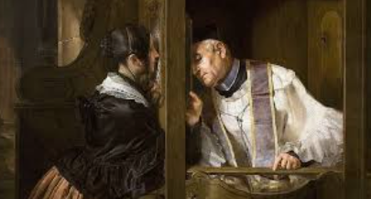
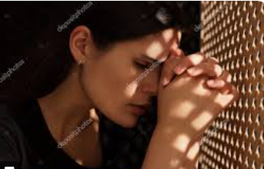
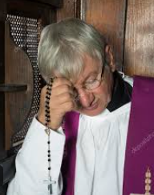
Week 5
Forgiveness of Sins by Priests

Slide 104
History
In the first few hundred centuries (i.e. the early Church), Christians publicly confessed their sins to the entire congregation or community. As Irenaeus confirmed “…Some of them, indeed, make a public confession of their sins...

Slide 105
History
Public confession must have been costly for the self-esteem and the social status of the confessor, at least temporarily. The willingness to bear that cost functioned as a costly signal of commitment

Slide 106
Catholic View – Historical
The public confession soon became impractical and appointed leaders (i.e. elders, 1 Corinthians 4:15) began hearing people's confessions privately. Priests believe that Christians could confess their sins directly to God, but a priest could also give advice and help a Christian heal by praying for them. As time went on the confessions became a requirement and eventually a sacrament. “…by the period of the fourth century a public penitential discipline administered by the bishops that led to reconciliation had developed on a widespread basis.”

Slide 107
Catholic View – Historical
Later writers, such as Origen (241), Cyprian (251), and Aphraates (337), are clear in saying confession is to be made to a priest
From Catholic site:
“by confessing to a priest, the Catholic learns a lesson in humility which is conveniently avoided when one confesses only through private prayer. Don’t we all desire to escape humbling experiences?”
https://en.wikipedia.org/wiki/Sacrament_of_Penance#:~:text=From%20%22as%20early%20as%20the,within%20a%20year%20of%20the

Slide 108
Didache 4:14; 14:1 (As early as 70 AD)
Confess your sins in church, and do not go up to your prayer with an evil conscience. This is the way of life…. On the Lord’s Day gather together, break bread, and give thanks, after confessing your transgressions so that your sacrifice may be pure.
Irenaeus (A.D. 180)
“…she spent her whole time in the exercise of public confession, weeping over and lamenting the defilement which she had received from this magician.”

Slide 109
Catholic View
-Venial sin is a lesser sin that is pardonable. It does not erase
grace from the soul.
-A mortal sin is deadly in the sense that it depletes the soul of
sanctifying grace.
-Through the sacrament of penance, grace is restored to the
participant’s soul.
Catholics use John 20:23; 2 Cor. 2:10 and Luke 13:3 to justify
their positions
More on this in week 7

Slide 110
Verses cited
John 20:23
"If you forgive the sins of any, their sins have been forgiven them; if you retain the sins of any, they have been retained."
2 Cor. 2:10
“But one whom you forgive anything, I also forgive; for indeed what I have forgiven, if I have forgiven anything, I did so for your sakes in the presence of Christ,”
Luke 13:4
“No, I tell you, but unless you repent, you will all likewise perish.”

Slide 111
James 5:16
“Therefore, confess your sins to one another, and pray for one another so that you may be healed. A prayer of a righteous person, when it is brought about, can accomplish much.”

Slide 112
Catholic View
Priests assigns penance for the satisfaction for sin:
“The voluntary enduring of the penalty imposed by the confessor
in order to compensate for the injury done to God and to redeem
or atone for the temporal punishment which is ordinarily due
even after sin has been forgiven.” - Manual of Dogmatic theology

Slide 113
Roman Catholicism teaches that though only God can forgive sins, He has willed to do so through the Church (CCC 1441-1445). Consequently, in the Sacrament of penance it is the responsibility of the priest to judge the sinner. The priest will ask a series of questions to measure the sinners guilt and then based on this information, the priest decided whether or not to pardon the sinner
Catechism 1422
"Those who approach the sacrament of Penance obtain pardon from God's mercy for the offense committed against him, and are, at the same time, reconciled with the Church which they have wounded by their sins and which by charity, by example, and by prayer labors for their conversion."
Catechism 1424
It is called the sacrament of confession, since the disclosure or confession of sins to a priest is an essential element of this sacrament. In a profound sense it is also a "confession" - acknowledgment and praise - of the holiness of God and of his mercy toward sinful man. It is called the sacrament of forgiveness, since by the priest's sacramental absolution God grants the penitent "pardon and peace. It is called the sacrament of Reconciliation, because it imparts to the sinner the live of God who reconciles: "Be reconciled to God." He who lives by God's merciful love is ready to respond to the Lord's call: "Go; first be reconciled to your brother.

Slide 114
Biblical View
-The Bible makes no distinction between venial and mortal sins.
There are some sins worse than others (Proverbs 6:16-19), but all
sin is deadly (Romans 3:23; 6:23; 7:13).
-1 John 5:16- “sin that leads to death” is not referring to venial sin.
This is referring to a sin that can lead to premature physical death.
Acts 5:1-11 & 1 Cor. 11:30 are examples of being judged early.
All sin results in spiritual death, but some lead to early physical
death

Slide 115
Bible View
When God forgives, He forgives all. Not a spot remains.
Isaiah 1:18
“…Though your sins are as scarlet, They will be as white as snow;
Though they are red like crimson, They will be like wool.
Christ made perfect and complete satisfaction
“He Himself is the propitiation for our sins” (1 John 2:2).

Slide 116
Biblical View
-The Bible says we are to confess our sins to God (1 John 1:9).
Psalm 32:5
“I acknowledged my sin to You, And I did not hide my guilt;
I said, “I will confess my wrongdoings to the LORD”;
And You forgave the guilt of my sin.”
Also Nehemiah 1:4-11; Daniel 9:3-19; Ezra 9:5-10.
We do not need a mediator but can approach God with confidence
– Hebrews 4:16

Slide 117
Biblical View
-James 5:16 – this passage is regarding Christians who are seeking
reconciliation with each other, not God. Once reconciled, a
Christian can pray more intelligently for each other.
-John 20:23- The tense of the verbs is actually saying they are
proclaiming what heaven has already proclaimed regarding
forgiveness. See Luke 24:46-48: “…repentance and forgiveness of
sins should be proclaimed in His name to all the nations…”
-They were given authority to declare what God does in regard to
salvation.
https://www.gotquestions.org/John-20-23.html

Slide 118
The concept of “binding and loosing” found in Matthew 16:19 and Matthew 18:18 was commonly used idiom among the Jewish people in relation to the authority of the rabbis to forbid and permit certain practices. Jesus gave Peter and the other apostles authority over both the doctrine and practices of the first-century church. Through the leading of the Holy Spirit, they would be given wisdom to know what to forbid and what to permit.

Slide 119
-Binding (to prohibit) and Loosing (to allow):
Examples of this was during the Jerusalem council in Acts 15.
They were debating the topic of circumcision and foods sacrificed
to idols and decided what to prohibit and what was allowed. They
made application for the New testament church for these are topics
that were already in the Old Testament.
Binding and loosing was not a blank check to create alternate
theologies like praying to the dead, Mary, Purgatory, indulgences,
Popes, infallibility etc. Jesus gave same authority to other apostles
binding and loosing (Matt 18:18), not just Peter.

Slide 120
Only God and His son Jesus Christ have this power to forgive sins
Mark 2:7:
“ “Why does this fellow talk like that? He’s blaspheming! Who can forgive sins but God alone?”
Mark 2:10: “ But I want you to know that the Son of Man has authority on earth to forgive sins.”
There is not a single example in the Book of Acts of an apostle
forgiving someone of his or her sins

Slide 121
Only God and His son Jesus Christ have this power to forgive sins:
Luke 7:48-49:
“ Then He said to her, “Your sins have been forgiven.” Those who were reclining at the table with Him began to say to themselves, “Who is this man who even forgives sins?”
Acts 5:31
He is the one whom God exalted to His right hand as a Prince and a Savior, to grant repentance to Israel, and forgiveness of sins

Slide 122
Only God and His son Jesus Christ have this power to forgive sins:
Acts 10:43; 13:38; 26:18 all show belief in Jesus results in forgiveness of sins.
All early believers proclaimed the gospel by which sins are forgiven (Romans 1:16; 1 Cor. 15:1-4).
2 Cor. 2:10 is dealing with a discipline issue in the church of Corinth where a person received church discipline. The person repented and was restored. Paul was forgiving a personal offense directed at him. He already forgave the man and wanted Corinth to restore fellowship.

Slide 123
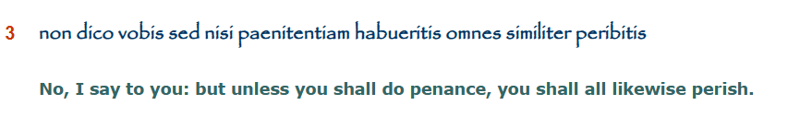
Only God and His son Jesus Christ have this power to forgive sins:
Luke 13:3
No, I tell you, but unless you repent[metanoe], you will all likewise perish.
The Greek word “metanoe” is to repent (inward psychological attitude). Latin Vulgate mistranslated this to “penance (outward practice).”
Latin Vulgate:
Notes:
theology reader p, 97

Slide 124
Atonement brought forgiveness of sins according to the Old Testament by a priest making sacrifices. But the Old Testament system is not in effect today in this regard because Christ has come and offered a single and eternal sacrifice (Heb. 10:10-11). The OT priests were not able to cleanse us via their animal sacrifices (Heb. 10:4). Their sacrifices were a representation of the one true sacrifice of Christ (Heb. 8:3-5). Since we now have that one and true sacrifice, we don’t need to do anything to make atonement for our sins since atonement was made by Jesus on the cross.
The New Testament teaches that it is Christ alone who makes the atonement by which our sins are removed:
“And He Himself bore our sins in His body on the cross, that we might die to sin and live to righteousness; for by
His wounds you were healed,” (1 Pet. 2:24).
“When He had made purification of sins…” (Heb. 1:3).
“Therefore, He had to be made like His brethren in all things, that He might become a merciful and faithful high priest
in things pertaining to God, to make propitiation for the sins of the people,” (Heb. 2:17).
“By this will we have been sanctified through the offering of the body of Jesus Christ once for all, 11 And every priest stands daily ministering and offering time after time the same sacrifices, which can never take away sins; 12 but He, having offered one sacrifice for sins for all time, sat down at the right hand of God,” (Heb. 10:10-12).
https://carm.org/roman-catholicism/penance-and-catholicism/

Slide 125
One of the greatest problems of this Roman Catholic system of confession is that it takes from God the greatest glory due him alone, and his sole right to forgive, purchased through the death of his Son.

Slide 126
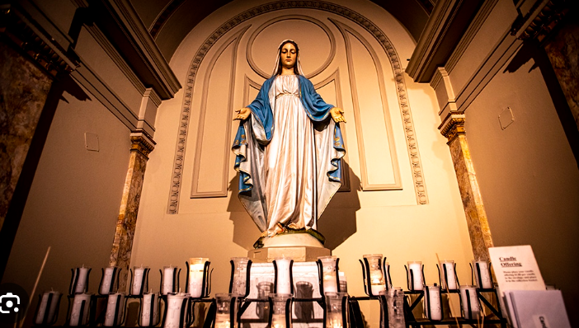
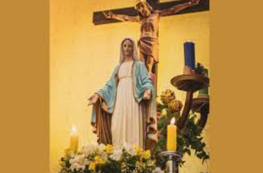
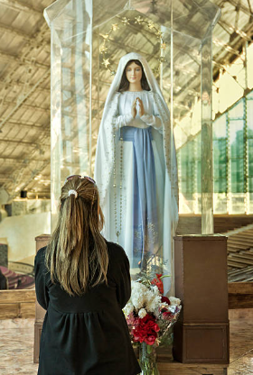
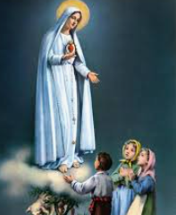
Week 6
Mary & Praying to the Dead
Veneration of angels, dead saints, and images A.D. 375
Prayers offered to Mary (250AD), dead saints and angels A.D. 600
Veneration of cross, images, relics authorized A.D. 786

Slide 127
Catholic Teaching
CC 966 "Finally the Immaculate Virgin, preserved free from all stain of original sin, when the course of her earthly life
was finished, was taken up body and soul into heavenly glory, and exalted by the Lord as Queen over all things, so that
she might be the more fully conformed to her Son, the Lord of lords and conqueror of sin and death."⁵⁰⁸ The
Assumption of the Blessed Virgin is a singular participation in her Son's Resurrection and an anticipation of the
resurrection of other Christians: In giving birth you kept your virginity; in your Dormition you did not leave the world,
O Mother of God, but were joined to the source of Life. You conceived the living God and, by your prayers, will
deliver our souls from death
CC 969 "This motherhood of Mary in the order of grace continues uninterruptedly from the consent which she
loyally gave at the Annunciation and which she sustained without wavering beneath the cross, until the eternal
fulfillment of all the elect. Taken up to heaven she did not lay aside this saving office but by her manifold intercession continues to bring us the gifts of eternal salvation . . . .
Therefore the Blessed Virgin is invoked in the Church under the titles of Advocate, Helper, Benefactress, and Mediatrix.“
Many later teachings are based on the Gospel of James (protoevangelium of James) which was a forgery and was condemned by Pope Innocent I and rejected in the Gelasian decree. Mike Winger video: https://www.youtube.com/watch?v=RHID4RtB3io

Slide 128
Catholic Teaching
-Mary was immaculately conceived, and was thereby preserved
from original sin.
-Mary perpetually remained a virgin, never engaging in sexual
relations with Joseph.
-Mary is the Mother of God, “the Ark of the Covenant”
-Mary is co-redeemer and mediatrix
-Mary was bodily assumed into heaven following her earthly life
-Mary is venerated by Catholics worldwide
-In many ways she becomes a female counterpart to Jesus

Slide 129
Catholic Teaching
Mary is the “Mother of God.” This was part of the
Chalcedon creed (AD451).
Mary was bodily assumed into heaven following her earthly life
Sub Tuum Praesidium
“We fly to thy patronage, O holy Mother of God; despise not our petitions in our necessities, but deliver us always from all dangers, O glorious and blessed Virgin. Amen.”
Sub Tuum Praesidium is probably the oldest known prayer to Mary, from around 250AD. The earliest Greek text was found in a third century Coptic Orthodox Christmas liturgy. The English version of the prayer can also start ‘Under thy protection…’.

Slide 130
Bible Teaching
Mary was a humble bondservant of God (Luke 1:38)
Mary was not immaculately conceived and had a sin nature
Mary was not a perpetual virgin. Catholics will say the reformers
believed this but in fact the reformers didn’t address this and
regardless, the Bible does not teach it so it does not matter if
it was removed by later reformers.
Mother of God – She is the mother of the person of the Son in
his human nature.

Slide 131
Bible Teaching
Very little is mentioned about Mary in the Bible
Jesus called her “woman” on several occasions (John 2:1-4; 19:26)
instead of “Mother”.
Mary was a sinner who needed a savior (Luke 1:47; 2:22-24). Also
Romans 5:12; 3:23 says all are sinners and did not exclude Mary.
Luke 18:19 says only God is good.
Mary is not a co-redeemer or mediatrix
Luke 1:28- “full of grace” (Catholic Bible) is actually translated
“favored one” in original Greek.

Slide 132
Bible Teaching
Matthew 1:25- Mary was a virgin UNTIL she gave birth to Jesus.
She was not perpetual virgin.
Matthew 13:55-56- The people in Jesus's hometown make reference
to Mary and Jesus’s brothers and sisters. Catholics have tried to say
they meant cousins but the word cousin (anepsios) was not used.
Cousin/anepsios is used in Col. 4:10 so they were aware of the word.
Messianic Psalm 69:8 says “I have become estranged from
my brothers and alien to my mothers sons.” This does not fit
with “cousins”.

Slide 133
Matthew 12:48-50
While He was still speaking to the crowds, behold, His mother and brothers were standing outside, seeking to speak to Him. Someone said to Him, “Behold, Your mother and Your brothers are standing outside seeking to speak to You.” But Jesus answered the one who was telling Him and said, “Who is My mother and who are My brothers?” And stretching out His hand toward His disciples, He said, “Behold My mother and My brothers! “For whoever does the will of My Father who is in heaven, he is My brother and sister and mother.”
Does that make sense if you switch the word “brother” with “cousin”
especially when combined with “sister?”

Slide 134
Bible Teaching
Mary is not co-redeemer or mediatrix. There is only one mediator –
Jesus (1 Tim. 2:5).
Mary did not offer Jesus to the Father as Catholics claim. It was
Christ who “offered Himself without blemish to God” (Heb. 9:14).
Only God is the Savior (Is 43:11) and Jesus is God so Jesus can be
the savior (Titus 2:13-14) who alone “we have redemption, the
forgiveness of sins” (Col. 1:14).
Jesus alone was sinless and the spotless lamb (Heb. 4:15; 2 Cor. 5:21;
1 Pet. 1:19). Jesus alone is God and man.

Slide 135
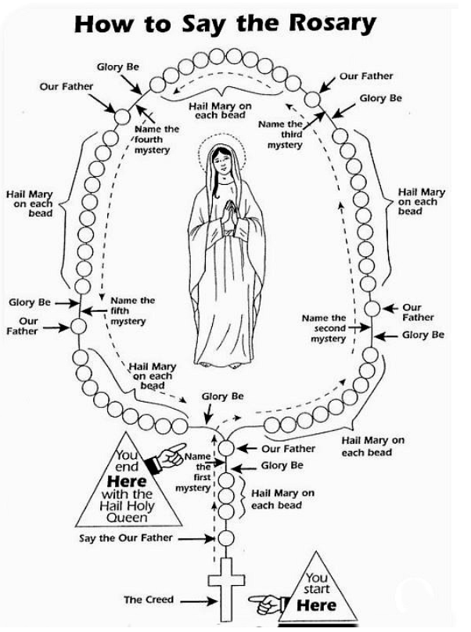
Luther changed his views on Mary later in life as he developed a biblical hermeneutic - https://www.aomin.org/aoblog/roman-catholicism/martin-luther-believed-in-devotion-to-mary/
Rosary- repetitious prayers
Bible Matthew 6:7- And when you are
praying, do not use meaningless repetition
as the Gentiles do, for they suppose that
they will be heard for many words.”

Slide 136
Prayers to the Dead
There is nothing in the Bible to pray to the dead for intercession. The Bible is clear about prayer for brethren while on earth since God can use them on earth to help. The dead COULD still pray for those on earth but we are never told to pray to them. We pray TO God FOR people. That is the formula in the Bible.
Catholic Bible support is found in the apocrypha: 2 Mac. 12:38-45; Wisdom 3:1;Tobit 4:17

Slide 137
Prayers to the Dead
God is omnipresent—everywhere at once—and is capable of hearing every prayer in the world. A human being, on the other hand, does not possess this attribute. Also, God is the only one with the power to answer prayer.
In order for a dead person to receive prayers, the dead individual has to hear the prayer, possess the power to answer it, and know how to answer it in a way that is best for the individual praying. Only God hears and answers prayer because of His perfect essence and because of what some theologians call His “immanence.” Immanence is the quality of God that causes Him to be directly involved with the affairs of mankind (1 Timothy 6:14-15); this includes answering prayer.

Slide 138
Prayers to the Dead –Biblical Response
Praying to the dead is strictly forbidden in the Bible. Deuteronomy 18:11 tells us that anyone who “consults with the dead” is “detestable to the Lord.” The story of Saul consulting a medium to bring up the spirit of the dead Samuel resulted in his death “because he was unfaithful to the LORD; he did not keep the word of the LORD and even consulted a medium for guidance” (1 Samuel 28:1-25; 1 Chronicles 10:13-14).
Notes:
https://www.gotquestions.org/praying-to-the-dead.html

Slide 139
Prayers to the Dead- Biblical Response
Romans 15:30, 2 Corinthians 1:11, Ephesians 6:18-19, 1 Thessalonian 5:25, 2 Thessalonian 3:1-2- Paul is requesting prayer from living people, to God for himself while on earth. He is not asking them to pray to someone dead for intercession.
Isaiah 8:19-22, Leviticus 19:31, and Deuteronomy 18:11 say not to talk to the dead.
Notes:
https://www.gotquestions.org/praying-to-the-dead.html

Slide 140
Prayers to the Dead- Biblical Response
Rom 8:26-27
In the same way, the Spirit helps us in our weakness. We do not know what we ought to pray for, but the Spirit himself intercedes for us through wordless groans. And he who searches our hearts knows the mind of the Spirit, because the Spirit intercedes for God’s people in accordance with the will of God.
Notes:
https://www.gotquestions.org/praying-to-the-dead.html

Slide 141
Prayers to the Dead- Biblical Response
Heb 7:24-25 "but because Jesus lives forever, he has a permanent priesthood. Therefore, he is able to save completely those who come to God through him, because he always lives to intercede for them."
1 Timothy 2:5
For there is one God, and one mediator also between God and mankind, the man Christ Jesus,
Notes:
https://www.gotquestions.org/praying-to-the-dead.html

Slide 142
Prayers to the Dead- Evangelism
Ask: Can you find one example where Jesus or the NT authors pointed anyone to Mary or dead people?
Ask: are there any clear passages that allows us to communicate to the dead?
Notes:
https://www.gotquestions.org/praying-to-the-dead.html

Slide 143
Veneration of angels, dead saints, and images A.D. 375
Veneration vs adoration (God)? Exodus 20:4-6 says both are not to be given to icons (bow down-proskuneo nor serve-latreuo).
The ark was kept out if sight so to not venerate
In NT there is a new covenant and in Jesus we have the image (eikon) of the invisible God (Col. 1:15)

Slide 144
Veneration of angels, dead saints, and images A.D. 375
When Cornelius fell down and worshipped (proskuneo) Peter, Cornelius was told to get up. Same with what the angel told John in Rev. 19:10. Psalm 97:7 says “confounded be all they that serve (proskuneo) graven images.
Constantine’s sister wanted an image painted of Christ, Eusebius of Caesarea-letter to constantia AD313) quoted Ex 20 passage

Slide 145
Veneration of angels, dead saints, and images A.D. 375
The use of images to depict events in the Bible for instructional purposes is a valid use. When the laity was made up of illiterate members, images depicting the major narrative was a helpful tool. The symbol of a cross reminds us of the suffering Christ went through and worn on jewelry or on clothing can identify a person as a Christ follower. The magnificent architecture of the Sistine Chapel and other church architectural features are amazing to gaze upon and appreciate. But appreciation of the craftsmanship and beauty of the painting is not directly prayer to the object. The architecture and painting/image are not personified. It is when a person directs prayer toward the image and bows down or kneels in front of the image where icons become problematic

Slide 146
Veneration of angels, dead saints, and images A.D. 375- Bible Response
Having statues around the house of Biblical figures, past saints and angelic beings can easily stretch the appropriateness of images. At that point the images are not serving an educational purpose nor serve an architectural feature but rather are in violation of second commandment. They are personified as if they are what the person is directing their prayer to. They become good luck charms or things to add protection from bad spirits. There is no protection in these things Isaiah called “all futile,” “of no benefit,” and the creators and those that acquire them are “put to shame” (Isaiah 44:9-20

Slide 147
Veneration of angels, dead saints, and images A.D. 375- Bible Response
Roman Catholic devotion to Mary first crosses the line into idolatry, when misguided Catholics kneel before a statue of Mary, kiss her feet, and offer her heartfelt praise and petition, they give to a creature the devotion which belongs to God alone…God will have no other gods before Him, regardless of how inferior
Read Psalm 115
Notes:
James G. McCarthy, The Gospel According to Rome: Comparing Catholic Tradition and the Word of God (Eugene, Oregon: Harvest House Publishers, 1995), 223.

Slide 148
Veneration of angels, dead saints, and images A.D. 375- Bible Response
The Hebrew the word "worship" in Ex 20:5 is translated in the Greek Septuagint as avad/abad which both dulia and latria are translated in their verbal and substantival forms. They use the words interchangeably. The Latin Vulgate uses duleo (to serve) and latreuo (to worship) using the same term servio. In Gal 4:8 Paul is talking about former idolatry of the Galatians. They served (dulia) idols which by nature are no gods at all. Since they only served them and not worship (latria) did that get them off the hook? No!.
Septuagint = latreuseis = shall you serve. Avda means both serve and worship.
Hebrew interlinear shachah (7812-bow down), abad (5637-serve)
Notes:
James G. McCarthy, The Gospel According to Rome: Comparing Catholic Tradition and the Word of God (Eugene, Oregon: Harvest House Publishers, 1995), 223.

Slide 149
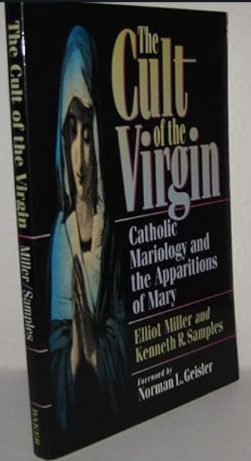
Mary Visions p. 1
Analysis and Comparison: Biblical and Modern Visions
After the resurrection, Paul records in 1 Corinthians 15:5-8 that Jesus appeared to the disciples, his brother James, Paul, and over 500 "brethren." During His ministry, Jesus spent time with these individuals, so they clearly knew His appearance and could easily recognize Him during the 40 days following His resurrection.
In contrast, we have no definitive idea of what Jesus, Mary, or the disciples looked like. There are no photographs, portraits, videos, or statues from that time to confirm their appearances. The only potential evidence would be the authenticity of the Shroud of Turin or a miraculous appearance of Jesus with unmistakable confirmation of His identity.
Book: https://www.amazon.com/Cult-Virgin-Catholic-Mariology-Apparitions/dp/0801062918
Article: https://crossexamined.org/appearances-of-mary-vs-jesus-resurrection-appearances/
https://www.youtube.com/watch?v=MjTEegtsRmw

Slide 150
Mary Visions p. 2
Supernatural Confirmations and Biblical Context
What might such confirmation look like? Accounts of near-death experiences often describe encounters with a being radiating indescribable love. Some identify this figure as Jesus, while others are unsure but provide descriptions consistent with Him.
In the Bible, when messengers (angels) appear, they identify themselves, deliver brief messages, and do not linger to answer unrelated questions. Their appearances often evoke fear, prompting them to reassure witnesses with the phrase "Do not be afraid."
The Bible teaches the existence of a supernatural world inhabited by good and evil spirits, which must be tested (1 John 4:1). If a spiritual being acts inconsistently with Scripture, it must be rejected (Galatians 1:8-9). Moreover, contacting the dead is expressly forbidden (Leviticus 19:31; Deuteronomy 18:9-14; Isaiah 8:19; Leviticus 20:6). God may send messages through His chosen means, but Satan can also masquerade as an angel of light (2 Corinthians 11:14).

Slide 151
Mary Visions – p.3
Modern Visions: Evaluating Authenticity
Modern visions of Mary or Jesus present challenges for validation. Without knowledge of their actual appearances, any vision resembling a 1st-century man or woman requires further confirmation. We cannot assume their authenticity based solely on visual resemblance.
Fraud or other explanations must also be considered. If these are spiritual manifestations, they must be tested. Key questions arise:
Do these visions provide overwhelming love or mental confirmation consistent with divine encounters?
Do they deliver messages, and can these messages be tested against Scripture?
Why would a spiritual being appear, do nothing, and then vanish?
Encounters lacking these elements lean toward deception, whether demonic or fraudulent.

Slide 152
Mary Visions – p.4
Conclusion: Biblical vs. Modern Vision Categories
Biblical appearances, such as those in 1 Corinthians 15, included direct physical confirmation, clear messages consistent with Jesus' teachings, and alignment with Scriptural context. Conversely, modern visions often lack evidence of identity, deliver no testable message, and sometimes conflict with Scriptural principles.
Until confirmed, such visions remain ambiguous and likely fall into categories of deception or mystery. The stark differences between biblical accounts and modern claims emphasize the need for caution and discernment. An apparition of a cloaked women who does not speak or speaks in conflict to the Bible is to be rejected and is not the same a appearances of Jesus who lived among them, spoke with them, ate with them, allowed them to touch him, and gave them supernatural confirmation.
Galatians 1:8 says, "But even if we or an angel from heaven should preach to you a gospel contrary to the one we preached to you, let him be accursed"

Slide 153
Week 7
Justification by Faith

Slide 154
Catholic Teaching
Since Adam and Eve, humans are born into the world devoid of
“sanctifying grace.”
For a person to be saved, sanctifying grace must be restored to the soul
Toward this end, the process of salvation starts out with “first actual grace.”
As one cooperates with first actual grace, one performs “salutary acts,”
which prepares the soul for baptism and justification.
At baptism, original sin is removed, sanctifying grace is infused into the soul,
and one experiences “initial justification.”
The second aspect of justification occurs throughout life as one continues to
cooperate with God’s grace and progresses in good works.

Slide 155
Catholic Teaching
A Sacrament is a “channel of grace.”
Sins are forgiven through sacrament of confession, however, the
temporal punishment remains so they must be “expiated” by
works in this life or satisfied in purgatory by suffering. Suffering,
tears, prayers, pilgrimages, acts of charity, etc. have merit making
satisfaction before God in expiating one’s sins.
Venial sins (daily sins) do not destroy sanctifying grace but impede
progress. they may not warrant confession to a priest but can be
expiated by sorrow, prayer, works of charity, etc.
Mortal sins destroy sanctifying grace and must be confessed to a priest.

Slide 156
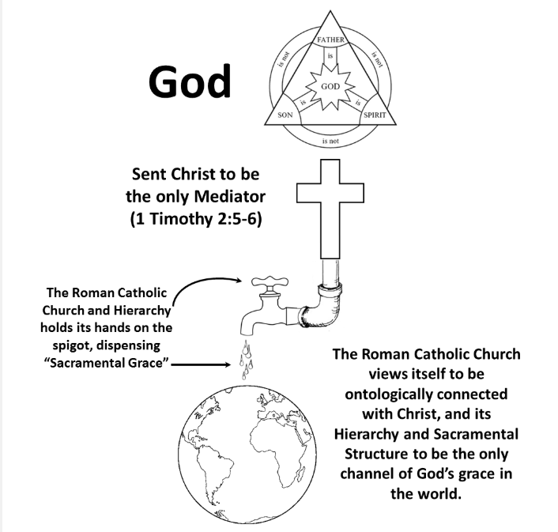
Catholic Teaching
https://apologeticsandagape.wordpress.com/2022/07/18/gregg-allison-on-roman-catholicism/

Slide 157
Catholic:
“If any one saith, that by faith alone the impious is justified; in such wise as to mean, that nothing else is required to co-operate in order to the obtaining the grace of Justification, and that it is not in any way necessary, that he be prepared and disposed by the movement of his own will; let him be anathema” (Council of Trent, Canons on Justification, Canon 9).

Slide 158
Catholic Teaching
Catholic – Scripture is necessary but not sufficient.
Catholic – Grace is necessary but not sufficient.
Catholic – You need the Roman Catholic Church as well. You
need the Holy Spirit working through the Church and the
Magisterium, not just Jesus.
Catholic view was not taught by the apostles but Catholicism defines “apostolic tradition”
as what the church teaches regardless of whether the apostles taught it.
By changing the definition, the Roman Catholic Church can make it seem like they mean one thing but they actually mean something completely different.

Slide 159
Catholic Teaching
All Christians are united by the Holy Spirit even though we live in three different states of being:
Some of us are pilgrims on earth journeying to heaven - The Pilgrim Church or The Church Militant
Others have died and are being purified in Purgatory - The Church Suffering
While still others are in the glory of heaven - The Church Triumphant
The saints in heaven can help us with their prayers. We can help the souls in Purgatory. The souls in Purgatory cannot help themselves but by offering our prayers, works, joys, sorrow and suffering for them we can speed them on to full union with God. They, in turn, pray for us and as they come closer to the glory of heaven, their prayers for us become more & more effective.
“Our prayer for them is capable of not only helping them, but also of making their intercession for us more effective” (Catechism of the Catholic Church, 958).
https://www.catholic365.com/article/35104/are-indulgences-still-a-thing-part-two.html

Slide 160
Catholic Teaching
This leads us to The Treasury of Grace/Merit
This treasury includes all of the grace Jesus won for us by his death and resurrection.
It also includes the merits of the saints - the prayers, acts of charity, joy and patient suffering of all the faithful who have ever lived in fidelity to his grace; what they have done through Him, with Him and in Him.
In the communion of saints, we all share in each other’s merits:
“In this wonderful exchange, the holiness of one profits others” (Catechism of the Catholic Church, 1475).
By receiving this grace and practicing virtue we may be purified of the temporal punishment of sin.
The Church dispenses this saving grace through the sacraments. But also through indulgences.
What the Church does, then, in administering an indulgence is apply the treasury of merits (that of Jesus and all the saints) to one of her children, under certain prescribed conditions (e.g., reading the Bible for thirty minutes).
https://www.catholic365.com/article/35104/are-indulgences-still-a-thing-part-two.html

Slide 161
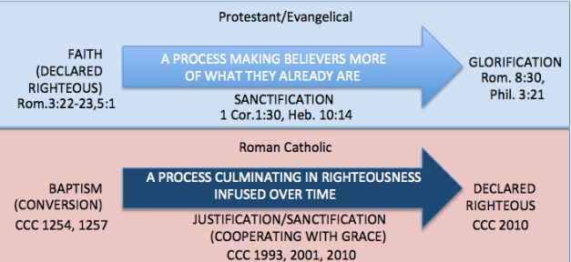
Justification

Slide 162
Biblical View
-The Bible teaches justification is a once for all based entirely
on God’s grace and received through faith alone. It is instantaneous
and based on the work of Christ on the cross that results in peace
with God. It is based on grace alone through faith alone (Eph 2:8-10).
-The Bible teaches justification is not based on works and occurs the
instant pardoning of the sinner declaring them righteous at the
moment they place their trust in Christ for salvation (Romans 3:25,
28,30; 8:33,34; Gal. 4:21-5:12; 1 John 1:7-2.2).

Slide 163
Biblical Teaching
Eph. 2:8-9
For by grace you have been saved through faith; and that not of yourselves, it is the gift of God;
not as a result of works, so that no one may boast.
Gal. 3:1-2
“You foolish Galatians, who has bewitched you, before whose eyes Jesus Christ was publicly portrayed as crucified? This is the only thing I want to find out from you: did you receive the Spirit by the works of the Law, or by hearing with faith?”
Gal 5:1-4
It was for freedom that Christ set us free; therefore, keep standing firm and do not be subject again to a yoke of slavery. Behold I Paul, say to you that if you receive circumcision, Christ will be of no benefit to you. And I testify again to every man who receives circumcision, that he is under obligation to keep the whole Law. You have been severed from Christ, you who are seeking to be justified by law; you have fallen from grace.

Slide 164
Biblical View
-Romans 5:1
Therefore, having been justified by faith, we have peace with God through our Lord Jesus Christ,
-Past tense “justified”
Romans 3:28
For we maintain that a person is justified by faith apart from works of the Law
Also, Romans 4:1-25; Gal. 3:6-14; Romans 3:26; 4:3; 5:,
show salvation is by faith alone

Slide 165
Simple Bible Teaching
Romans Road to Salvation
Romans 3:23 -for all have sinned and fall short of the glory of God,
Rom. 3:10 -as it is written: “THERE IS NO RIGHTEOUS PERSON, NOT EVEN ONE;
Rom. 6:23-For the wages of sin is death, but the gracious gift of God is eternal life in Christ Jesus our Lord.
Rom. 5:8 - But God demonstrates His own love toward us, in that while we were still sinners, Christ died for us.

Slide 166
Romans Road to Salvation
Rom. 10:9-13 -that if you confess with your mouth Jesus as Lord, and believe in your heart that God raised Him from the dead, you will be saved; for with the heart a person believes, resulting in righteousness, and with the mouth he confesses, resulting in salvation, Everyone who calls on the name of the Lord will be saved.

Slide 167
Romans Road to Salvation
Rom. 8:1-Therefore there is now no condemnation at all for those who are in Christ Jesus.
Rom. 8:38-39 - For I am convinced that neither death, nor life, nor angels, nor principalities, nor things present, nor things to come, nor powers, nor height, nor depth, nor any other created thing will be able to separate us from the love of God that is in Christ Jesus our Lord.
1 Cor. 15:3-4 - For I handed down to you as of first importance what I also received, that Christ died for our sins according to the Scriptures, and that He was buried, and that He was raised on the third day according to the Scriptures,

Slide 168
Biblical View
-Where do works fit in?
Paul is talking about knowing (vertical) a person is saved.
James 2:17, 26 is talking about showing (horizontal) a person is saved.
We are not saved by good works, but we do good works to
show we are saved.
Eph 2:8-10
“for by grace you have been saved through faith; and this is not of yourselves, it is the gift of God; not a result of works, so that no one may boast. For we are His workmanship, created in Christ Jesus for good works, which God prepared beforehand so that we would walk in them.”
Also Romans 3:20.

Slide 169
Biblical View
-Isaiah 53:5, 11-12 – ‘…pierced for our transgressions…crushed for our iniquities…by his scourging's we are healed…justify the many…He Himself bore the sin of many…”
2 Cor. 5:21 – He made Him who knew no sin to be sin on our
behalf, so that we might become the righteousness of God in Him.”
There is no need for temporal satisfaction. Christ bore ALL of our sins.
Christians have a finished work of Christ.
Catholicism does not have a finished work.
We are united with Christ and his merits become our merits. (Phil 3:8-9)

Slide 170
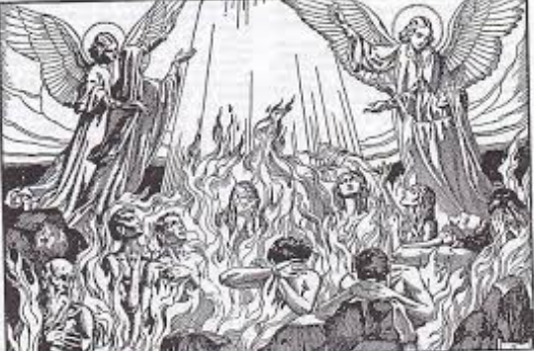
Purgatory
The doctrine of Purgatory by Gregory I A.D. 593
Sale of indulgences A.D. 1190
Purgatory proclaimed as a dogma by the Council of Florence in A.D. 1439

Slide 171
The Doctrine of Purgatory – Catholic view
“Purgatory is a place or state in which souls of those who die in grace but with the blemish of venial sin or temporal debt for sin unpaid. Here the soul is purged, cleaned, readied for eternal union with God in heaven.*
Dogma in AD 1439. Pope Gregory I (AD 593) said that those who after this life "will expiate their faults by purgatorial flames," and he adds "that the pain be more intolerable than any one can suffer in this life”
Saying prayers for loved ones, giving alms, good works and saying a mass for dead loved one can shorten their time. In addition, indulgences, making sign of the cross, saying the rosary, visiting a Catholic shrine, etc. can reduce the time.
Notes:
*James G. McCarthy, The Gospel According to Rome: Comparing Catholic Tradition and the Word of God (Eugene, Oregon: Harvest House Publishers, 1995), 233.

Slide 172
The Doctrine of Purgatory – Catholic view
Council of Florence (1439) DS 1304 says that sacrifices of the Mass, prayers, almsgiving, works of piety can help those in purgatory.
Mary and the Saints earned excess merits so they went into the “treasury of merit” along with Christs merits so the treasury is always full. An indulgence is a withdrawal from the treasury

Slide 173
The Doctrine of Purgatory –Biblical Refutation
Hebrews 7:24-25 says Christ saves to the uttermost forever so why do we need expiation? God can allow trials and chastening to conform us into the image of His Son but this is not as a judge exacting justice from us. He already poured out wrath upon Christ.
Propitiation is a stronger word than expiation because it turns away the wrath of God. Rom. 3:25 Christ was our propitiation. Also, Hebrews 2:17.

Slide 174
The Doctrine of Purgatory –Biblical Refutation
The righteousness by which we stand before God is the righteousness of Jesus alone. This is the righteousness we plead before the judgement throne of God. Christ is our substitute. Our sins are imputed to Him. His righteousness is imputed to us.
Romans 5:1-2
“Therefore, since we have been justified through faith, we have peace with God through our Lord Jesus Christ, through whom we have gained access by faith into this grace in which we now stand. And we boast in the hope of the glory of God”
Notes:
James G. McCarthy, The Gospel According to Rome: Comparing Catholic Tradition and the Word of God (Eugene, Oregon: Harvest House Publishers, 1995), 223.

Slide 175
Rom 4:7-8- BLESSED ARE THOSE WHOSE LAWLESS DEEDS HAVE BEEN FORGIVEN, AND WHOSE SINS HAVE BEEN COVERED. BLESSED IS THE MAN WHOSE SIN THE LORD WILL NOT TAKE INTO ACCOUNT.”
Who is the blessed man?
We can be the blessed man in Rom 4:7-8 because we are not the one working, we are the one believing.
Are people blessed if they have to go to Purgatory?

Slide 176
The Doctrine of Purgatory –Biblical Refutation
Once we repent and turn to Christ, the Holy Spirit indwells us and starts the continuous process of sanctification which removes the pollution. Justification is about our status. Sanctification is about the work of God whereby we are changed and conformed to His image.
Justification the Father takes the lead (Rom 8:13)and sanctification the Holy Spirit does (2 Thess. 2:13). Sanctification is a transformation (2 Cor 3:17-18).
Rom 8:13 - "...in order that the righteous requirement of the law might be FULLY met in us, who do not live according to the flesh but according to the Spirit.
Phil 1:6 being confident of this, that he who began a good work in you will carry it on to completion until the day of Christ Jesus.
Notes:
James G. McCarthy, The Gospel According to Rome: Comparing Catholic Tradition and the Word of God (Eugene, Oregon: Harvest House Publishers, 1995), 223.

Slide 177
The Doctrine of Purgatory –Biblical Refutation
I am a new creature in Him (2 Cor 5:17 ): “Therefore if anyone is in Christ, he is a new creature; the old things passed away; behold, new things have come”.
We will never have to come into judgement again.
John 5:24 Very truly I tell you, whoever hears my word and believes him who sent me has eternal life and will not be judged but has crossed over from death to life.
Heb 7:24-25 "but because Jesus lives forever, he has a permanent priesthood. Therefore, he is able to save completely those who come to God through him, because he always lives to intercede for them."
Heb 10:14 " For by one sacrifice he has made perfect forever those who are being made holy."
Heb 10:10 –”By this will, we have been sanctified through the offering of the body of Jesus Christ once for all time.
Notes:
James G. McCarthy, The Gospel According to Rome: Comparing Catholic Tradition and the Word of God (Eugene, Oregon: Harvest House Publishers, 1995), 223.

Slide 178
The Doctrine of Purgatory –Biblical Refutation
It was a one time saving. Jesus saved completely. No need for us to make expiation for our sins both on earth and in purgatory. Jesus perfectly atoned. No need for propitiatory mass or purgatory. Jesus is the one saving (Heb. 7:25-26) so he will not fail (John 6:37-40).
Why can Catholics get less time in purgatory by the living by giving indulgences if Jesus can’t do it?
How can a Pope fully clean you and Jesus cant’? Someone on this side of Heaven can reduce your time? How does that clean you?
Pope can give plenary indulgence which is full cleaning.
Is this good news?
Notes:
James G. McCarthy, The Gospel According to Rome: Comparing Catholic Tradition and the Word of God (Eugene, Oregon: Harvest House Publishers, 1995), 223.

Slide 179
The Doctrine of Purgatory –Biblical Refutation
Eph 2:8-9
"For it is by grace you have been saved, through faith -- and this not from yourselves, it is the gift of God -- not by works, so that no one can boast"
Rom 5:1-2
Therefore, since we have been justified through faith, we have peace with God through our Lord Jesus Christ, 2 through whom we have gained access by faith into this grace in which we now stand. And we boast in the hope of the glory of God
Notes:
James G. McCarthy, The Gospel According to Rome: Comparing Catholic Tradition and the Word of God (Eugene, Oregon: Harvest House Publishers, 1995), 223.

Slide 180
The Doctrine of Purgatory –Biblical Refutation
Titus 3:5-6
“He saved us, not on the basis of deeds which we have done in righteousness, but according to His mercy, by the washing of regeneration and renewing by the Holy Spirit, 6whom He poured out upon us richly through Jesus Christ our Savior, 7so that being justified by His grace we would be made heirs according to the hope of eternal life”
2 Tim 1:9
“He has saved us and called us to a holy life—not because of anything we have done but because of his own purpose and grace. This grace was given us in Christ Jesus before the beginning of time,…”
Nowhere does it say we are saved by an organization metering our grace points that someday will earn us less time in purgatory unless we buy our way out with indulgences or have the Pope reduce our sentence.
Notes:
James G. McCarthy, The Gospel According to Rome: Comparing Catholic Tradition and the Word of God (Eugene, Oregon: Harvest House Publishers, 1995), 223.

Slide 181
The Doctrine of Purgatory –Biblical Refutation
“For to me, to live is Christ, and to die is gain“(Phil. 1:21) and "Absent with the Body is present with the Lord“(2 Cor. 5:8).
John 19:10- Jesus said “it is finished.” He completion the work of redemption on the cross. John 17:4-”completling the work” and John 1:7- The blood of Jesus purifies us from all sin.
Where does RCC get the notion that we will first stop off at the divine waiting room of purgatory? Purgatory is not “gain”
Did Jesus tell the thief on the cross he would be with Jesus in purgatory? No!
Notes:
James G. McCarthy, The Gospel According to Rome: Comparing Catholic Tradition and the Word of God (Eugene, Oregon: Harvest House Publishers, 1995), 223.

Slide 182
Final note on Sacraments
Catholic- Baptism – John 3:5 "Unless you are reborn of water and the Holy Spirit, you shall not reach the kingdom of heaven.“
Christian – this verse is talking about flesh and spirit not a requirement for baptism for salvation. - https://carm.org/doctrine-and-theology/baptism-and-john-35/ and https://www.gotquestions.org/baptism-John-3-5.html
Catholic-Communion John 6:53 "Unless you eat the flesh of the Son of man and drink His blood, you shall not have life in you.“
Christian - To “eat” or “drink” Jesus is to come to Him in faith - https://carm.org/roman-catholicism/transubstantiation-and-john-651-55/
https://www.ewtn.com/catholicism/library/sacraments-channels-of-divine-grace-10776

Slide 183
Week 8
The Mass
Sacerdotal mass instituted by Cyprian 3rd c.
The Mass developed gradually as a sacrifice. Attendance made obligatory 11th c.

Slide 184
Catholic Teaching
The Mass is the most important sacrament involving a “re-presenting’ of the
sacrifice of Jesus
At the prayer of consecration, the bread and wine miraculously turn into the
actual body and blood of Jesus. This is known as transubstantiation.
Jesus is therefore now upon the altar as a sacrificed victim. He is offered up
as a perpetual sacrifice. A living sacrifice. Re-presentation in an unbloodied
manner.
This sacrifice is said to soothe God’s wrath (propitiatory) and cover people’s sin.
The Mass perpetuates Christ’s sacrifice throughout the ages
The sacrifice of the Eucharist is the considered by some as the highest form of worship. Romans 12:1 contradicts this. Do the angels in heaven lack the highest worship since they are not sacrificing the eucharist? (Isaiah 6:2-3).

Slide 185
Sacerdotal Mass and Priests
Catholic Teaching
Sacerdotal - a doctrine which ascribes sacrificial functions and spiritual or supernatural powers to
ordained priests
Sacerdotalism is the belief that priests are essential mediators between God and man. The word sacerdotal comes from the Latin word for “priest” and literally means “to make sacred.” Catholic, Orthodox, and Anglican forms of worship are sacerdotal.
The Old Testament law placed the Jews under a sacerdotal system. Aaron and his sons were divinely selected to be the first priests to minister to Israel (Exodus 28:1). The priestly duties included offering sacrifices for the atonement of sin (Hebrews 5:1); representing the nation before God (Exodus 28:9-12); and teaching the people God’s Word (Ezekiel 44:23).
Notes:
https://www.gotquestions.org/sacerdotalism.html

Slide 186
Sacerdotal Mass and Priests
Catholic Teaching
You can receive grace and forgiveness, but not perfection. You do not have peace or certainty that you have fulfilled justification.
You can go to Mass over and over thousands of times in
your life and never be perfected and can loose it with unconfessed
mortal sin.
Notes:
https://www.gotquestions.org/sacerdotalism.html

Slide 187
Sacerdotal Mass and Priests –Biblical Response
The Old Testament priesthood was a picture of the future ministry of Christ, who fulfills all that the Levitical priesthood anticipated. The book of Hebrews, especially chapters 5-10, presents Jesus Christ as the perfect High Priest and the fulfillment of the Old Testament law. In Christ, the entire legalistic system of sacrifice and ritual, including the priesthood, is made obsolete (Romans 10:4).
The New Testament does not support a sacerdotal system of worship. As Martin Luther points out in The Private Mass and Consecration of Priests, the Holy Spirit has “in the New Testament diligently prevented the name sacerdos, priest or cleric, from being given even to an apostle or to various other offices.” In other words, the Bible never uses the word priest in relation to church leadership; rather, the Bible teaches the universal priesthood of all believers.

Slide 188
Sacerdotal Mass and Priests – Biblical Response
When Jesus offered Himself as the ultimate proprietary sacrifice for sin, God tore the veil in the temple in two, indicating open access to His presence through the body of Christ (Hebrews 10:19-20). Jesus now occupies the office of eternal High Priest, making constant intercession for His people (Hebrews 7:24-25). Finished work not perpetual so the Lord’s supper is a remembrance of this.
Sacerdotalism insulates people from God, erecting human barriers where the New Testament places none. The Scripture is clear that “there is one God and one mediator between God and men, the man Christ Jesus” (1 Timothy 2:5). Biblically speaking, every believer is a priest “offering spiritual sacrifices acceptable to God through Jesus Christ” (1 Peter 2:5). We offering ourselves in serve (praise etc.) to Christ not proprietary sacrifice.

Slide 189
Sacerdotal Mass and Priests – Evangelism
Exercise: Read Hebrews 9:12.
The Verse says “Jesus entered the Holy placed once and for all.” Also, it says “having obtained eternal redemption.”
Ask: Since Jesus completed this task, why would we need an ongoing process like the mass? Why would we think this means “enters into” or obtaining” like it is a present tense? The word “entered” is an aorist tense in the Greek, indicating it is a
one-time past event. A propitiatory sacrifice like the Mass which does not perfect you have not truly been propitiated. Heb 7:25 say Jesus saves to the uttermost/forever.

Slide 190
Sacerdotal Mass and Priests – Evangelism
Exercise: Read Romans 3:25 and 1 John 2:2.
These verses also say that Jesus is "the propitiation for our sins." This means that Jesus satisfied God's wrath against sin and against us through his perfect life and atoning death. Heb 8- “…I will remember their sins no more…” Rom. 4- blessed man because the sins of man have been imputed to Christ. Heb 9:11- don’t go back to old system.
Notes:
https://www.gotquestions.org/sacerdotalism.html

Slide 191
Sacerdotal Mass and Priests – Evangelism
Exercise: Read 1 Cor. 10:21.
The Verse says “”…partake of the table of the Lord….”
Ask: This does not say “alter of the Lord” so it is not and ongoing sacrifice on an alter.
Read Heb. 10:18- there is no longer any offering for sin.”
Ask: Why does the Catholic church have a mass that is a continuous offer of a propitiatory sacrifice to God?
Notes:
https://www.gotquestions.org/sacerdotalism.html

Slide 192
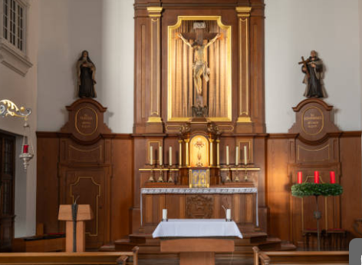
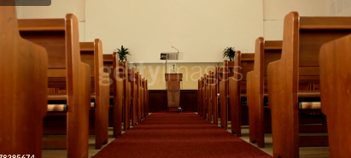
Sacerdotal Mass and Priests – Evangelism
In churches where Scripture is central the pulpit is in the middle of the stage
In RCC the pulpit is off to the side and the alter is in the middle
Notes:
https://www.gotquestions.org/sacerdotalism.html

Slide 193
Sacerdotal Mass and Priests – Evangelism
The Eucharist as an offering is no where in Bible or early teachings. The Eucharist was referred to as a sacrifice but with a different meaning. Early fathers said it was
a sacrifice of praise and thanksgiving or a remembrance/commemoration of the sacrifice of Jesus on the cross. Council of Trent condemned this definition and said it was a propitiatory sacrifice which could be applied to the dead.
Reformed traditions say the supper is a representation, application and sealing of the once for all sacrifice of Jesus to the believer.
Notes:
https://www.gotquestions.org/sacerdotalism.html

Slide 194
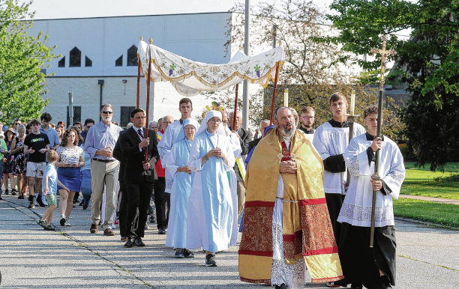
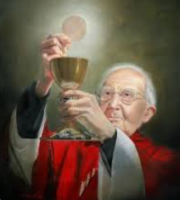
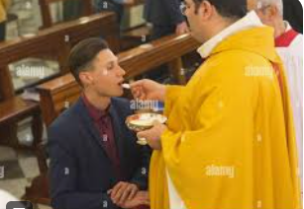
Transubstantiation
Seven Sacraments, defined by Peter Lombard 12th c.
Transubstantiation, defined by Innocent III A.D. 1215

Slide 195
Catholic Teaching
Transubstantiation – When the priest repeats the words of Jesus at
the last supper is believed to change the bread and wine into Christ’s
body and blood by the Holy Spirit (1105-1106, 1353).
Catechism of the Catholic Church explains, “As bodily nourishment restores lost strength, so the Eucharist strengthens our charity, which tends to be weakened in daily life; and this living charity wipes away venial sins” (CCC 1394).
1413 By the consecration the transubstantiation of the bread and wine into the Body and Blood of Christ is brought about. Under the consecrated species of bread and wine Christ himself, living and glorious, is present in a true, real, and substantial manner: his Body and his Blood, with his soul and his divinity
Code of Canon Law states,
A person who is conscious of grave sin(mortal) is not to . . . receive the body of the Lord without previous sacramental confession unless there is a grave reason and there is no opportunity to confess; in this case the person is to remember the obligation to make an act of perfect contrition which includes the resolution of confessing as soon as possible. (CIC 916)

Slide 196
Catholic Teaching
THE EPISTLE OF IGNATIUS TO THE SMYRNAEANS SHORTER AND LONGER VERSIONS.
CHAP. VII. — LET US STAND ALOOF FROM SUCH HERETICS.
“They abstain from the Eucharist and from prayer,(7) because
they confess not the Eucharist to be the flesh of our Saviour
Jesus Christ, which suffered for our sins, and which the Father,
of His goodness, raised up again.”
Does this teach early transubstantiation? – NO!
This letter is addressing Docetism which was the belief that Jesus only seemed like he was in the flesh.
The Docetists were a heretical group that only affirms Jesus was spiritual. They were not participating
in the Lord’s supper because they denied Jesus came in the flesh.
Early church had a concept of “real presence” but it was not until hundreds of years later that Aristotle categories
of “accidents” and “substances” were used by Aquinas (1200’s) to try and explain this miracle.
https://www.catholicculture.org/culture/library/view.cfm?id=3836

Slide 197
Bible Teaching
Example Symbols

Slide 198
Symbols
Matt 4:4 /Duet 8:3 Jesus answered, "It is written: 'Man shall not live on bread alone, but on every word that comes from the mouth of God.'"
1 Pet 2:2 like newborn babies, long for the pure milk of the word, so that by it you may grow in respect to salvation,
Heb 5:12-14 For though by this time you ought to be teachers, you have need again for someone to teach you the elementary principles of the oracles of God, and you have come to need milk and not solid food. For everyone who partakes only of milk is not accustomed to the word of righteousness, for he is an infant. But solid food is for the mature, who because of practice have their senses trained to discern good and evil.

Slide 199
Symbols
John 6:32-33 Jesus said to them, “Very truly I tell you, it is not Moses who has given you the bread from heaven, but it is my Father who gives you the true bread from heaven. For the bread of God is the bread that comes down from heaven and gives life to the world
He is quoting Psalm 78:24 .Source of true bread is the Father who gave them(past tense) manna but is now giving(present tense) true bread from heaven. He gives them not perishable food but rather a person –”the one coming down from Heaven".
These are Symbols. Also John 6 is a year before the last supper.

Slide 200
Symbols
John 6:34-35 “Sir,” they said, “always give us this bread.”
Then Jesus declared, “I am the bread of life. Whoever comes to me will never go hungry, and whoever believes in me will never be thirsty.
Symbol eating=believing

Slide 201
John 6:52 Then the Jews began to argue sharply among themselves, “How can this man give us his flesh to eat?”
Jesus then explains it in 6:53-58. eating my flesh and drinking my blood is the exact same position as: (1) hearing His word and believing in Him who sent Jesus(John 5:24; (2)being drawn by the Father (6:44); (3) looking to the Son and believing (6:40); or (4) simply believing(6:47). The result is the same in each case-eternal life, or being raised up at the last day. Clear definition of the metaphor. Jesus is not talking about a sacrament of the Eucharist established years later. His referring to His body and blood parallel clearly with belief in the Son and the drawing of the Father. John 15 Jesus is using metaphor of "i am the vine". Matthew and Paul record the fact that the blood of which the Lord speaks is the "blood of the covenant" of the "new testament(covenant) in My blood. The blood of the cross. Heb 9 and 10 is clear the sacrifice was a one time never to be repeated complete and perfect action. Jesus and Paul continue to refer to the elements as bread and wine not as the body and blood of Christ. When Jesus refers to the cup He says "i will not drink again of this FRUIT of the vine from now until that day....(Matt 26:29). He doesn’t say its His literal blood. He says its fruit of the vine. Does this mean He will still be transubstantiating wine into blood in the kingdom of God? 1 Cor 11:26 again Paul refers to it as bread and wine not body and blood. It was and always was intended to be a memorial not something we do that causes a past event to happen again.

Slide 202
Its His sacrifice that gives life, not simply the flesh.
John6:44 No one can come to me unless the Father who sent me draws them, and I will raise them up at the last day.
John 6:47 Very truly I tell you, the one who believes has eternal life.
Look at positions: looking to the Son, drawing, believing-Leads to eternal life.

Slide 203
John 6:53-58 Jesus said to them, “Very truly I tell you, unless you eat the flesh of the Son of Man and drink his blood, you have no life in you.
John 5:24 Very truly I tell you, whoever hears my word and believes him who sent me has eternal life and will not be judged but has crossed over from death to life.
John 6:40 For my Father’s will is that everyone who looks to the Son and believes in him shall have eternal life, and I will raise them up at the last day.
Look at position: eating=hearing and drinking=believing leads to eternal life

Slide 204
The result is the same in each case-eternal life, or being raised up at the last day. Clear definition of the metaphor. His referring to His body and blood parallel clearly with belief in the Son and the drawing of the Father.
Jesus often used figures of speech
John 16:25
“These things I have spoken to you in figures of speech; an hour is coming when I will no longer speak to you in figures of speech, but will tell you plainly about the Father. ”

Slide 205
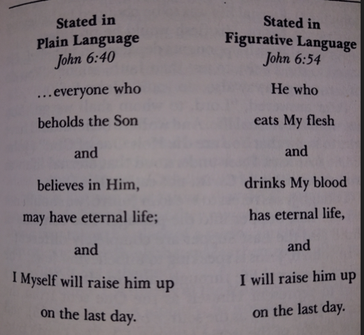

Slide 206
John 6:51 "I am the living bread that came down out of heaven; if anyone eats of this bread, he will live forever; and the bread also which I will give for the life of the world
is My flesh."
Notice it says the bread is my flesh. Symbolically
John 10:9 "I am the door; if anyone enters through Me, he will be saved, and will
go in and out and find pasture.
1 Cor 10:4 and all drank the same spiritual drink, for they were drinking from a spiritual rock which followed them; and the rock was Christ
Notice again "spiritual drink".

Slide 207
Drinking actual blood is forbidden- Genesis 9:4; Lev. 3:17.
Peter said he had never eaten anything unholy and unclean (Acts 10:14) and
the Jerusalem Council repeated this restriction in Acts 15:29).
In the incarnation Jesus body was physically located in once place. If his
actual physical body is being eaten everywhere on earth, doesn’t that mean
his human body is omnipresent? The Bible says only in his divine nature is
He omnipresent.
Roman Catholic- Cannot take communion if you are unworthy (mortal sin)
Bible- We are all unworthy and we take it because we are unworthy and
are remembering what Jesus did to make us worthy.

Slide 208
Communion is remembering the sacrifice of Jesus by partaking in the
symbols of his body and blood.
The Lord’s Supper 1 Cor. 11:23-29
²³ For I received from the Lord that which I also delivered to you, that the Lord Jesus, on the night when He was betrayed, took bread; ²⁴ and when He had given thanks, He broke it and said, “This is My body, which is for you; do this in remembrance of Me.” ²⁵ In the same way He also took the cup after supper, saying, “This cup is the new covenant in My blood; do this, as often as you drink it, in remembrance of Me.” ²⁶ For as often as you eat this bread and drink the cup, you proclaim the Lord’s death until He comes.

Slide 209
Real Presence
The early church and reformers did affirm a “real presence” when taking the Lord’s supper but this was not transubstantiation.
https://www.aomin.org/aoblog/the-dividing-line/ignatius-and-the-real-presence/

Slide 210
Debate notes
Catholic Isaiah 66:21- “Some” will be priests- priests offer sacrifices.
Response:
March 1:11-pure offerings will be brought to me.
Response: commentary- prayers and praise are also incense and offering.
1 Cor. 10:16 –”participation in the body and blood”
Response –this is talking about the participation in the benefits of Christ’s shed blood. the breaking of his body
and blood shed for us.
Didache-Chapters 9 and 10-
He thinks sacrifice on the alter and eating the sacrifice that Israel did (participated) must be same as NT context.
NT however is the eating (believing and receiving) bread of life not eating that person.

Slide 211
Debate notes
Chapter 14. Christian Assembly on the Lord's Day
But every Lord's day gather yourselves together, and break bread, and give thanksgiving
after having confessed your transgressions, that your sacrifice may be pure. But let no
one that is at variance with his fellow come together with you, until they be reconciled,
that your sacrifice may not be profaned. For this is that which was spoken by the Lord:
In every place and time offer to me a pure sacrifice; for I am a great King, says the Lord,
and my name is wonderful among the nations.
This term sacrifice is identical with the English offering

Slide 212
Debate notes
Justin Martyr
Justin makes it clear that he is talking about a sacrifice of praise. Indeed, pay careful attention to
what he said:“Now, that prayers and giving of thanks, when offered by worthy men, are the only
perfect and well-pleasing sacrifices to God, I also admit. For such alone Christians have
undertaken to offer, and in the remembrance affected by their solid and liquid food, whereby
the suffering of the Son of God which He endured is brought to mind.” Justin actually believes
that prayer and thanksgiving is the true sacrifice. The act of partaking of the bread and the
wine in remembrance becomes a sacrifice of praise in that it calls us to prayer and thanksgiving.
It is the remembrance itself in thanks for what God has done that is the sacrifice
https://carm.org/roman-catholicism/did-justin-martyr-teach-the-eucharist-as-a-propitiatory-sacrifice/

Slide 213
Week 9-10
Review

